Slide 1
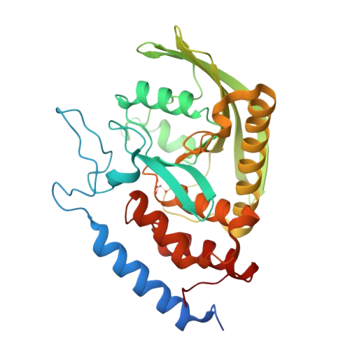
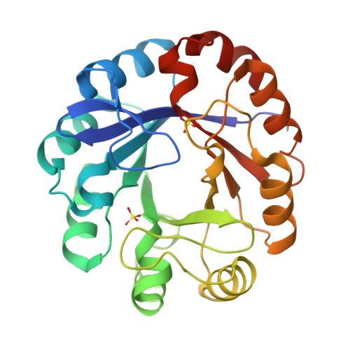
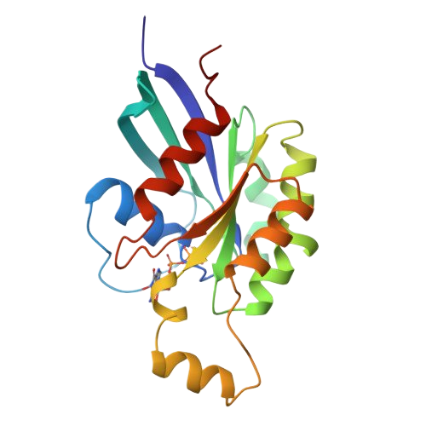
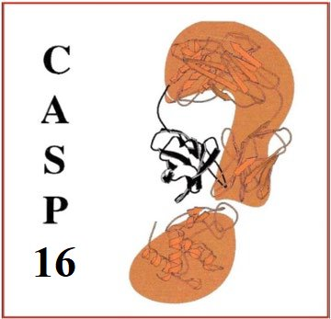
Protein Model Accuracy Estimation with MULTICOM in CASP16
Pawan Neupane
University of Missouri-Columbia, USA

Slide 2
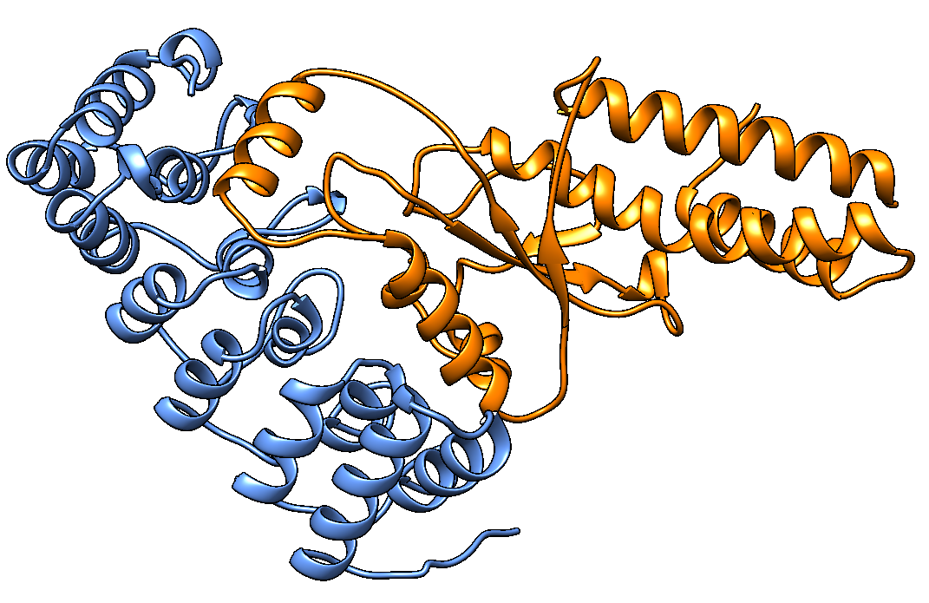
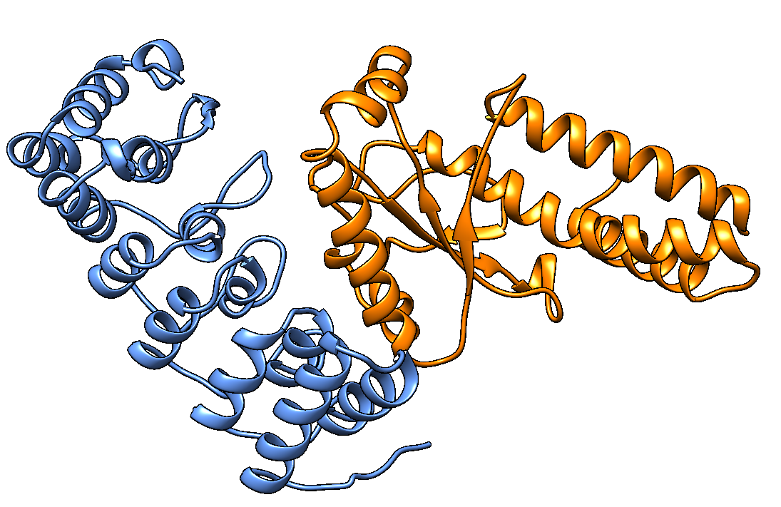
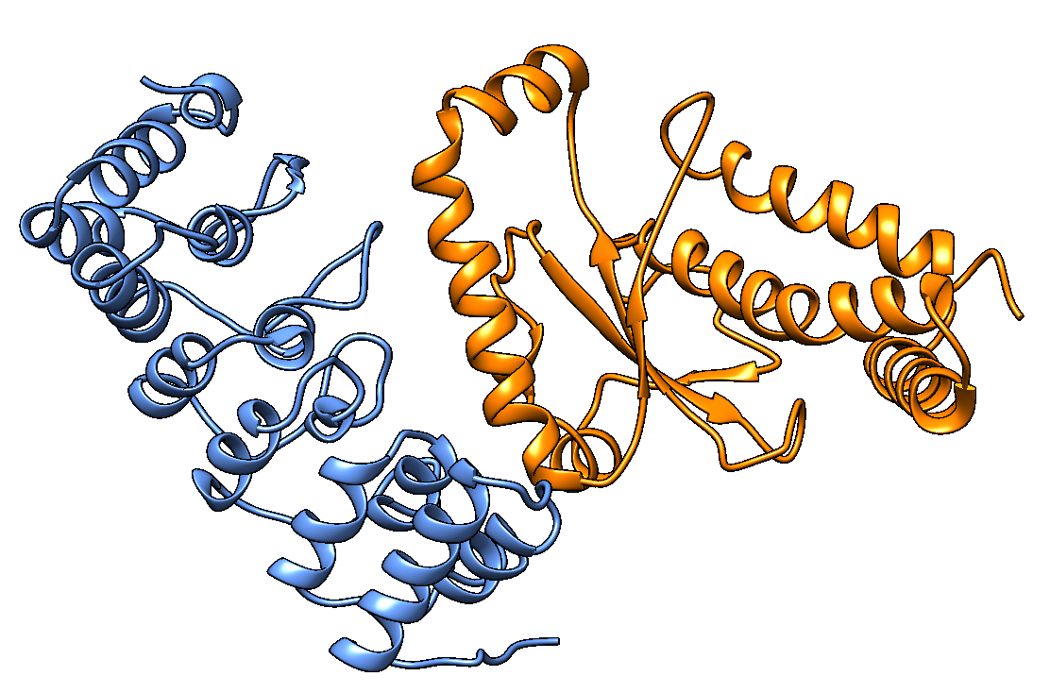
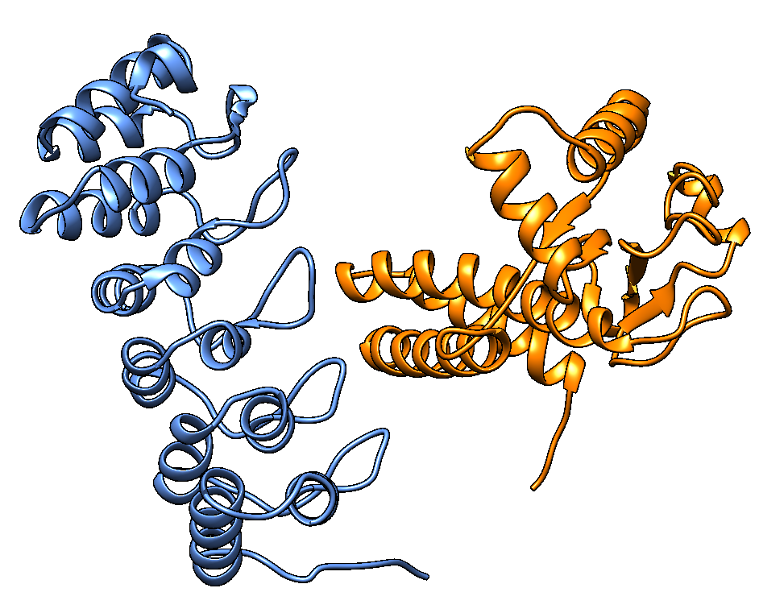
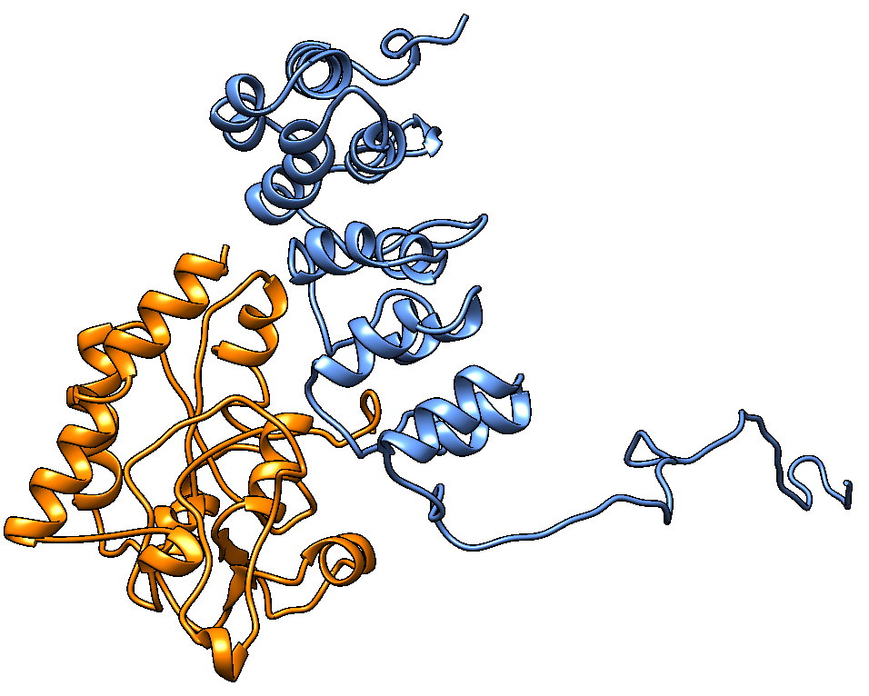
Motivation
1. Single-model methods are less accurate in estimating model quality scores
2. Multi-model methods, especially for average pairwise similarity scores, though simple but highly effective
3. Multi-model methods often struggle when there are few good models in a model pool
TM-score
...
...

Slide 3
Methodology Overview
MULTICOM_LLM : Average pairwise similarity (TM-score)
MULTICOM_GATE : Graph transformer for estimating model accuracy (GATE)
MULTICOM_human : Average of (1) average pairwise contact area difference(CAD)score, (2) GCPNet-EMA (Geometric complete graph neural network for single model quality score), and (3) GATE score

Slide 4
MULTICOM_LLM (Group #: 319)
Uses Average pairwise similarity score between models calculated using MMalign ​
​
decoy_1
decoy_2
decoy_3
decoy_4
decoy_5
Average pairwise similarity for i^{th} decoy is given by:

Slide 5
MULTICOM_LLM
Uses Average pairwise similarity score between models calculated using MMalign ​
​
decoy_1
decoy_2
decoy_3
decoy_4
decoy_5
decoy_1
decoy_2
decoy_3
decoy_4
decoy_5
0.7883
0.9220
0.8080
For decoy_1:
TMscore_{avg}(1) = Σ([0.7883, 0.9220, 0.8080, 0.2990])/4 = 0.7043
0.2990

Slide 6
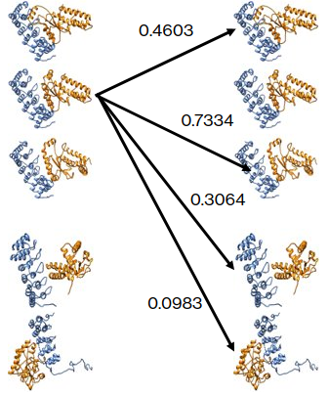
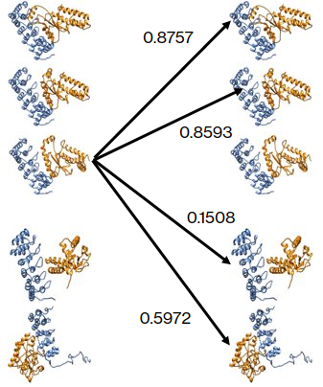
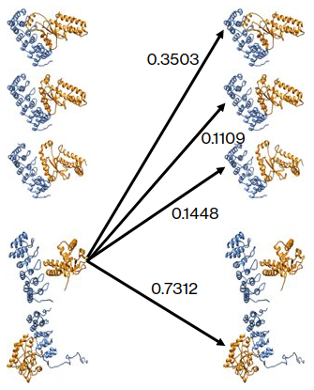
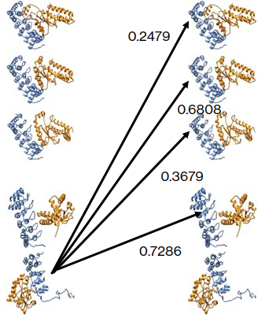
MULTICOM_LLM
Uses Average pairwise similarity score between models calculated using MMalign ​
​
For decoy_2:
TMscore_{avg}(2) =0.3996
For decoy_3:
TMscore_{avg}(3) =0.6208
For decoy_4:
TMscore_{avg}(4) =0.3343
For decoy_5:
TMscore_{avg}(5) =0.5063

Slide 7
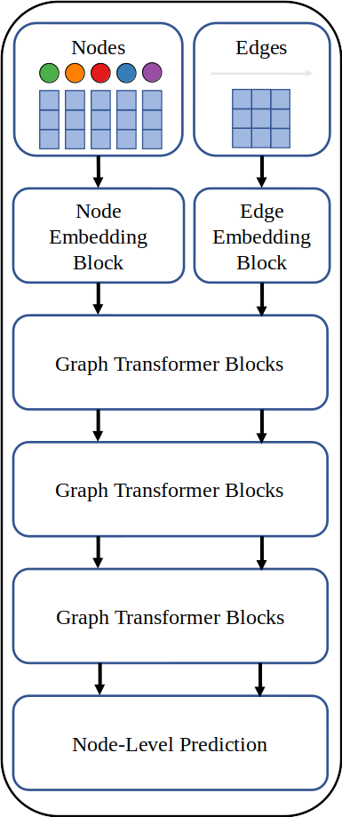
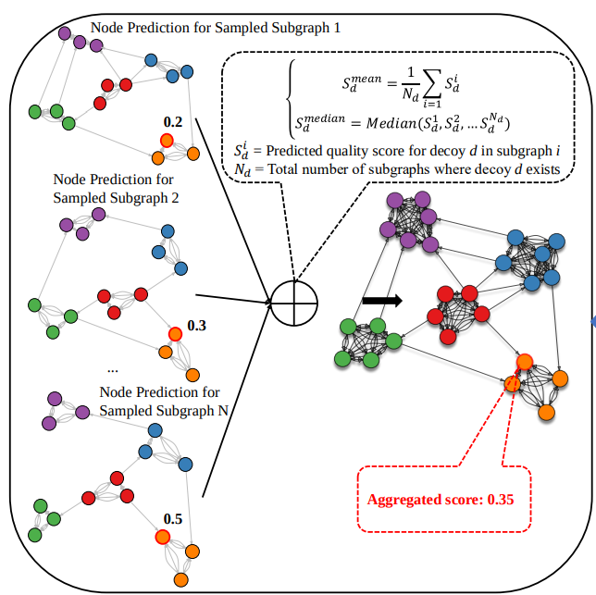
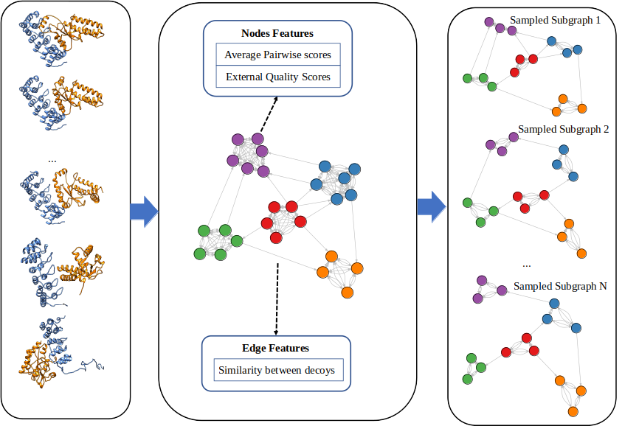
MULTICOM_GATE (Group #: 425)
Uses Graph Transformer trained for model quality estimation ​
​
A novel approach using graph transformers and pairwise similarity graphs.​
Integrates single-model and multi-model assessments.​
Captures both local and global structural relationships between decoys

Slide 8
MULTICOM_GATE (GATE Features)
Edge Features : capture the similarity between decoys
the number of common interfaces
TM-scores
QS-scores between nodes.
Node Features: captures the qualities of a single model
Average pairwise similarity score
AlphaFold global (average) plDDT score
EnQA score (3D-equivariant graph neural network for single model quality estimation)
GCPNet-EMA score
ICPS (Interface contact probability score) score
DProQA (Gated-Graph Transformer for Protein Complex Structure Assessment) score
VoroMQA (Voronoi tessellation based graph neural network) score
*Scores in blue are only applicable to complexes

Slide 9
MULTICOM_human (Group #: 345)
Average pairwise CAD score
Average
GCPNet-EMA score
MULTICOM_human score
GATE score

Slide 10
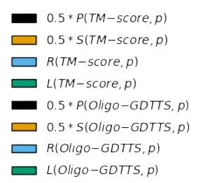
QMODE1 (Estimating global quality scores of CASP16 models)
Evaluation Metrics:
Pearson's correlation of estimated and true TM-scores
Spearman's correlation of estimated and true TM-scores
ROC_AUC score of estimated TM-scores
Ranking loss of TM-scores
Pearson's correlation of estimated and true Oligo-GDTTS
Spearman's correlation of estimated and true Oligo-GDTTS
ROC_AUC score of estimated Oligo-GDTTS
Ranking loss of Oligo-GDTTS
SCORE

Slide 11
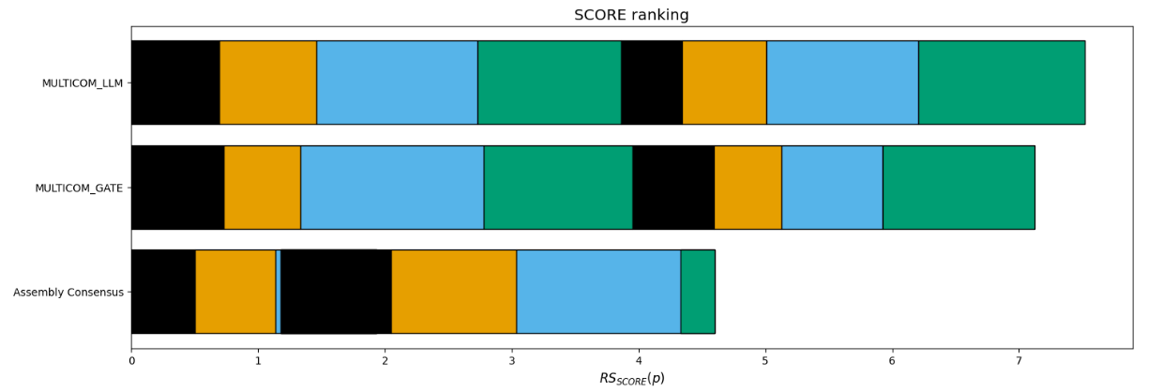
Results of QMODE1 (Estimating global quality scores of CASP16 models)
Based on 38 QMODE1 targets

Slide 12
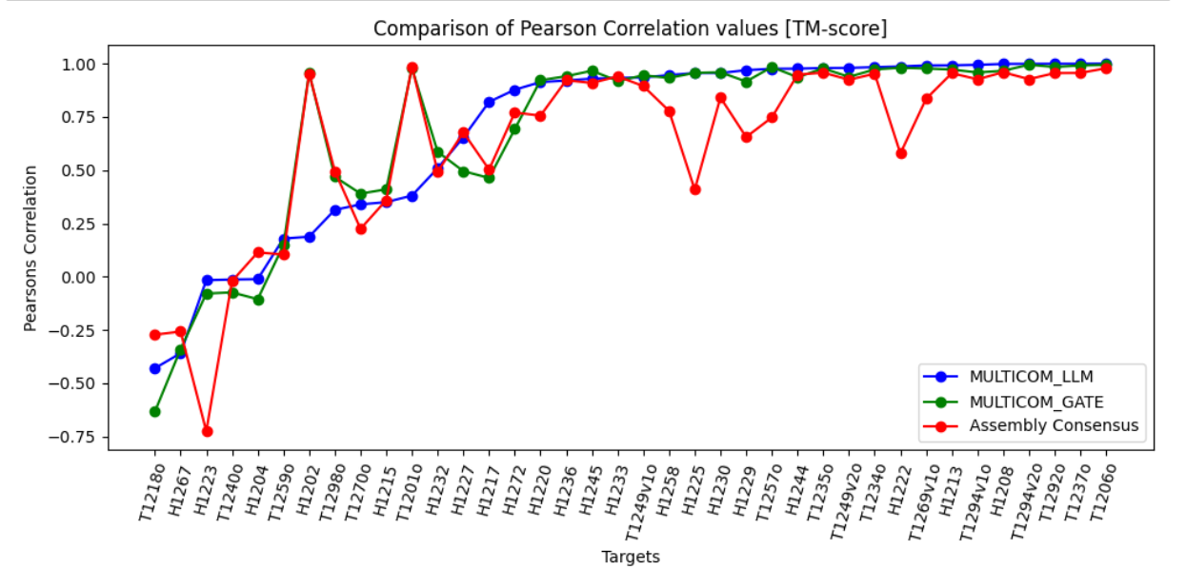
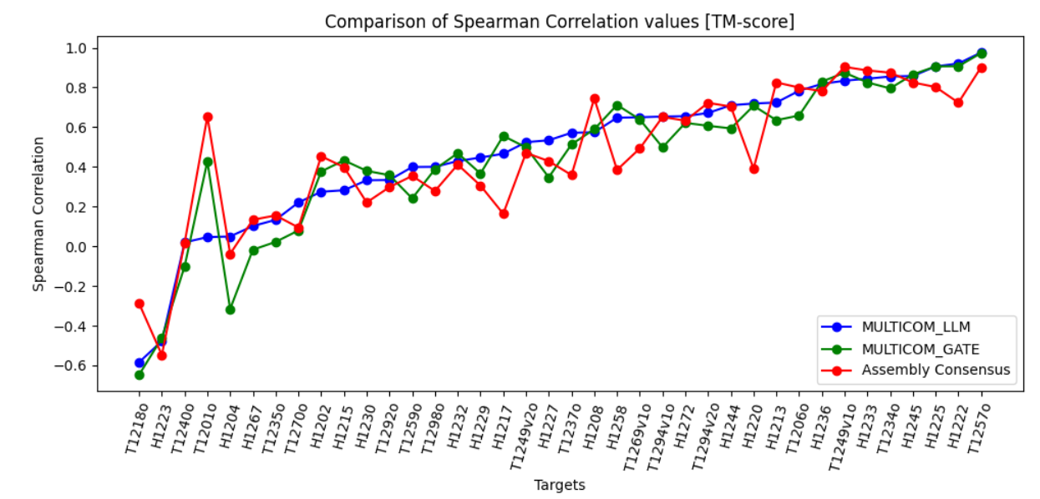
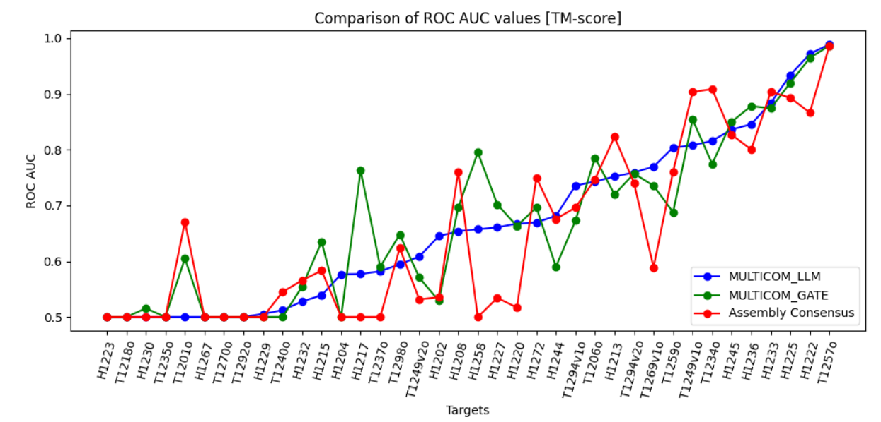
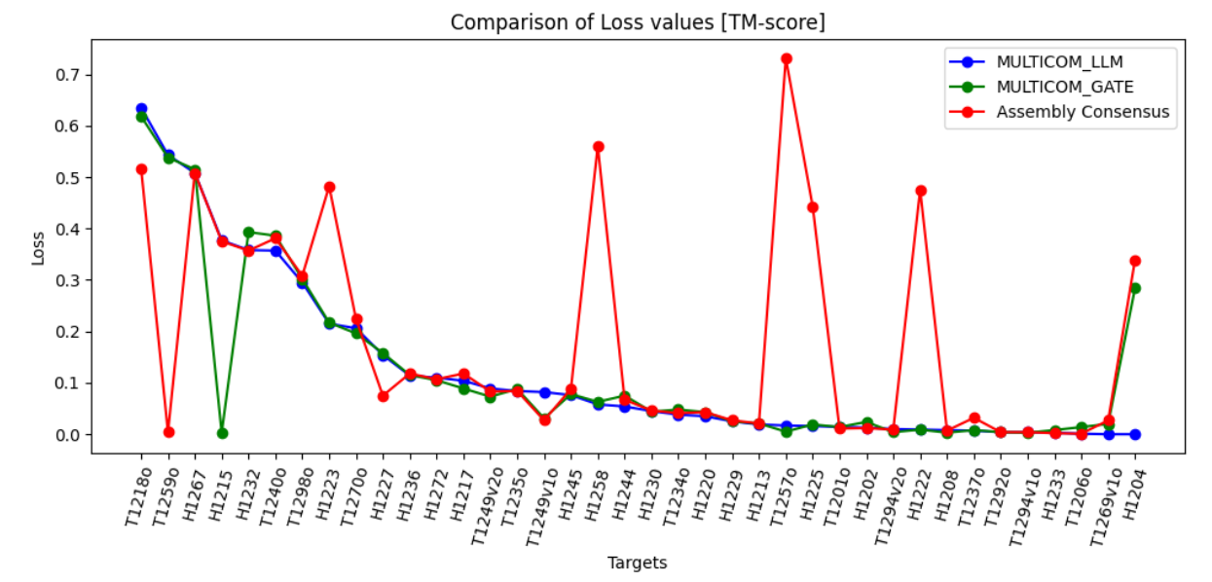
Target-wise comparison using Pearsons Correlation, Spearman Correlation, ROC_AUC and Loss [TM-score]
​

Slide 13
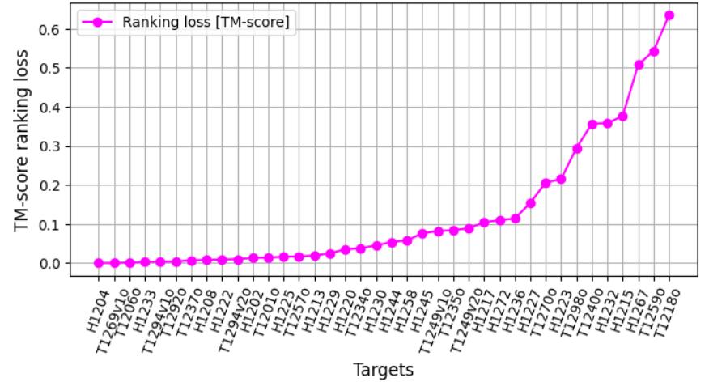
TM-score Loss of MULTICOM_LLM in QMODE1
Failed cases
Successful Cases

Slide 14
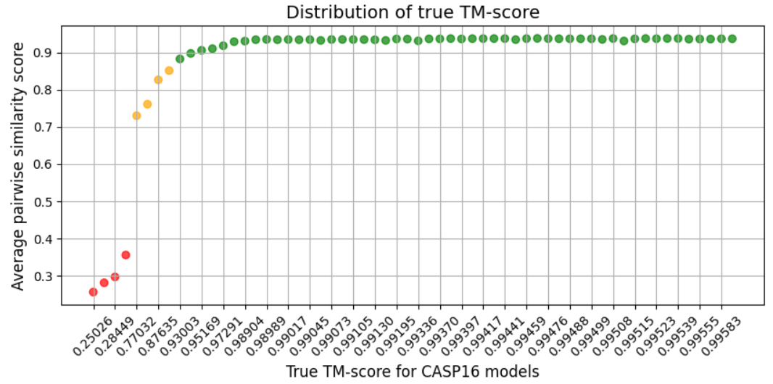
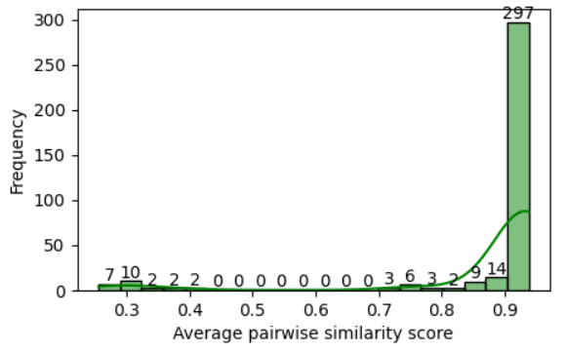
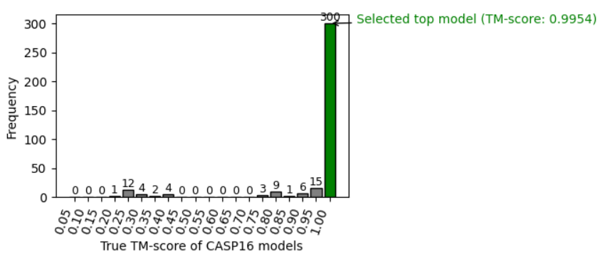
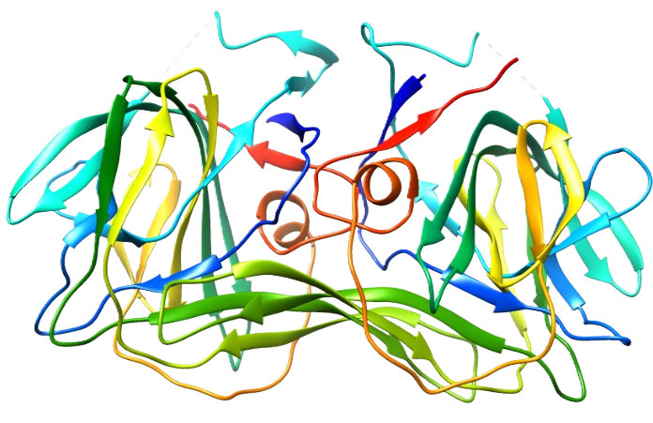
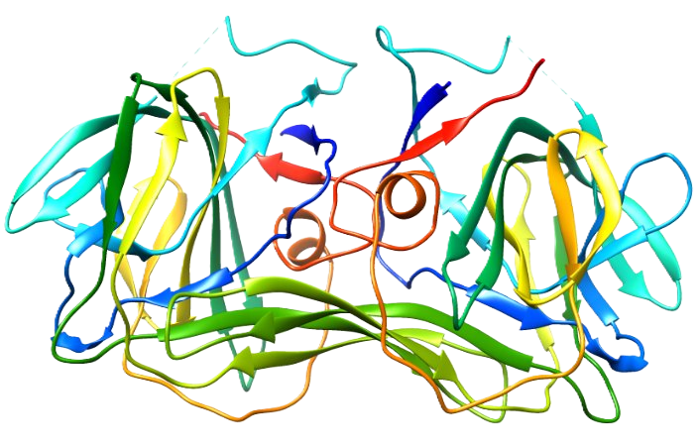
T1206o (TM-score ranking loss = 0.001 and Pearson correlation = 0.9996)
Native structure
Selected top 1 structure (TM-score = 0.9954)
Actual top 1 structure (TM-score = 0.9962)

Slide 15
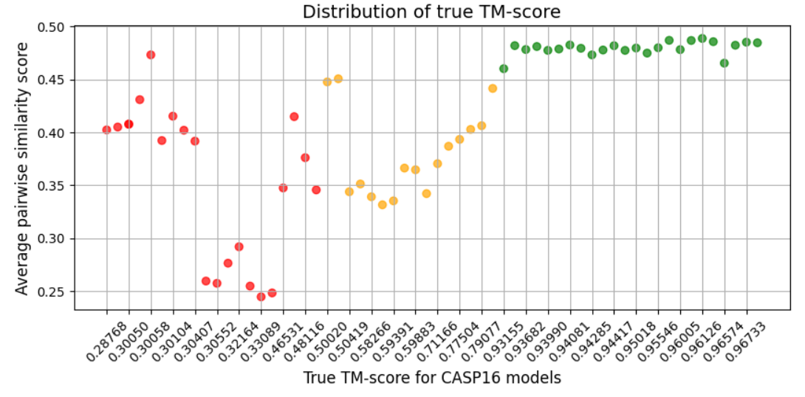
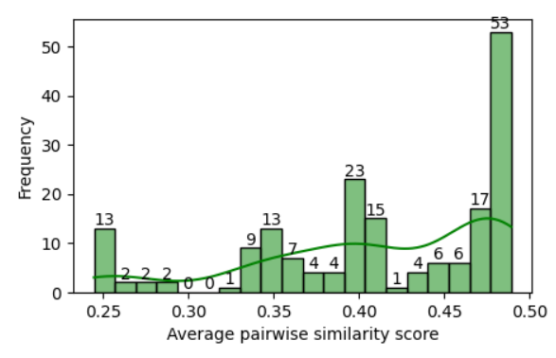
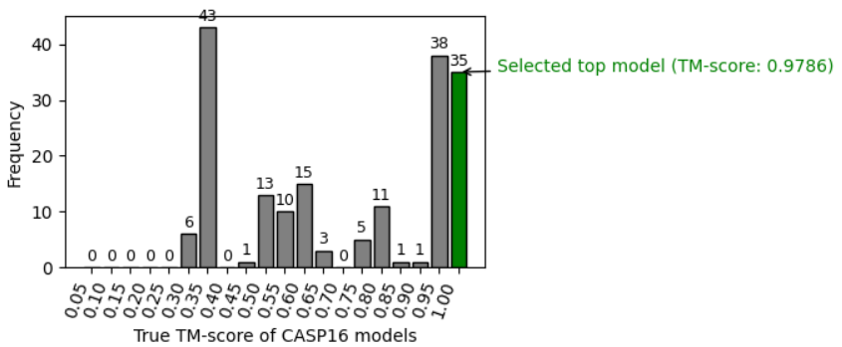
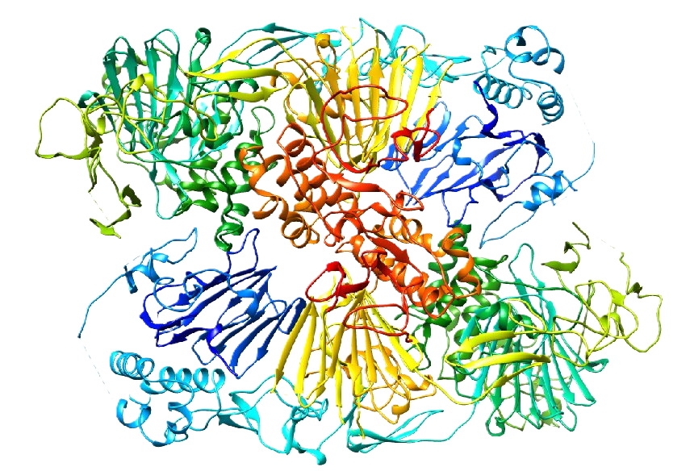
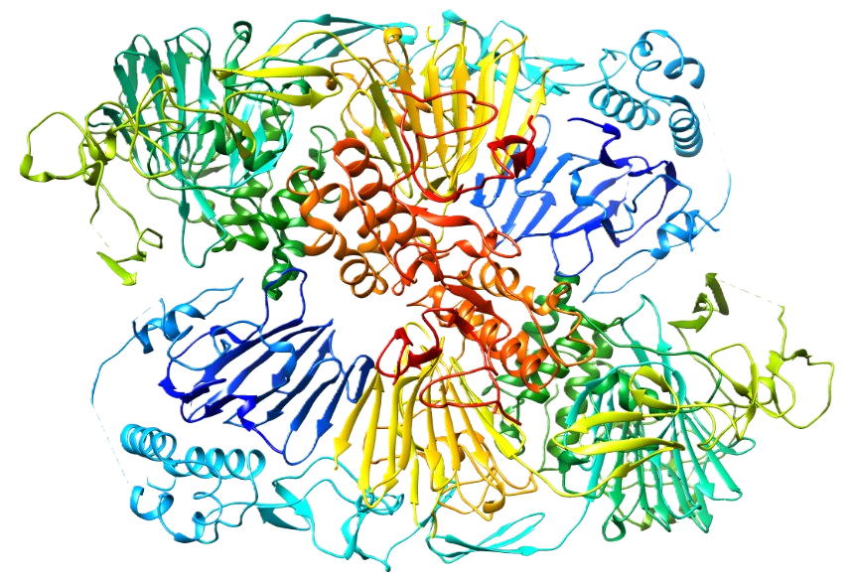
T1269v1o (TM-score ranking loss = 0.00 and Pearson correlation = 0.9911)
Native structure
Selected top 1 structure (TM-score = 0.9786)
Actual top 1 structure (TM-score = 0.9786)

Slide 16
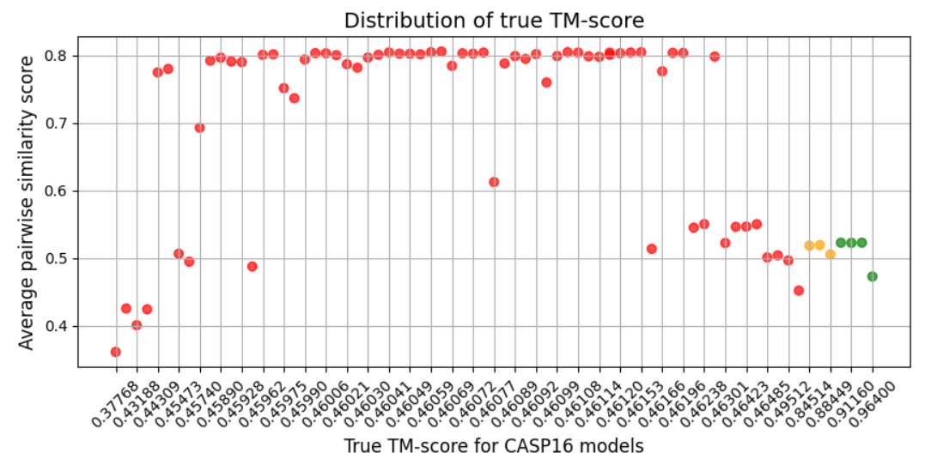
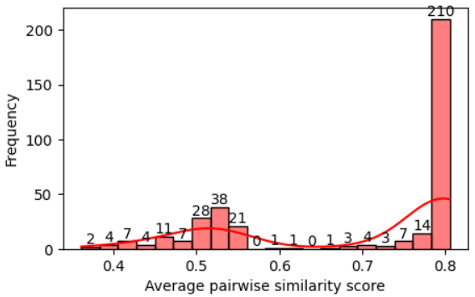
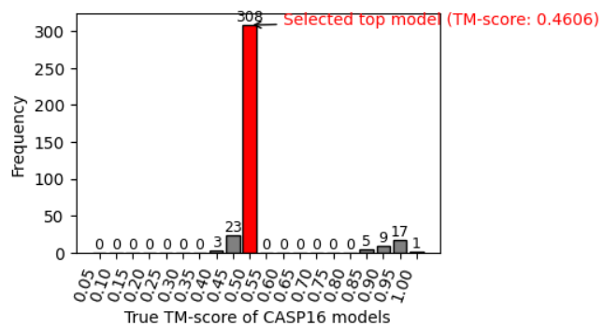
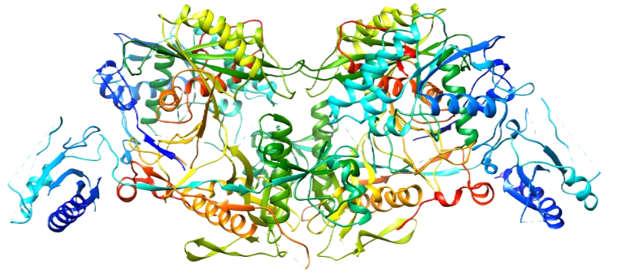
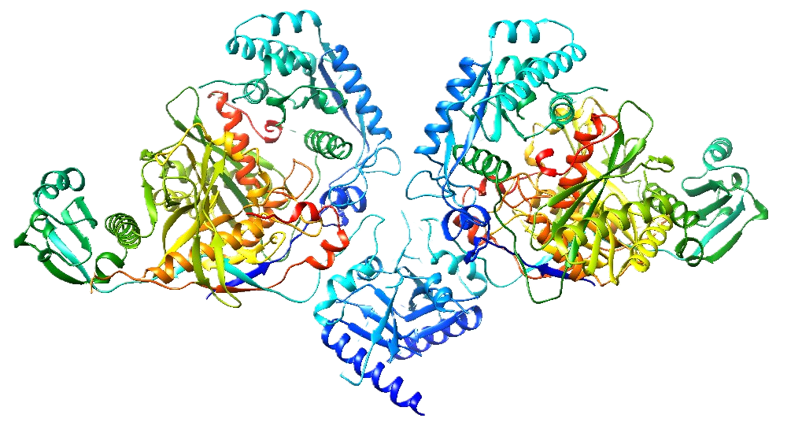
H1267 (TM-score ranking loss = 0.508, Pearson correlation = -0.3592)
Native structure
Selected top 1 structure (TM-score = 0.4606)
Actual top 1 structure (TM-score = 0.964)

Slide 17
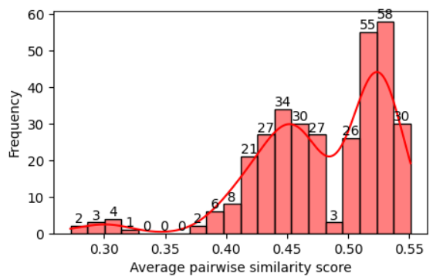
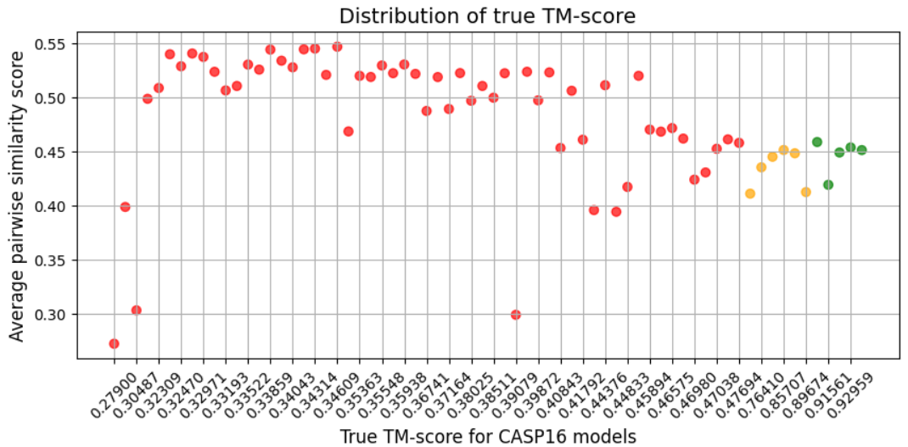
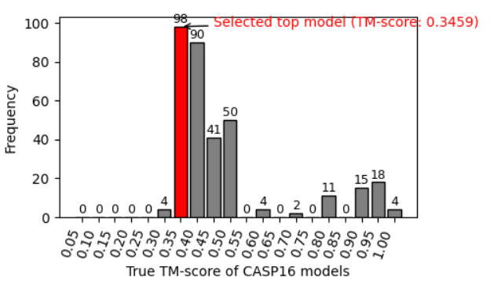
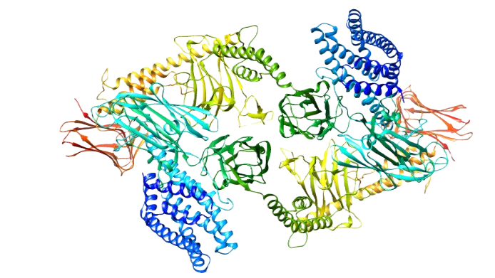
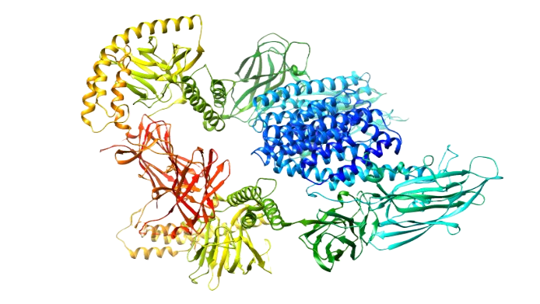
T1218o (TM-score ranking loss = 0.635, Pearson correlation = -0.4295)
Native structure
Selected top 1 structure (TM-score = 0.3459)
Actual top 1 structure (TM-score = 0.9641)

Slide 18
QMODE3 (Rank and select top 5 Massivefold models )
Model Selection Strategy
Select top 200 models based on Alphafold2 global plddts score for monomer and Alphafold2 Confidence score for multimer
Apply the three EMA methods (MULTICOM_LLM, MULTICOM_GATE and MULTICOM_human) to the 200 models and select top 5

Slide 19
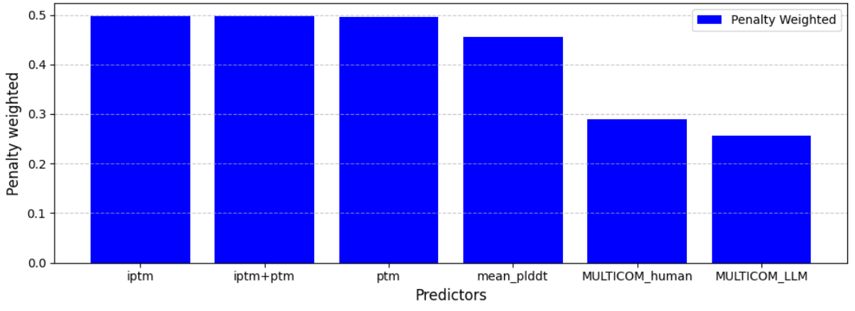
Compare MULTICOM_human and MULTICOM_LLM with baseline methods on 15 homomultimer targets
Evaluation metric : CASP16 penalty_weighted score
It is computed using Mahalanobis distance between the scores for the chosen and correctly-ranked five models.

Slide 20
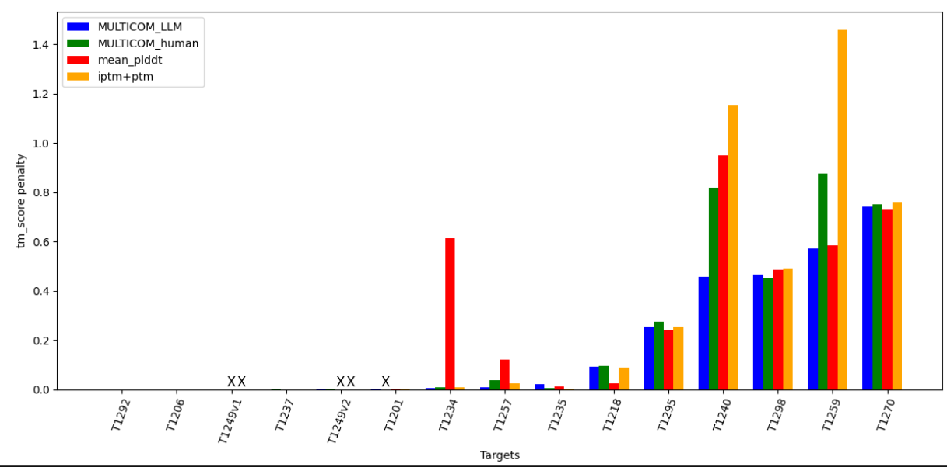
Per target tm_score penalty for 15 homomultimer targets
Successful Case
Failed case

Slide 21
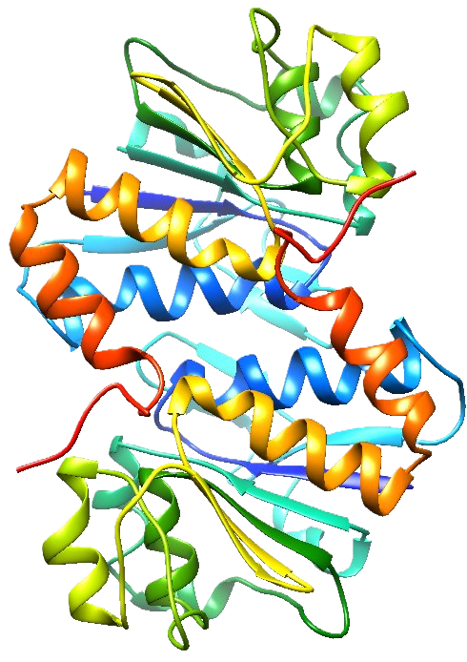
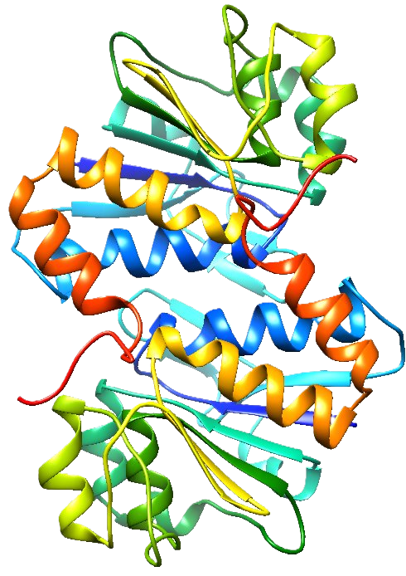
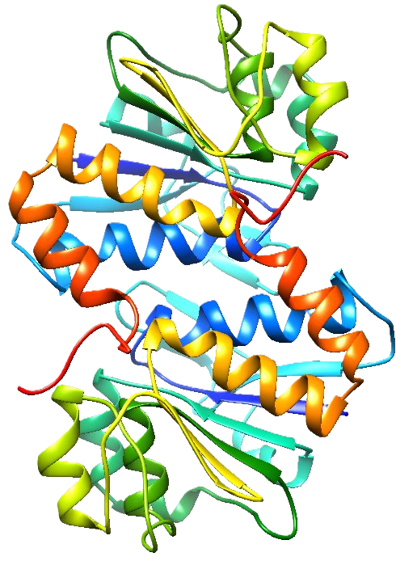
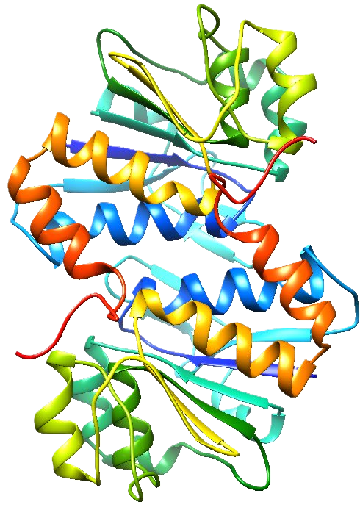
T1292 (tm_score penalty = 0.000059)
Native structure
Selected top 5 structures
TM-score = 0.9968
TM-score = 0.9969
TM-score = 0.9969
TM-score = 0.9969
TM-score = 0.9968

Slide 22
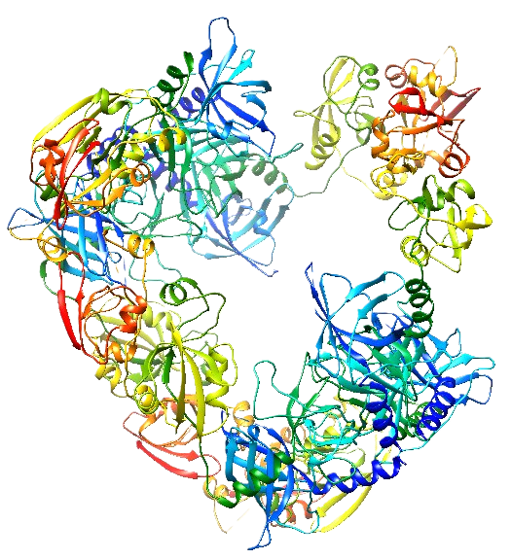
T1270 (tm_score penalty = 0.74049)
Native structure
Selected top 5 structures
TM-score = 0.5571
TM-score = 0.5571
TM-score = 0.5588
TM-score = 0.5574
TM-score = 0.5575

Slide 23
Per target penalty_weighted scores for 22 monomer targets

Slide 24
What went well?
QMODE1
Average pairwise similarity score works well for most targets.
Combining pairwise similarity and single model quality assessment by graph transformer (GATE) is useful.
QMODE3
MULTICOM_LLM and MULTICOM_human worked well on selecting models for homomultimer targets (better than Alphafold confidence scores)
MULTICOM_LLM and MULTICOM_human worked better than Alphafold pLDDT score on selecting models for monomer targets

Slide 25
What went wrong?
QMODE1
Pairwise similarity score often failed when majority of models in the model pool are bad
QMODE3
Performed worse than Alphafold scores on selecting models for heteromultimers

Slide 26
Acknowledgement
Jian Liu
Advisor: Dr. Jianlin Cheng

