Slide 1
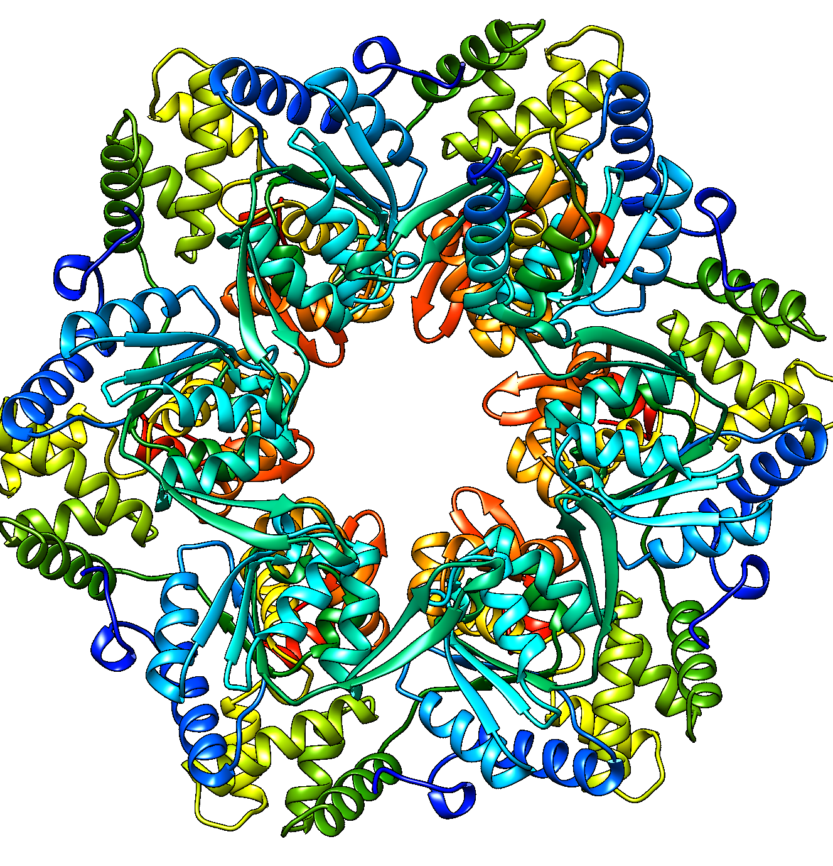
Combining Pairwise Similarity and Interface Contact Prediction to Estimate the Accuracy of Protein Assembly Models
Jianlin Cheng
University of Missouri
Columbia, MO, USA
CASP15, December 13th, 2022

Slide 2
An Overview of Methods of Estimating Assembly Model Accuracy (EMA)
Energy/potential-based method (e.g., Panlab, ChaePred, ZRank)
Machine learning prediction of global & local quality (e.g., GuijunLab-RocketX, MULTICOM_egnn/dep, VoroIF , APOLLO, GuijunLab-Human, FoldEver, LAW, MASS)
Geometric model similarity (e.g., consensus of multiple models)
Hybrid method (combining complementary/different scoring metrics: Venclovas, VoroMQA-select-2020, ModFOLDdock, MUFold2, Bhattacharya, MULTICOM_qa)
MULTICOM_qa is a hybrid method with new design and implementation

Slide 3
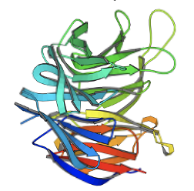
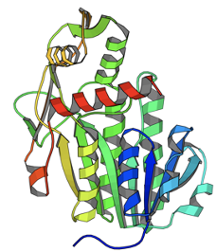
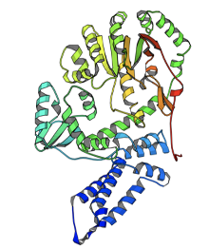
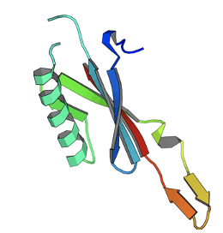
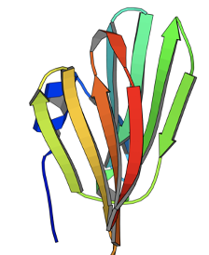
Lessons Learned from Evaluating Protein Tertiary Structures
The average structural similarity between one model and all other models is a good indicator of its quality
Model consensus approaches work well in most cases
...
...

Slide 4
Why and When does the Pairwise Similarity Work Well?
There is only one way to be correct. Good models are similar to each other.
There are many ways to be wrong. Bad models tend to be more dissimilar to each other.
Philosophy

Slide 5
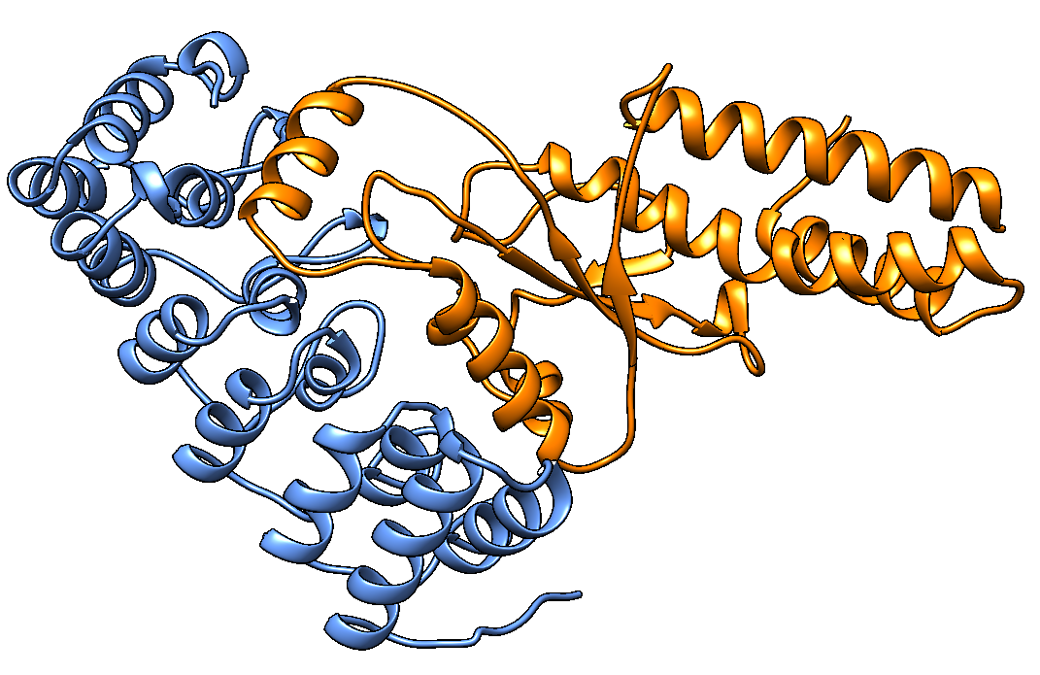
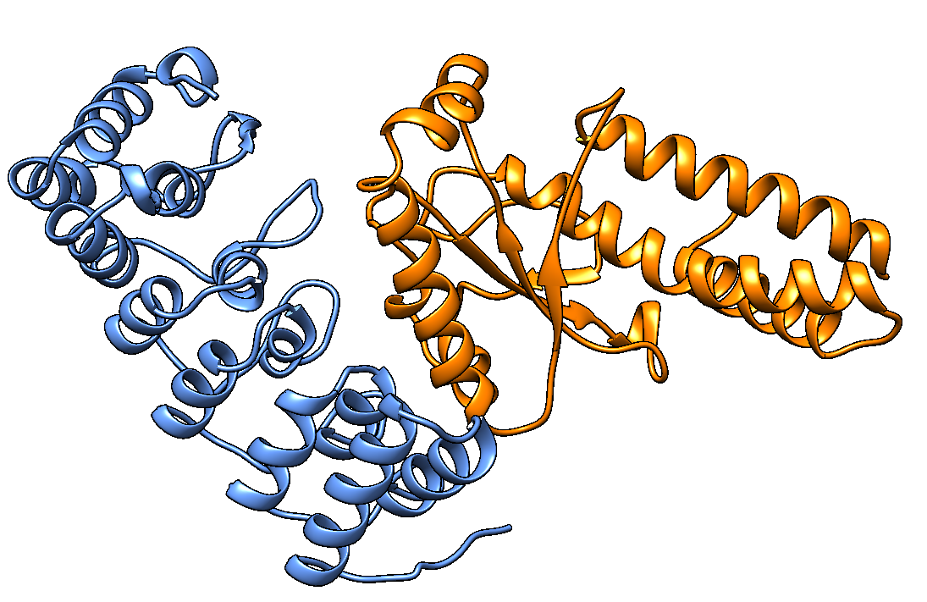
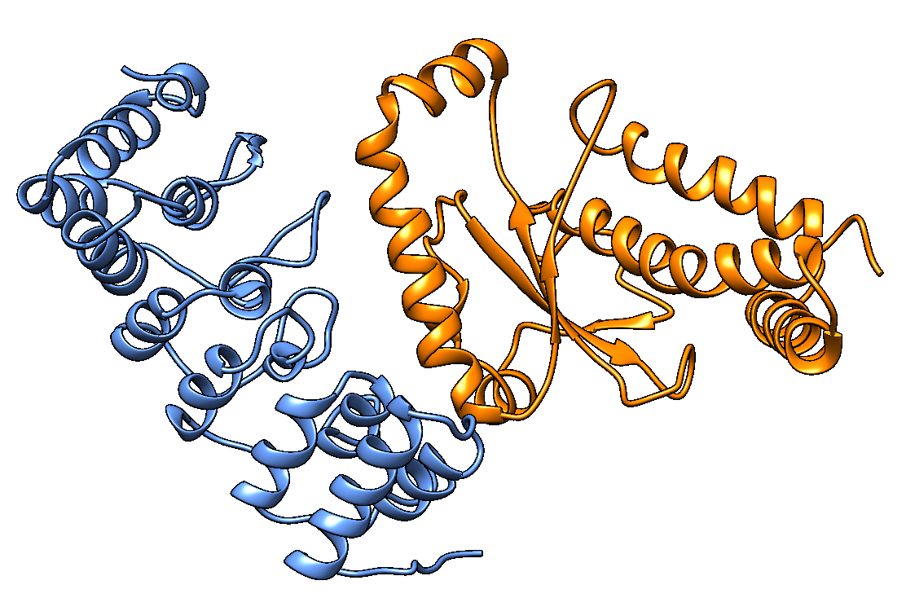
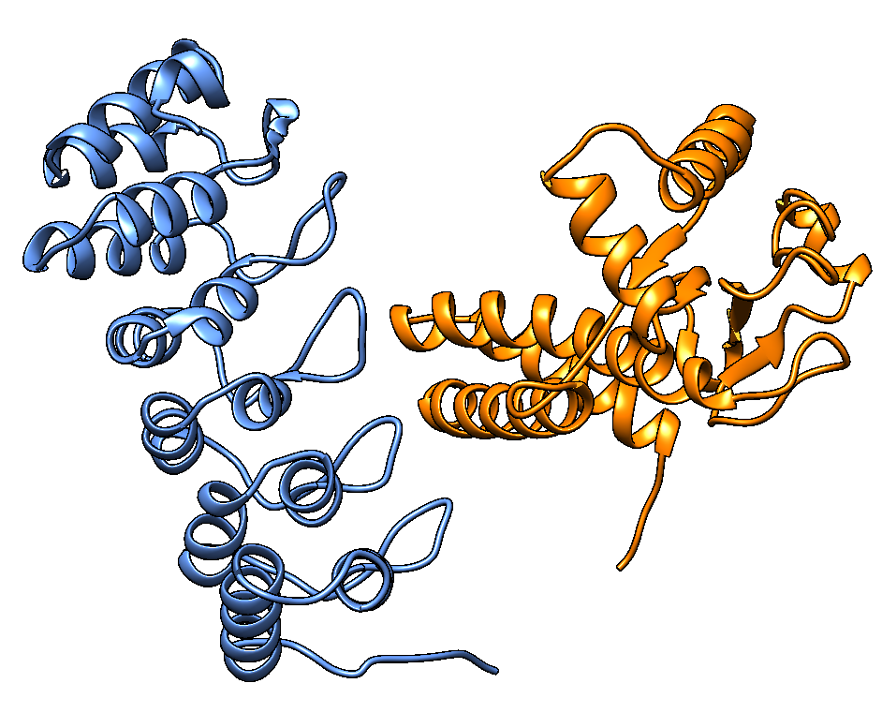
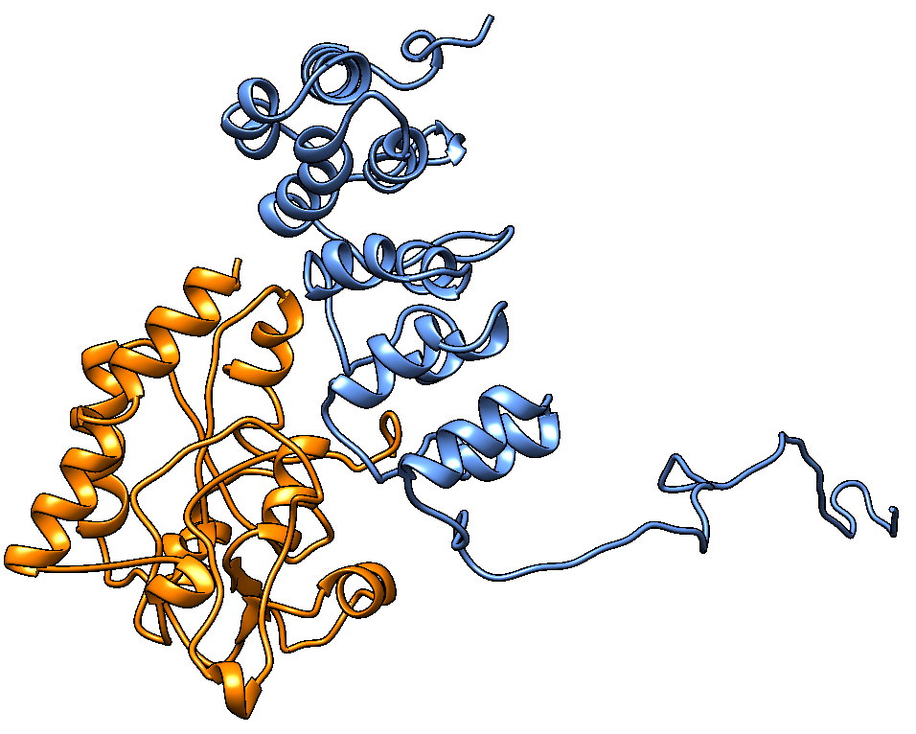
The First Key Score to Estimate the Global Fold Accuracy of Protein Assembly Models
Use MMalign to calculate the pairwise similarity score between assembly models
Average the similarity between a model and all other models
TM-score
...
...

Slide 6
When does the Pairwise Similarity Fail?
There are too few good models
Bad models are similar to each other
A counter measure: a single-model interface contact score predicted by deep learning

Slide 7
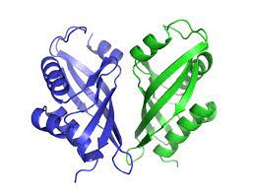
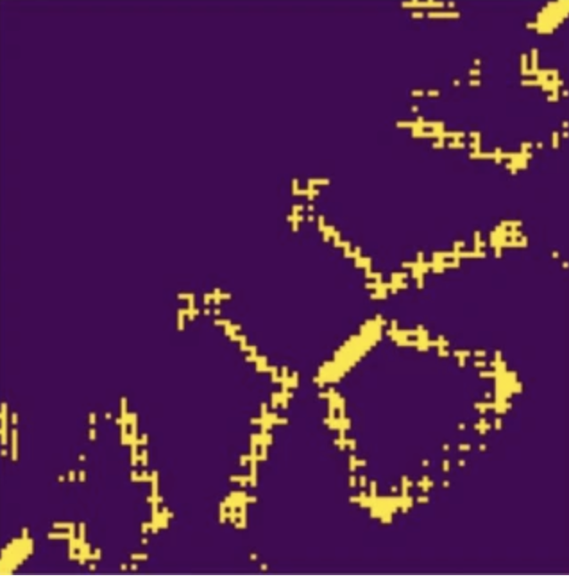
Interface Contact Score
ICPS: average interface contact probability score
Inter-chain contacts in
an interface of a model
Inter-chain contact probability map predicted by deep learning

Slide 8
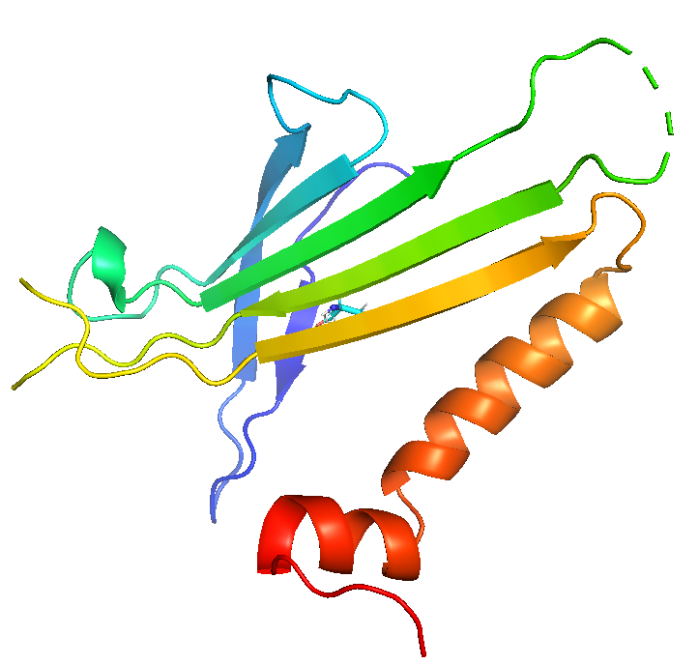
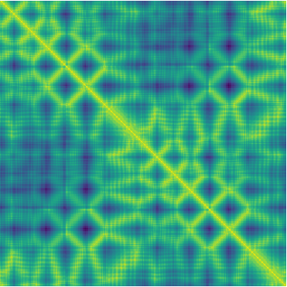
Inter-Chain Contact/Distance Map Prediction by CDPred
>17% more accurate than state-of-art methods
Sequence
Conv2D (1*7)
Multiple sequence alignment
Channel Attention
Block
NormalizationBlock
NormalizationBlock
Conv2D (7*1)
NormalizationBlock
Spatial Attention block
Block_Input
Conv2D
Conv2D
+
Block_Output
P
Q
A
Conv2D (3*3)
A
I
V
I
D
Two interacting
chains
A
D
A
Q
A
PSSM
T
CCmpred
P
Attention maps
Language model
Distance map
SoftMax
Input
Conv2D
Maxout
ResNetBlock
Conv2D
Monomer structure
https://github.com/BioinfoMachineLearning/CDPred
Guo et al., Nature Communications, 2022

Slide 9
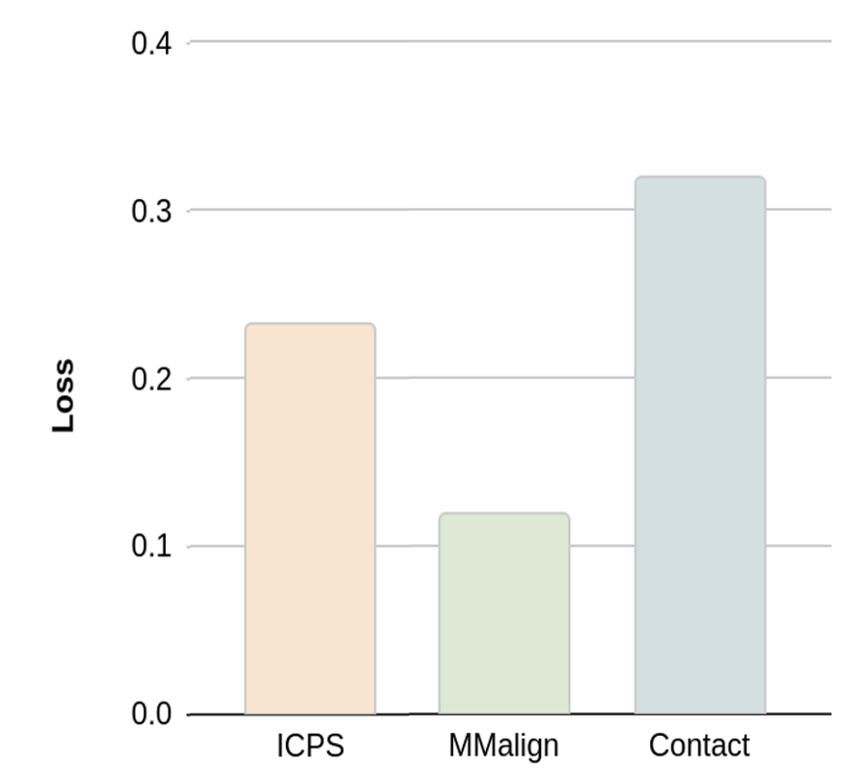
Evaluation of Pairwise Similarity Score and Interface Contact Score on Ranking CASP14 Multimer Models
Ranking Loss = TM-score of best model – TM-score of top 1 ranked model
# of interface contacts in multimer models
A weighted average of pairwise similarity score and ICPS
ICPS: average probability of
interface contacts of multimer models
Average pairwise similarity score of
multimer models by MMalign

Slide 10
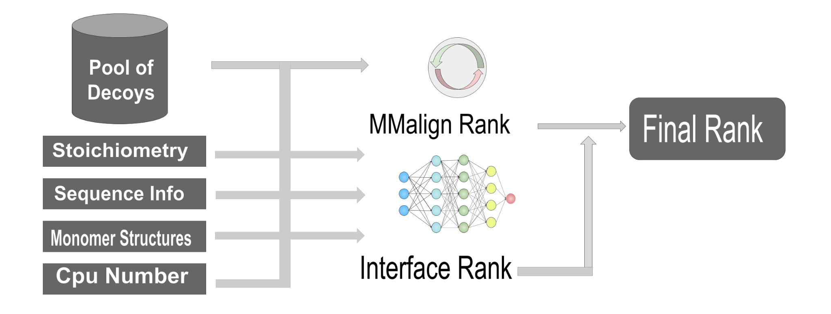
MULTICOM_qa Pipeline for CASP15
Overall fold Score = 0.6 x PSS + 0.4 x ICPS
Interface score = ICPS
Pairwise Similarity Score (PSS)
Interface Contact Probability Score (ICPS)

Slide 11
Distribution of Per-Target Correlation of Global Quality on CASP15 Models of 36 Multimers
Average per-target correlation between MULTICOM_qa scores and true TM-scores = 0.66
Distribution of Per-Target Ranking Loss of Global Quality on Models of 36 Multimers
Average ranking loss of MULTICOM_qa = 0.14
The correlation between
per-target correlation scores and ranking losses = -0.84

Slide 12
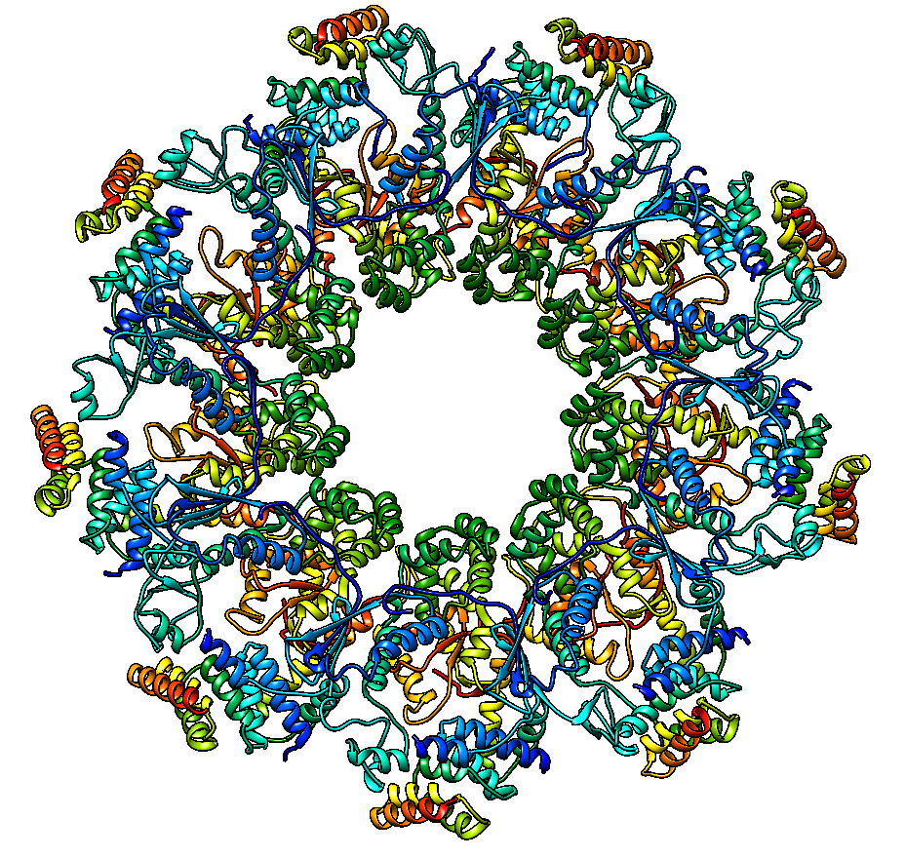
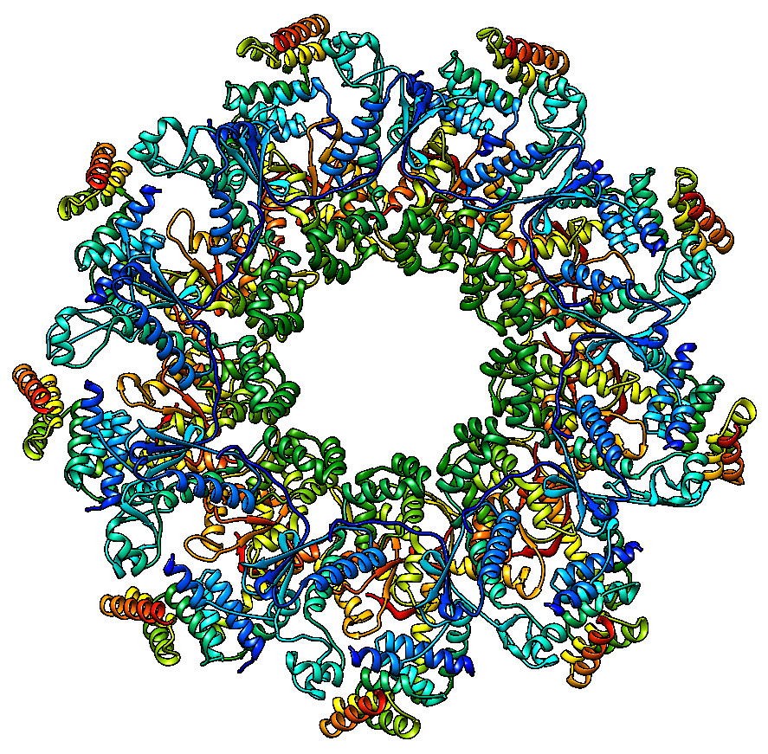
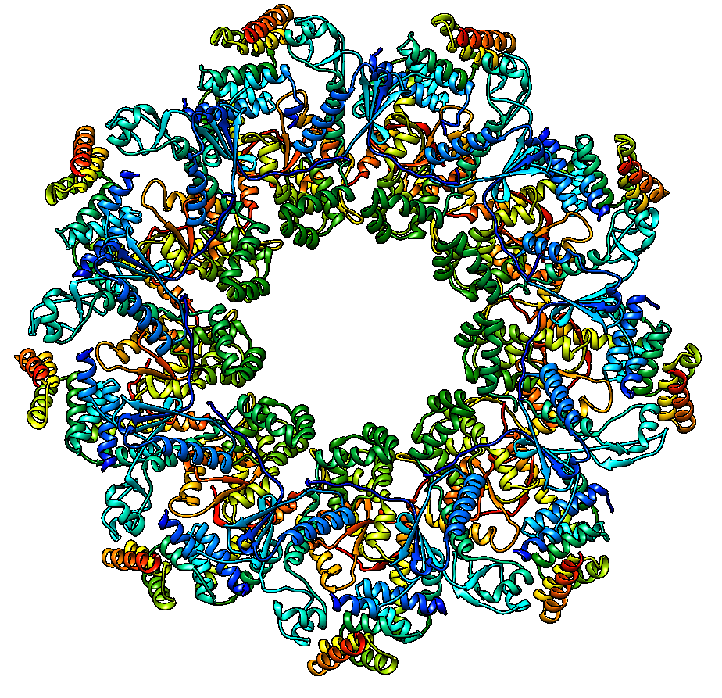
H1111 Stoichiom.: A9B9C9 loss = 0.031 correlation = 0.62
Native structure
True Top-1 model
TM-score = 0.983
Selected Top-1 model
TM-score = 0.952

Slide 13
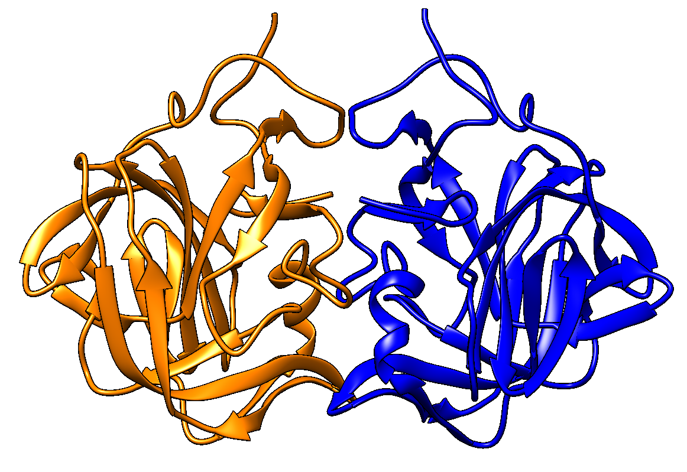
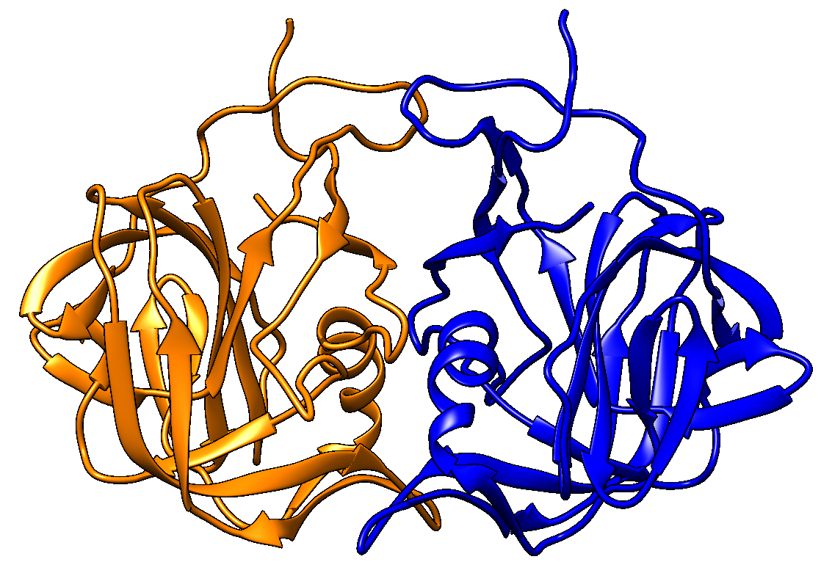
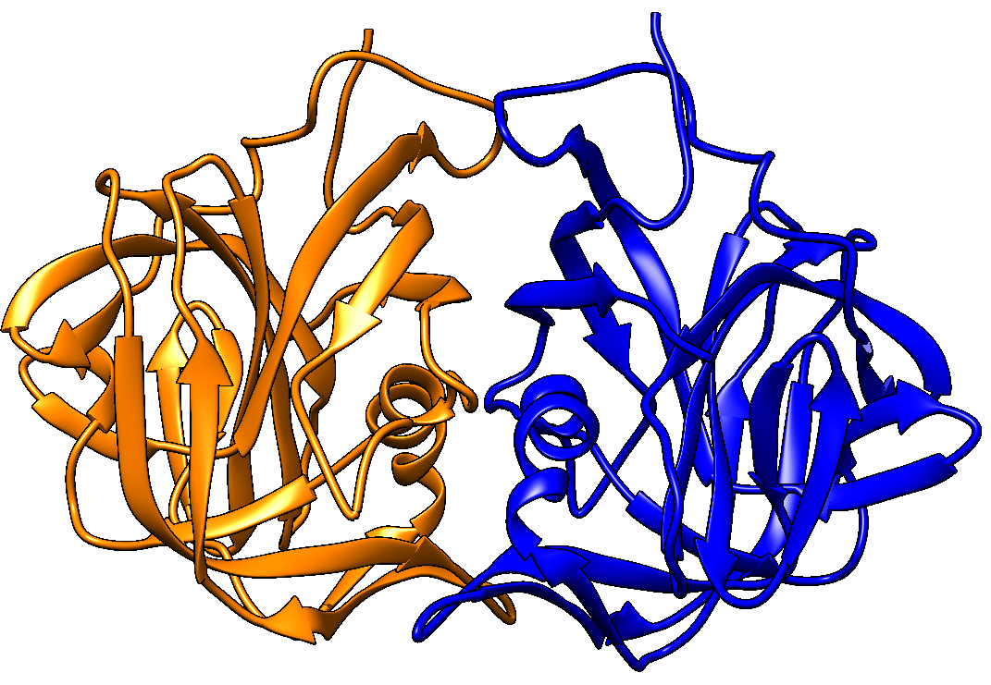
T1123 Stoichiom.: A2 loss = 0.017 correlation = 0.98
True Top-1 model
TM-score = 0.923
Selected Top-1 model
TM-score = 0.906
Native structure

Slide 14
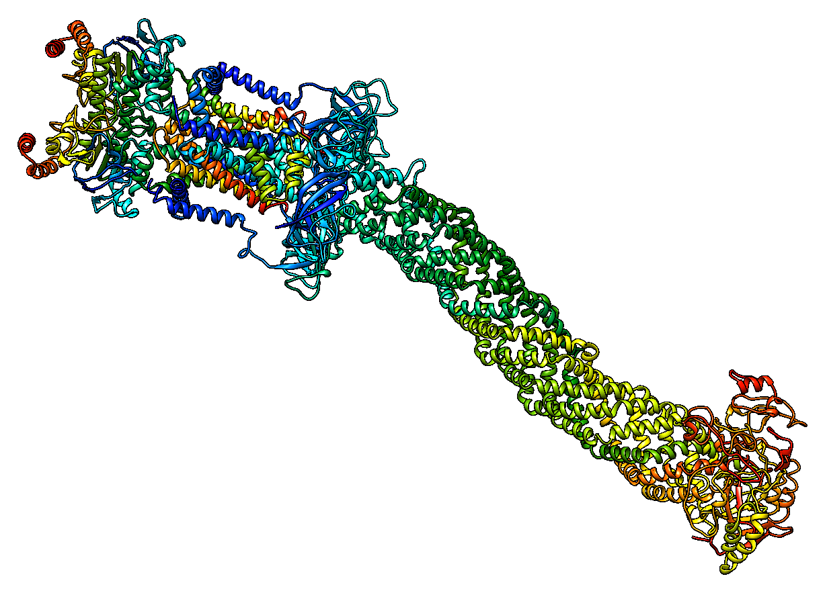
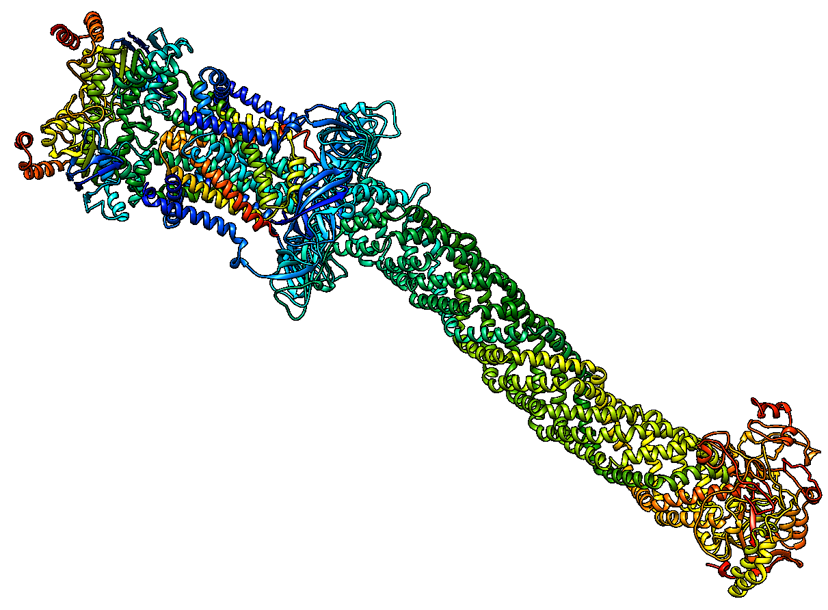
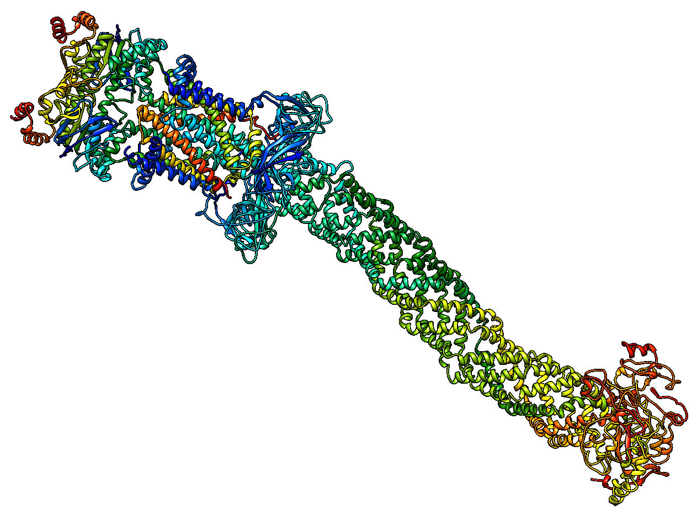
H1137 Sto.: A1B1C1D1E1F1G2H1I1 loss = 0.059 correlation = 0.96
Native structure
True Top-1 model
TM-score = 0.936
Selected Top-1 model
TM-score = 0.876

Slide 15
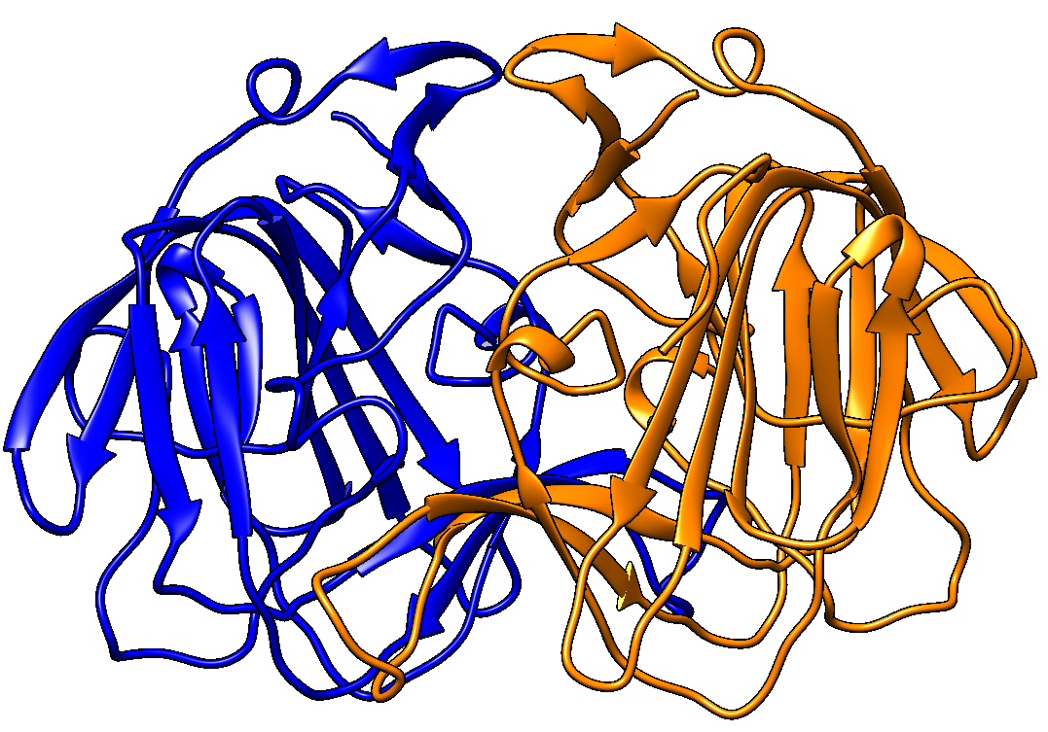
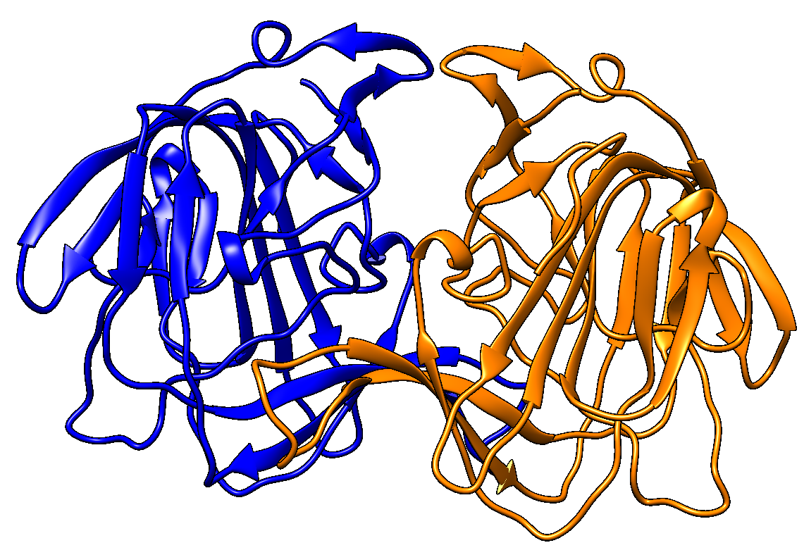
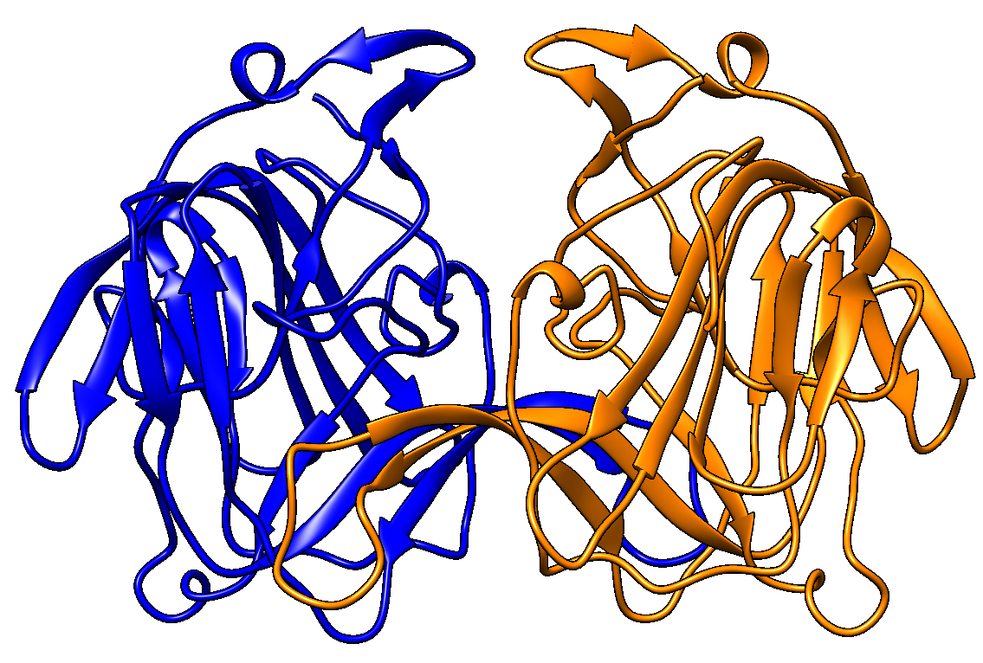
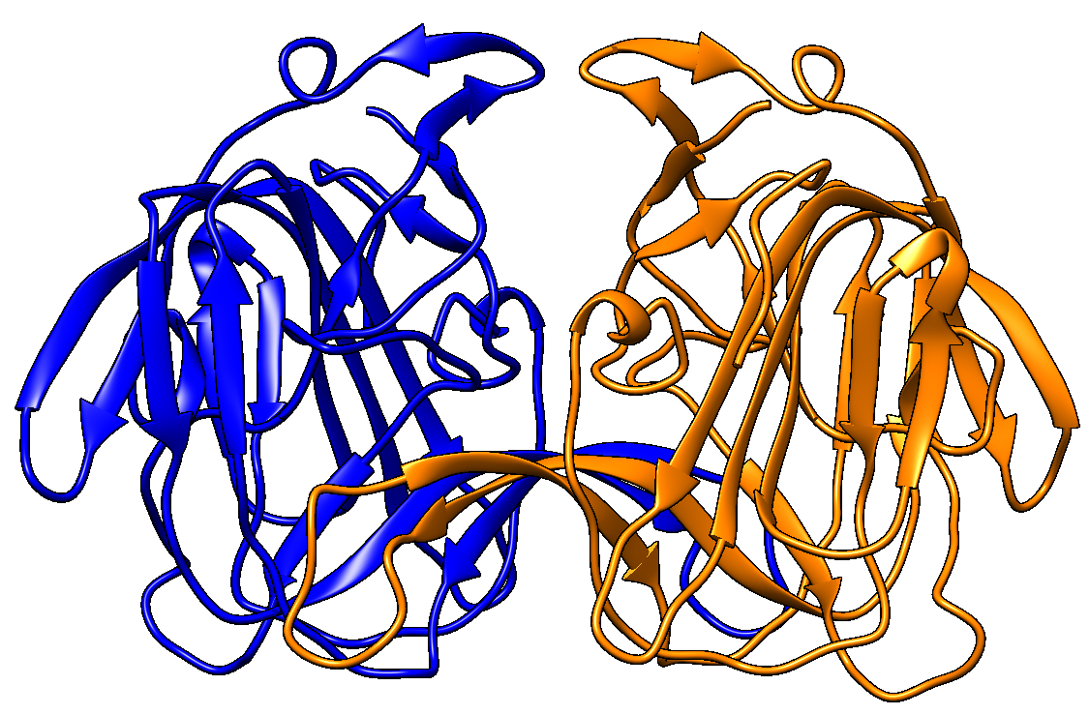
T1179
Stoichiom.: A2
loss = 0.066
correlation = 0.12
Native structure
True Top-1 model
TM-score = 0.969
Pairwise similarity score
selected Top-1 model
TM-score = 0.854
MULTICOM_qa
selected Top-1 model
TM-score = 0.903

Slide 16
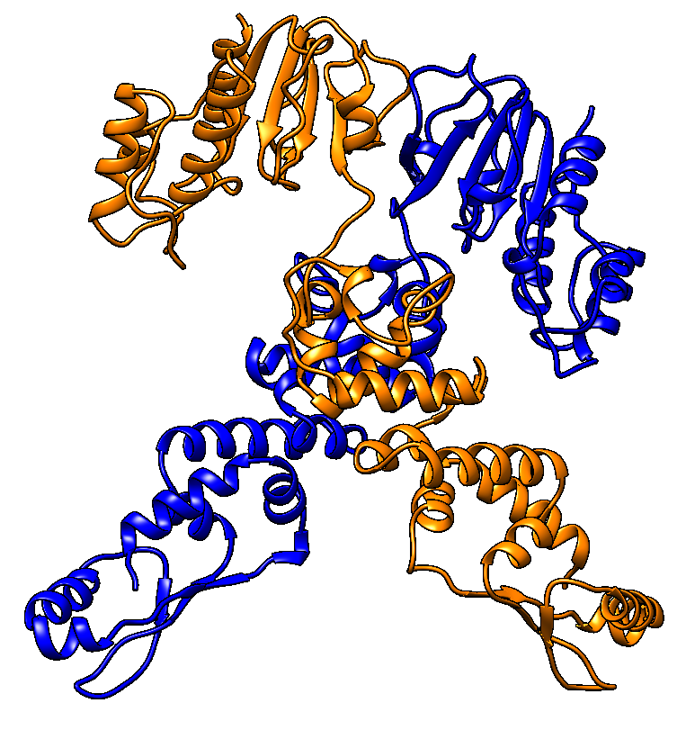
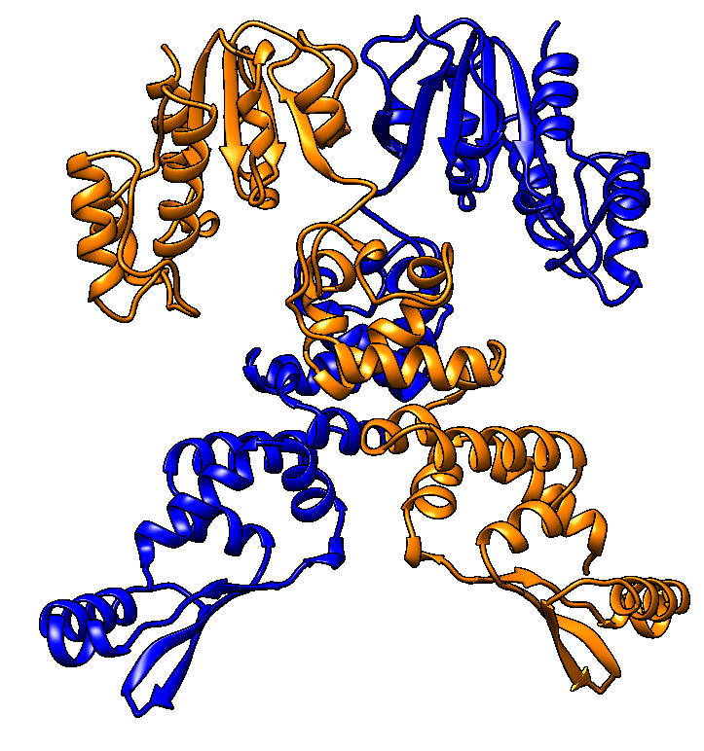
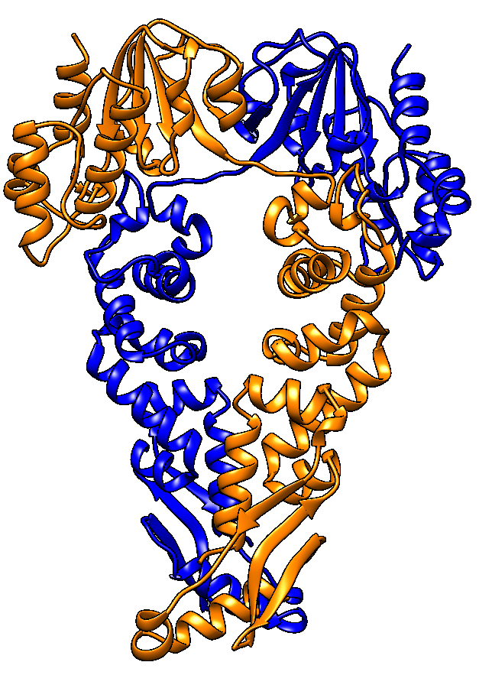
T1121
Stoichiom.: A2
loss = 0.35
correlation = -0.39
Native structure
True Top-1 model
TM-score = 0.853
Selected Top-1 model
TM-score = 0.506
Failure

Slide 17
How well can the approach work when the modeling knowledge is available?
Average Score VS AlphaFold Confidence Score on our In-house CASP15 models
H1140
H1144
H1167
H1134
H1129
p-value = 0.2378

Slide 18
Challenges of Assembly Evaluation versus Tertiary Structure Evaluation
Harder to align large assembly models (largely solved now?)
More complicated: both tertiary structure quality and interface quality need to be considered
Fewer machine learning tools for estimating single-model accuracy
Fewer methods for effectively combining different scoring metrics

Slide 19
Conclusion
The pairwise model similarity score is a very useful measure with a significant weakness
Inter-chain contact prediction can be used to estimate the accuracy of assembly models and interfaces
More single-model scoring metrics are needed to correct the weakness of the pairwise model similarity score
Better approaches for combining complementary scoring metrics are needed

Slide 20
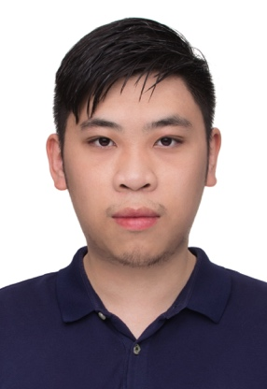
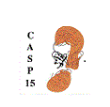
Acknowledgements
Raj Roy
Jian Liu
Zhiye Guo
Nabin Giri

Slide 21
Distribution of Per-target Correlation of Local Interface Quality on CASP15 Models of 36 Multimers
Average per-target correlation between MULTICOM_qa scores and true DockQ scores = 0.53

Slide 22
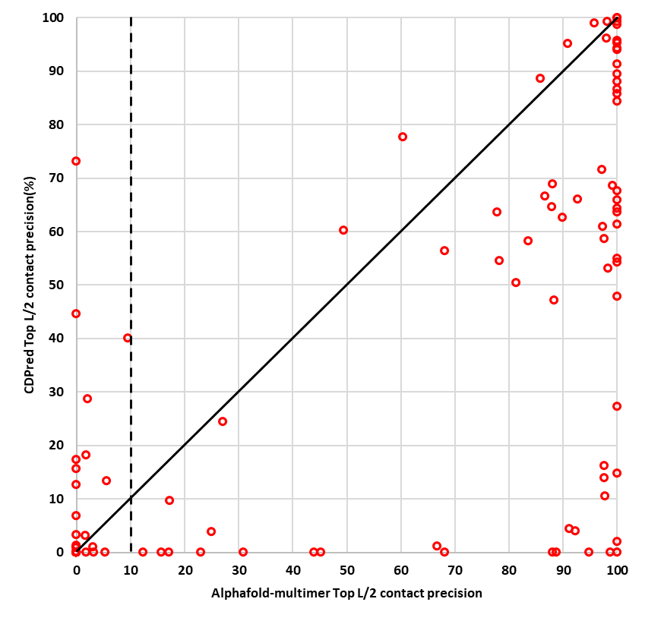
Complementarity between CDPred and AlphaFold-multimer
CDPred top L/2 contact precision
AlphaFold-multimer top L/2 contact precision

