Slide 1
Template-guided method for protein-ligand complex structure prediction: Application to CASP15 protein-ligand studies
Xianjin Xu, Rui Duan, Xiaoqin Zou
Dec. 10-13, 2022
Dalton Cardiovascular Research Center, Department of Physics, Department of Biochemistry & Institute for Data Science and Informatics
University of Missouri - Columbia

Slide 2
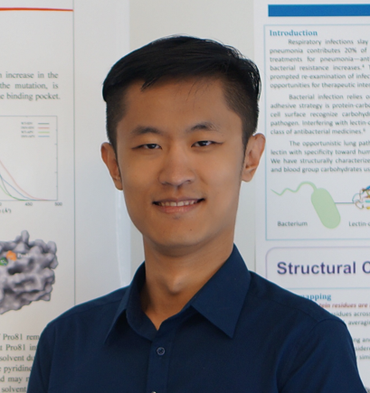
Outline
Methods used for protein-ligand complex structure prediction
Application to CASP15 protein-ligand studies
Lessons we have learned
Dr. Xianjin Xu
Dr. Rui Duan

Slide 3
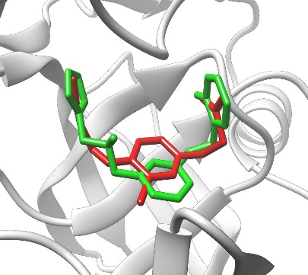
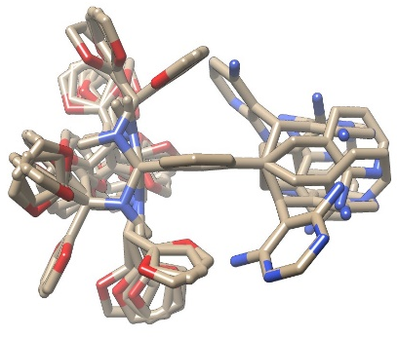
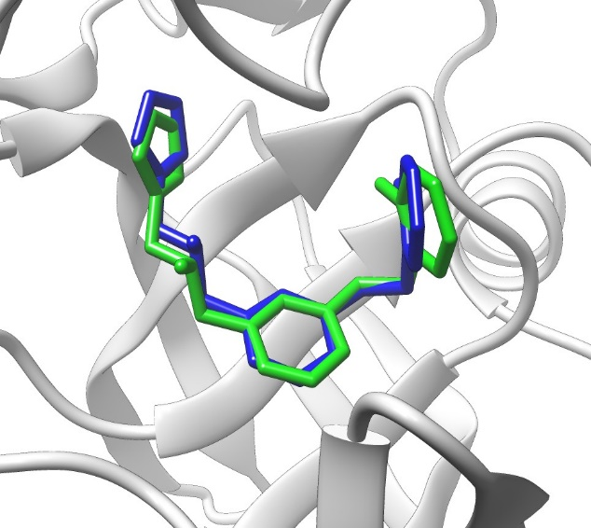
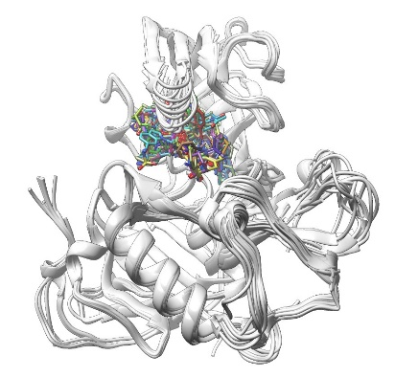
General strategy of our template-guided method for predicting protein-ligand interactions
Conformer ensembles
···
Conformer
generation
(OMEGA2)
Best superimposition
for each template
Query ligand
Flowchart
Superimposition of the query ligand
onto the templates
Refinement/
Hybrid scoring
Protein-ligand
complex structures
from PDB
MRETDEEPEEPGRRGSFVEMVDNLRGKSGQGYYVEMTVGSPPQTLNILVDTGSSNFAVGAAPHP
…
Search of
co-bound structures
(SHAFTS)
Target protein
Xu & Zou. Int. J. Mol. Sci. 2021, 22(22), 12320; Xu et al. J. Comput. Aided Mol. Des. 2019, 33, 367-374.
OMEGA2 (OpenEye Inc.): Hawkins et al. J. Chem. Inf. Model. 2010, 50, 572–584; J. Chem. Inf. Model. 2012, 52, 2919–2936.
SHAFTS: Liu et al. J. Chem. Inf. Model. 2011, 51, 2372–2385. AutoDock Vina: Trott & Olson. J. Comput. Chem. 2010, 31:455-61.

Slide 4
A newly constructed protein-ligand complex structural dataset for systematic analysis
The dataset consists of 17 different proteins with a total of 2752 protein-ligand PDB entries:
One peptidase A1 protein (BACE1, 330 PDBs);
Three peptidase S1 proteins (THRB, 141 PDBs; TRY1, 118 PDBs; FA10, 108 PDBs);
Five protein kinases (CDK2, 296 PDBs; MK14, 165 PDBs; PIM1, 128 PDBs; CHK1, 121 PDBs; AURKA, 83 PDBs);
One heat shock protein (HS90A, 220 PDBs);
Two nuclear hormone receptors (ESR1, 210 PDBs; PPARG, 116 PDBs);
Six other proteins (a total of 583 PDBs).
Peptidase A1
(330 PDBs)
Others
(583 PDBs)
Peptidase S1
(367 PDBs)
HSP90
(220 PDBs)
Nuclear receptors
(326 PDBs)
Protein kinases
(793 PDBs)
Each selected protein has >70 co-bound ligands.

Slide 5
RMSD vs 3D similarity
For each protein in the dataset, a leave-one-out cross validation strategy was used for calculations of the molecular 3D similarities (SHAFTS score) and the corresponding RMSDs among the ligands.
Cases with higher similarity scores tend to have lower RMSD values, which is consistent with the molecular similarity principle.
Two high-density centers:
at around SHAFTS score 1.0 and RMSD 6.0 Å: dissimilar ligands bind in dissimilar fashion;
at around SHAFTS score 1.1 and RMSD 1.0 Å: dissimilar ligands bind in a similar fashion.
Dissimilar ligands bind in dissimilar fashion
3D similarity is assessed using our intercomparison strategy and the SHAFTS score, ranging between 0 and 2.
Shafts score = shape score + chemical score
0: no similarity; 2: identical
Cutoff of similar and dissimilar ligands: 1.2
Dissimilar ligands bind in similar fashion

Slide 6
Percentage of the cases in which at least one good template ligand were successfully found (structurally similar or dissimilar) with the RMSD lower than a threshold (Lowest RMSD).
Importantly, 95.6% of the query ligands had at least one dissimilar template ligand with lowest RMSD ≤ 2.0 Å, suggesting that dissimilar ligands binding in a similar fashion is common in protein-ligand complexes.
similar ligands
dissimilar ligands

Slide 7
Scoring: a hybrid scoring function
The hybrid scoring function considers both the protein-ligand binding score (Vina score) and the molecular similarity score (SHAFTS score):
Hybrid_Score = Vina_score +α*SHAFTS_score , α = min(Vina scores)/2
Top model
similar templates
Success rates using the hybrid score.
Using 2.0 Å as a threshold:
85.8% for SHAFTS score ≥ 1.2 (similar templates);
63.2% for SHAFTS score < 1.2 (dissimilar templates).
Reference: Success rate of bound docking
(bound protein structure, ligands built from SMILES strings) with Vina: 44.5%
dissimilar templates
Vina

Slide 8
Application to CASP15 protein-ligand studies
Protein structures: AlphaFold2
Ligand 3D conformers: OMEGA2 (OpenEye)
Prediction Methods: template-guided method; AutoDock Vina docking if no template was available
Assessment Criteria:
Protein in the predicted models and in the experimental structures were superimposed with UCSF Chimera (the MatchMaker Tool).
bRMSD: backbone RMSD of the protein targets
hRMSD: RMSD of the heavy atoms of the protein contact residues
L-RMSD: RMSDs of the heavy atoms in the ligands, which were calculated using the maximum common substructure (MCS) functionality of the OEChem Python toolkit (version 2.5.1.4, OpenEye Scientific Software, Santa Fe, NM, USA. http://www.eyesopen.com)

Slide 9
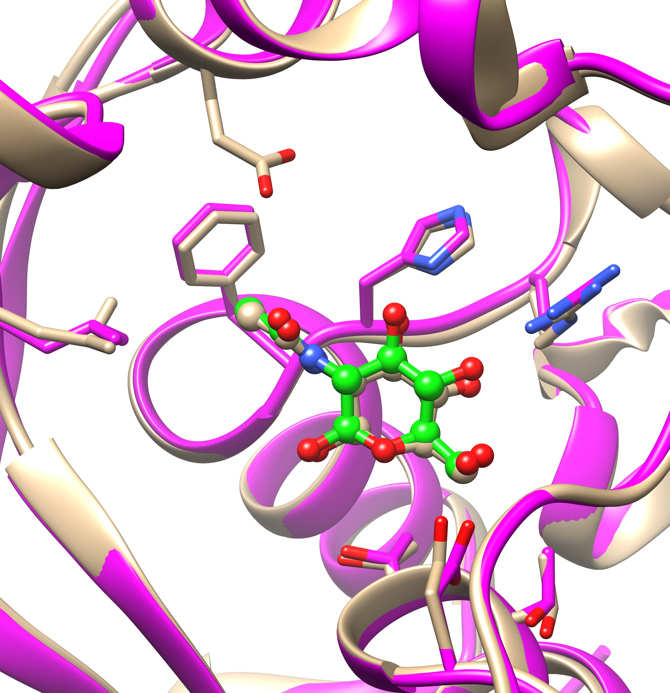
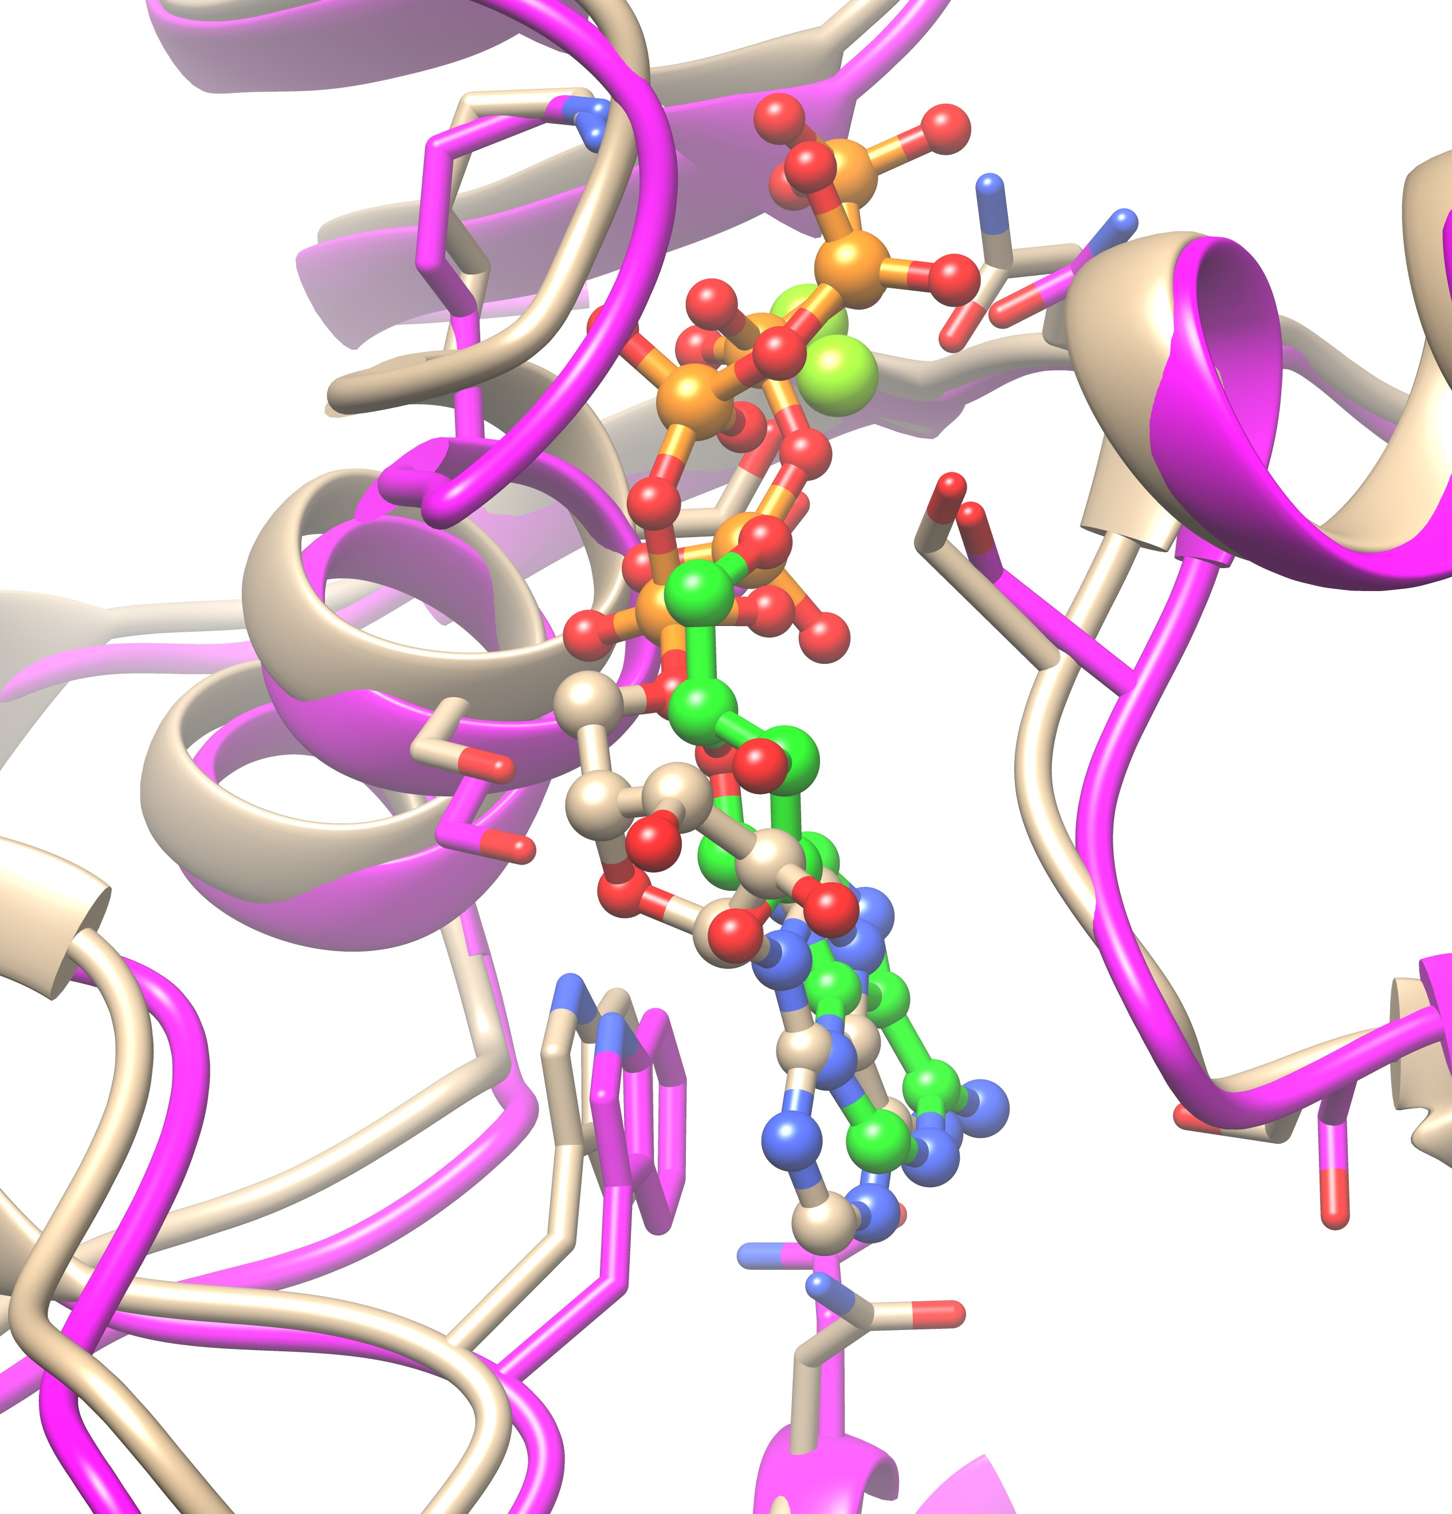
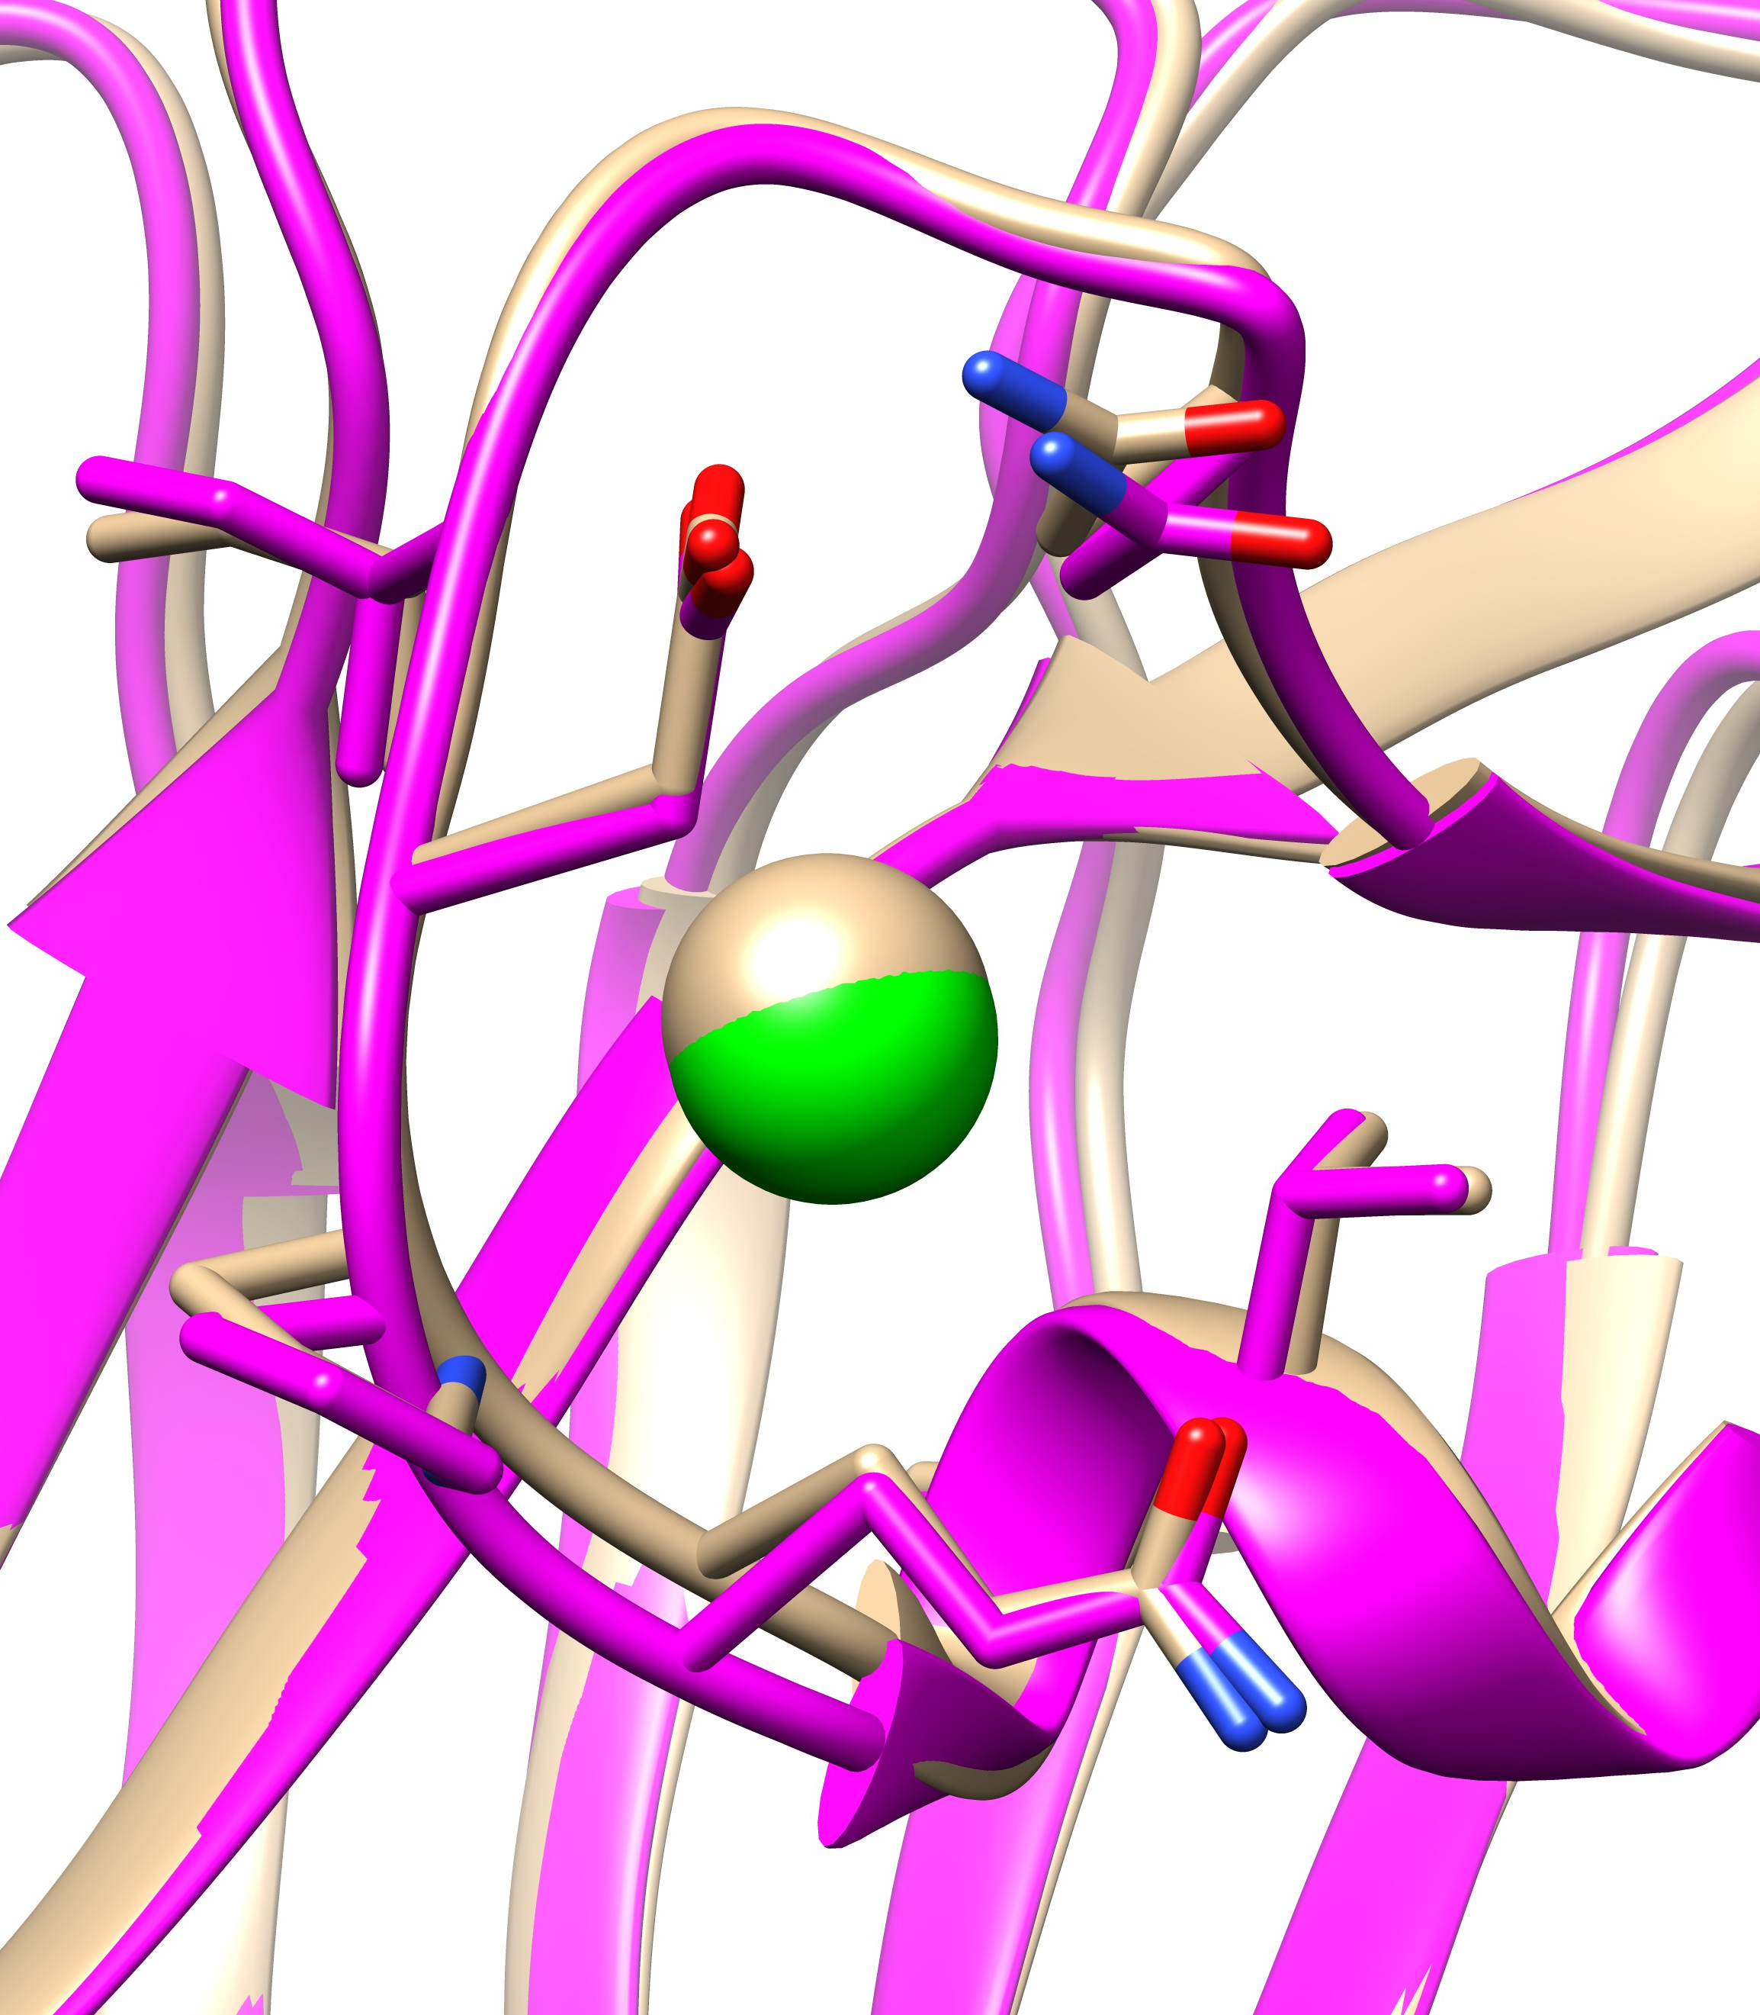
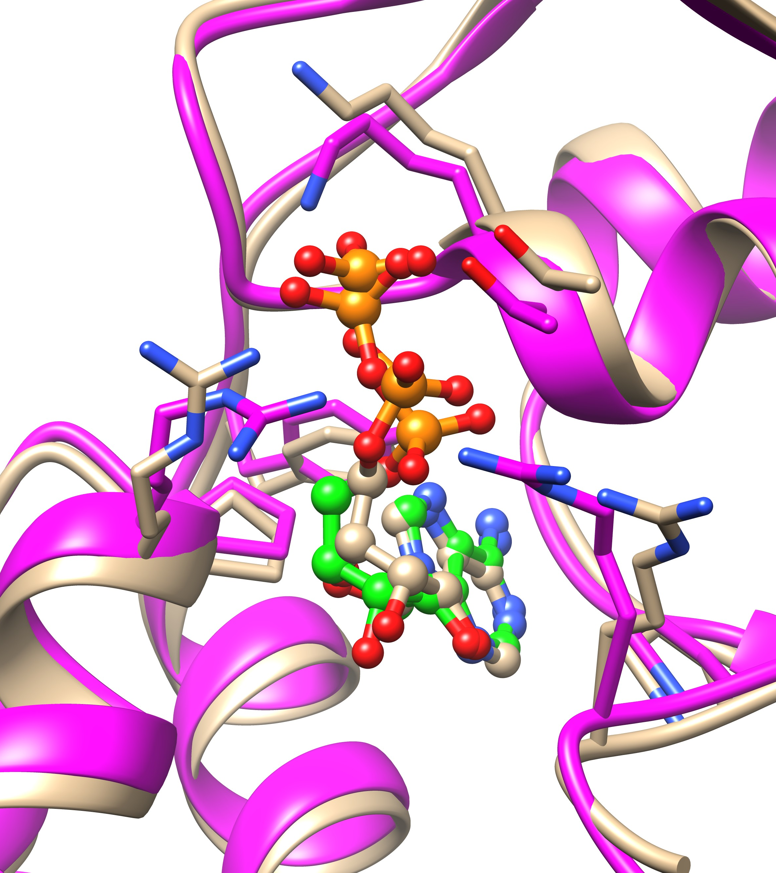
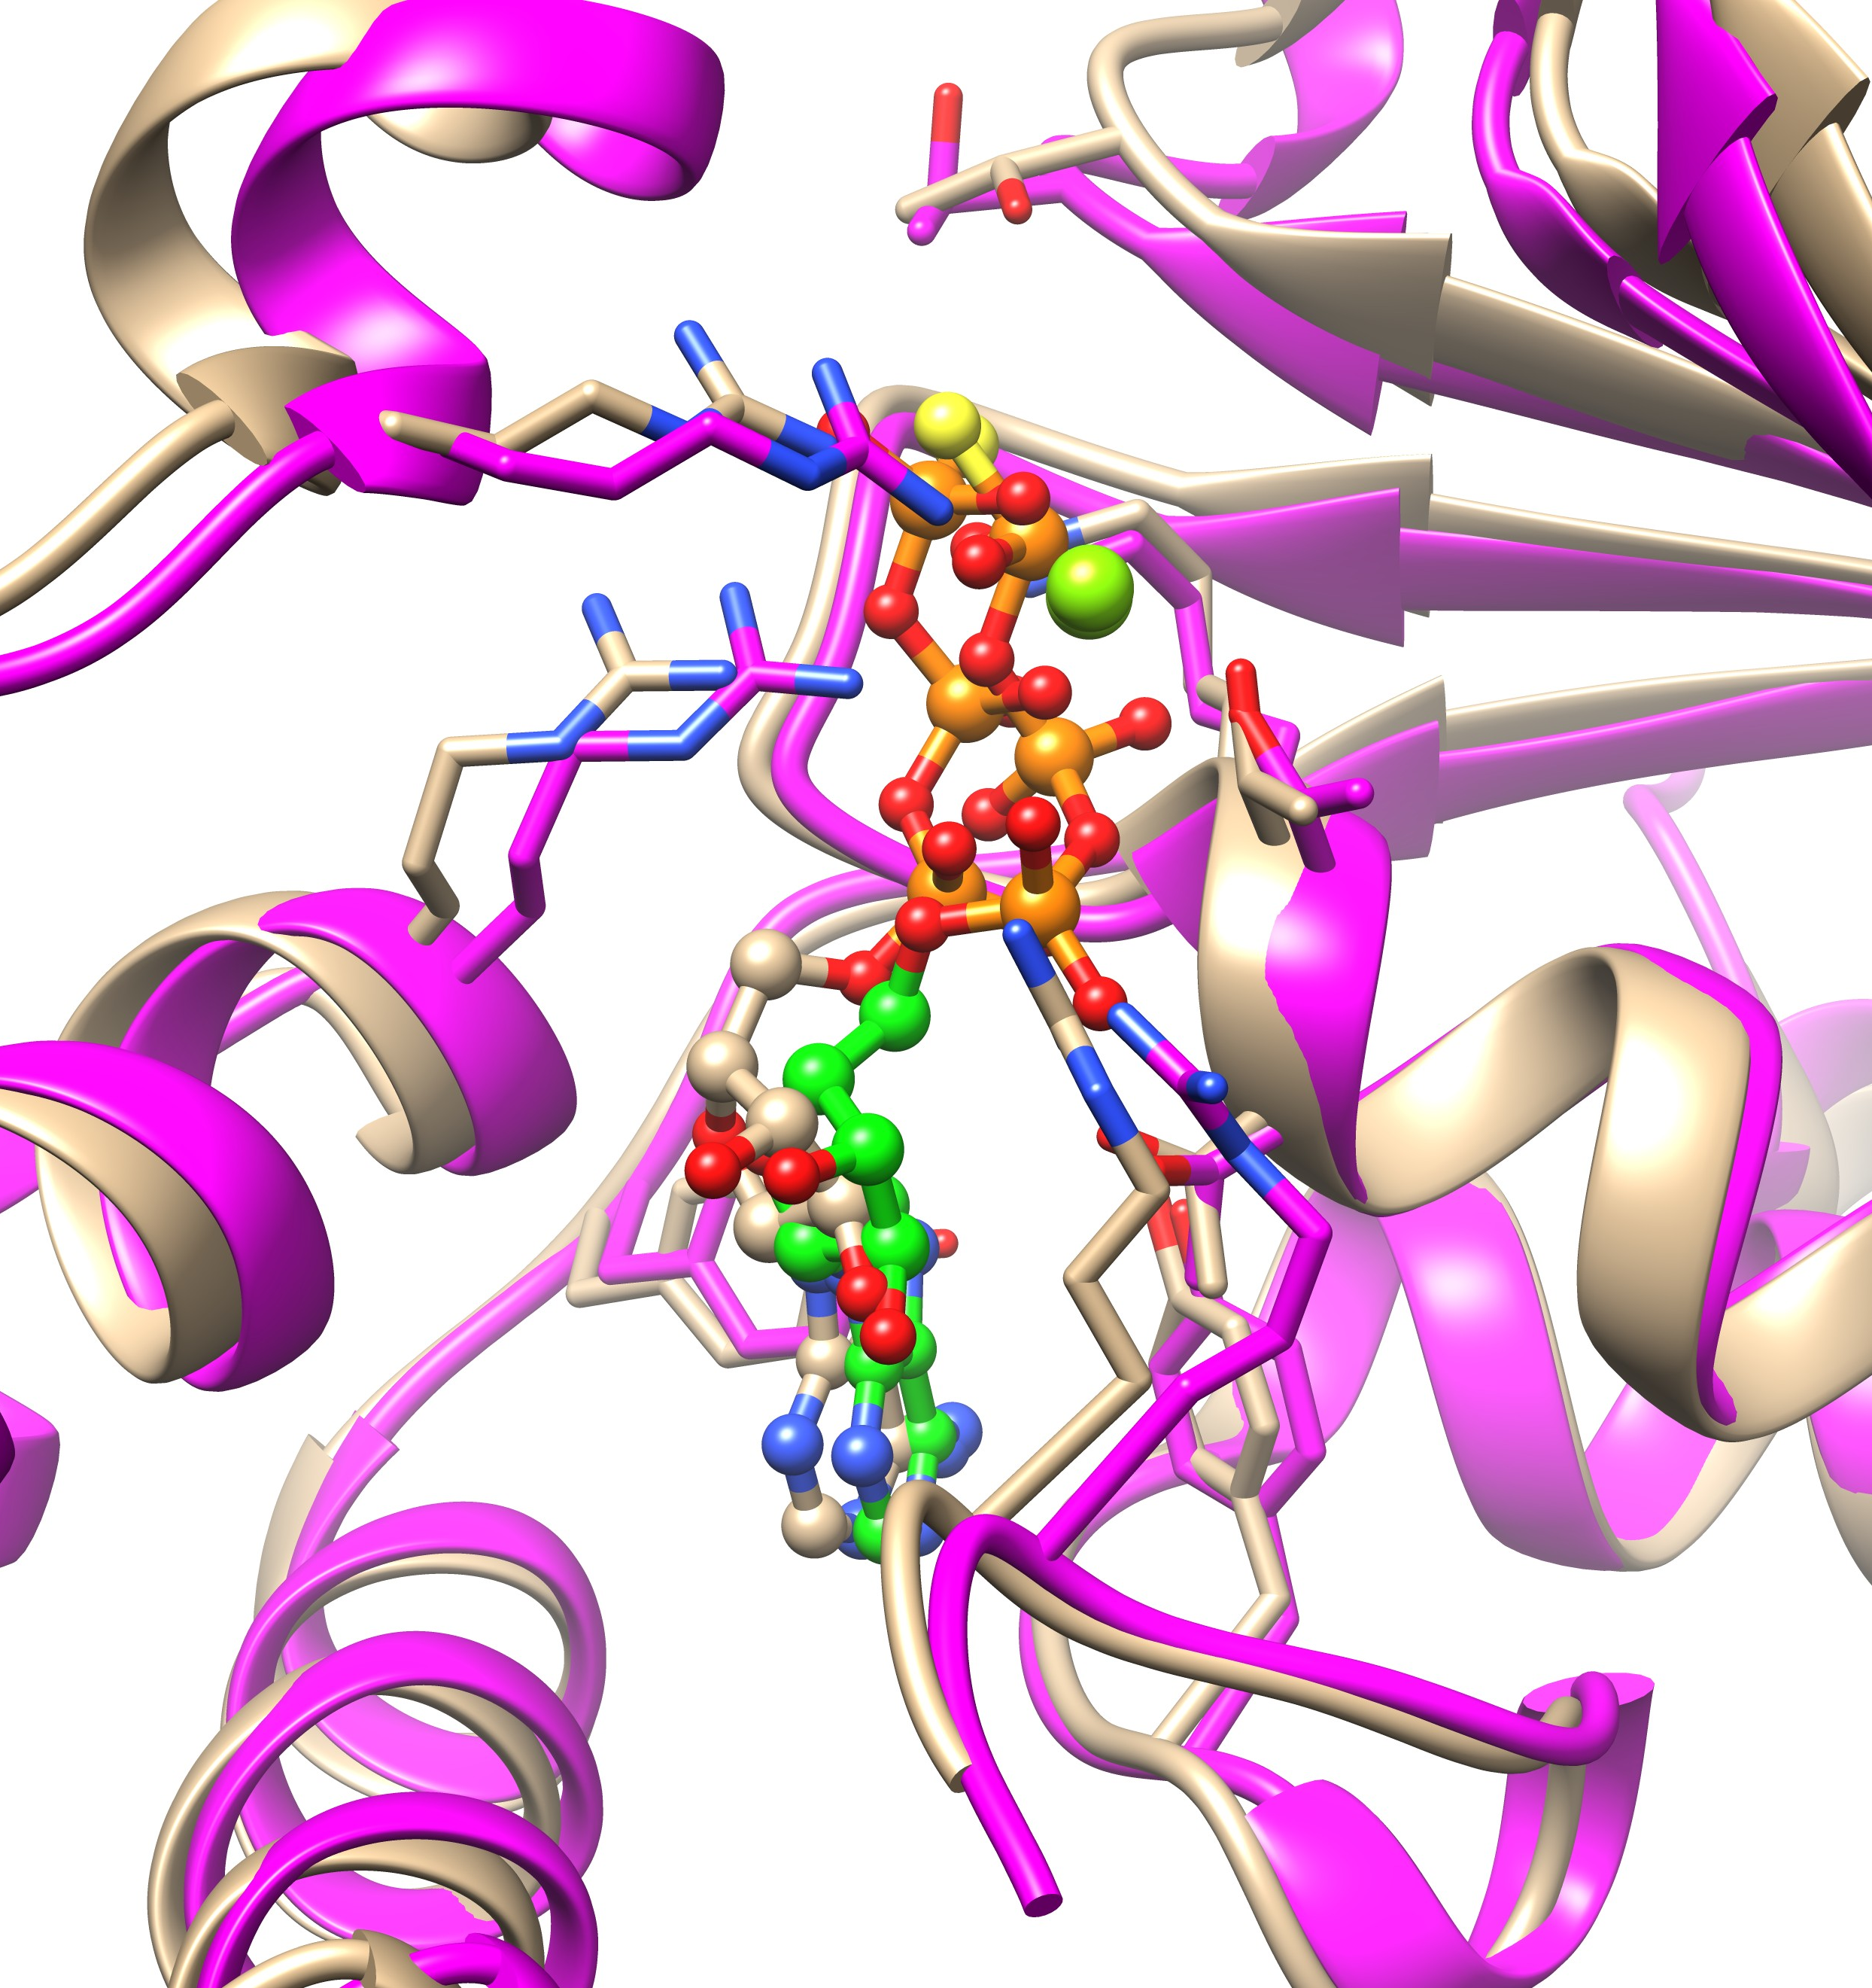
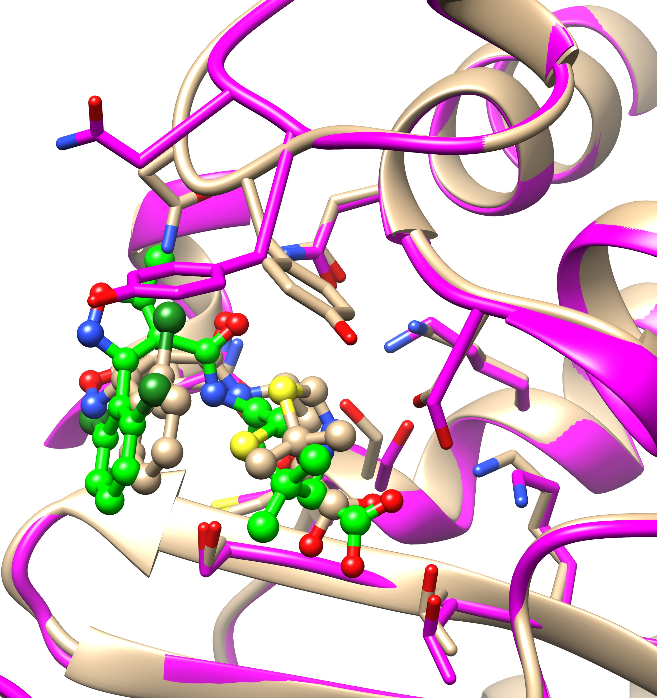
Targets with reliable templates
Experimental structures provided by CASP: tan
Predicted structure: protein (magenta) and ligand (green)
T1146: NAG
T1158v4: ATP
H1135: K⁺ ion
hRMSD : 1.3 Å
L-RMSD: 2.1 Å
Templates: 6msm,
6o2p, 7sv7
hRMSD : 0.5 Å
ion distance: 0.2 Å
Template: 6r15
hRMSD: 0.9 Å
L-RMSD: 0.5 Å
Template: 4q68
T1170: ADP
T1170: AGS
T1186: LIG
hRMSD : 1.5 Å
L-RMSD: 0.8 Å
Template: 6blb
hRMSD : 1.4 Å
L-RMSD: 1.5 Å
Template: 6oax
hRMSD: 1.8 Å
L-RMSD: 2.0 Å
Template 4cyq

Slide 10
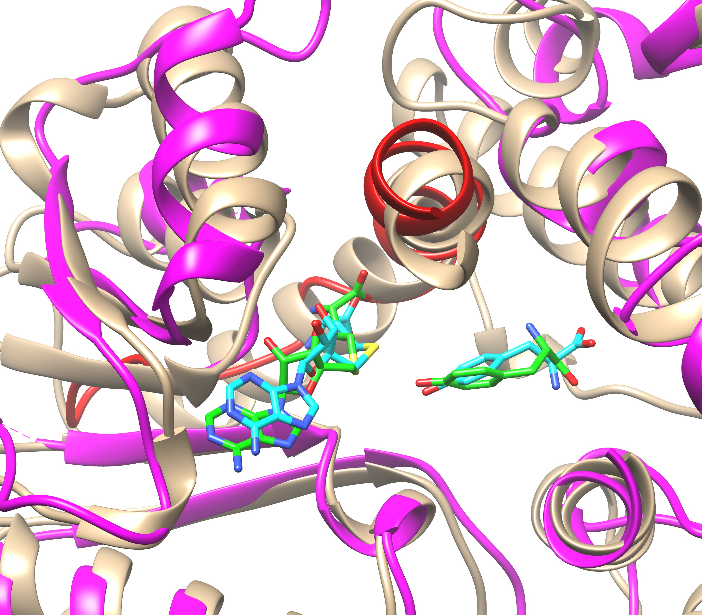
Low-quality protein structure still allows for good ligand prediction
T1124
Misalignment in the protein structure
bRMSD: 8.3 Å
Ligand: SAH
L-RMSD: 1.7 Å
Template: 4a6e
Ligand: TYR
L-RMSD: 1.9 Å
No template.
From docking

Slide 11
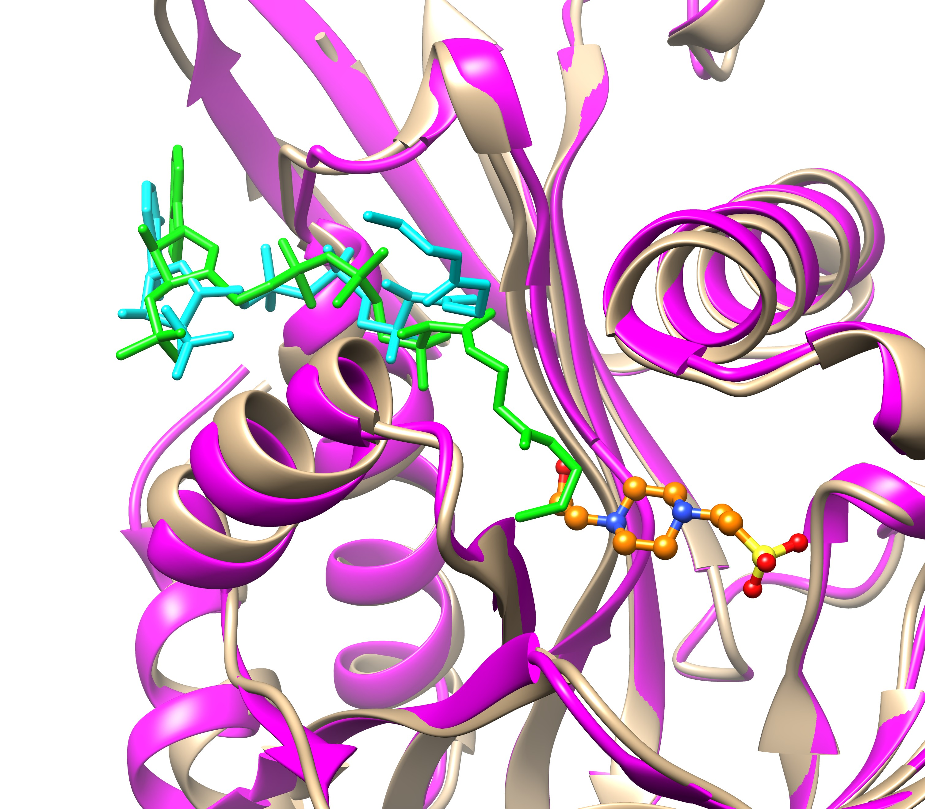
A missing cofactor ligand in the binding pocket leads to wrong prediction of a ligand fragment
T1127
Predicted
bRMSD: 1.2 Å
L-RMSD: 4.2 Å (largely due to the flexible tail)
Template: 3bj7
Crystal
This cofactor ligand, though present in the experimental structure, was not mentioned in the target and therefore was not considered during the prediction.
The cofactor blocks part of our docking site.

Slide 12
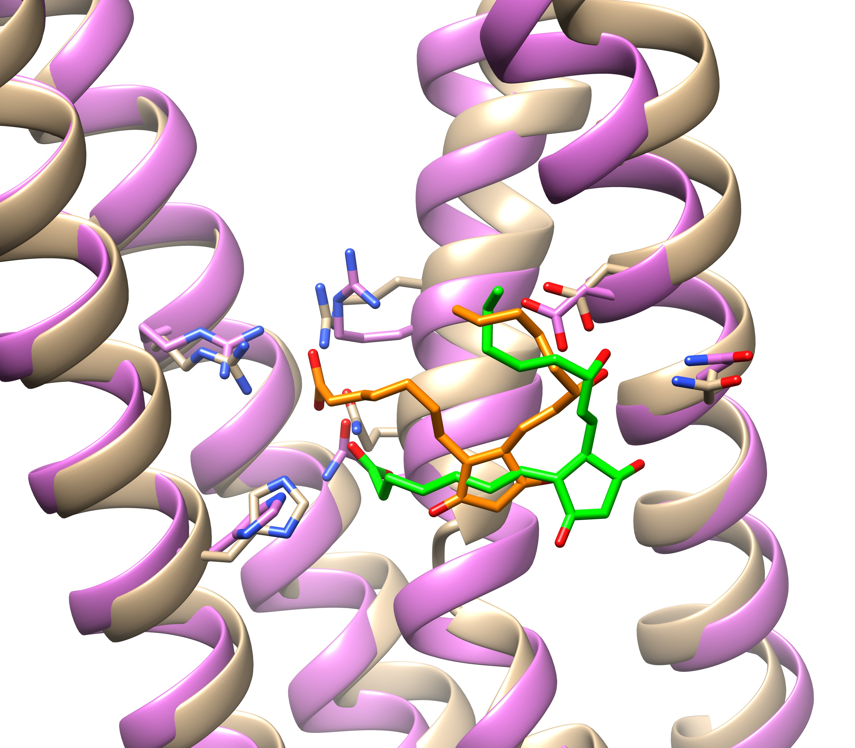
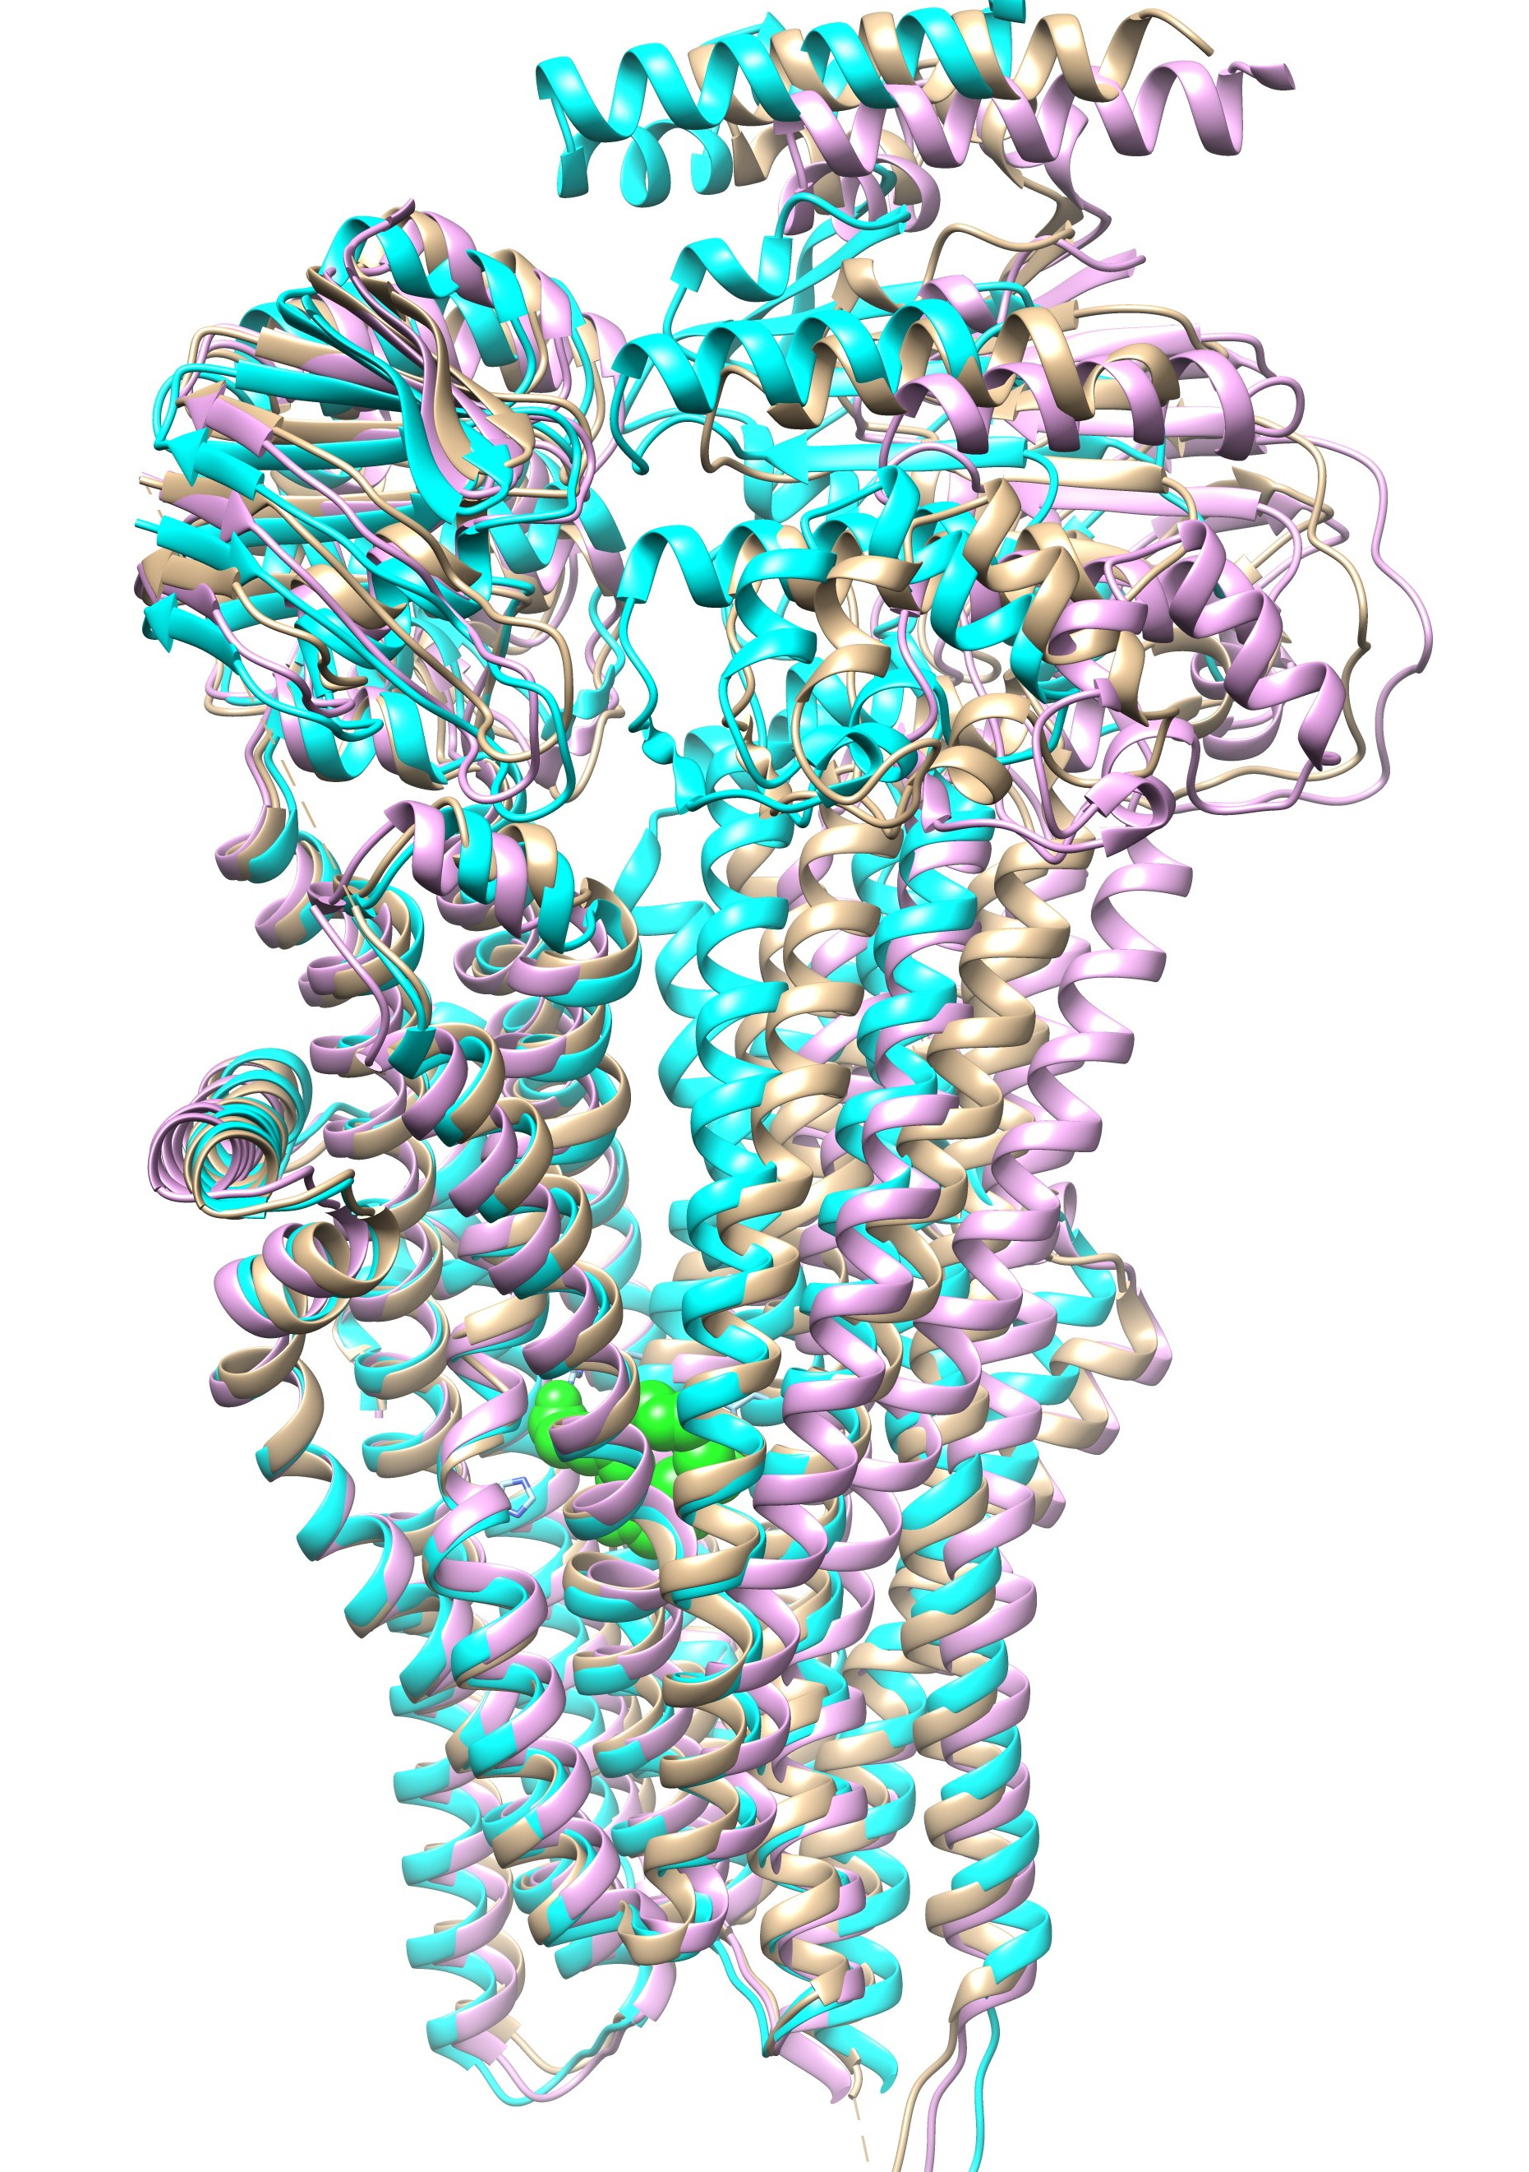
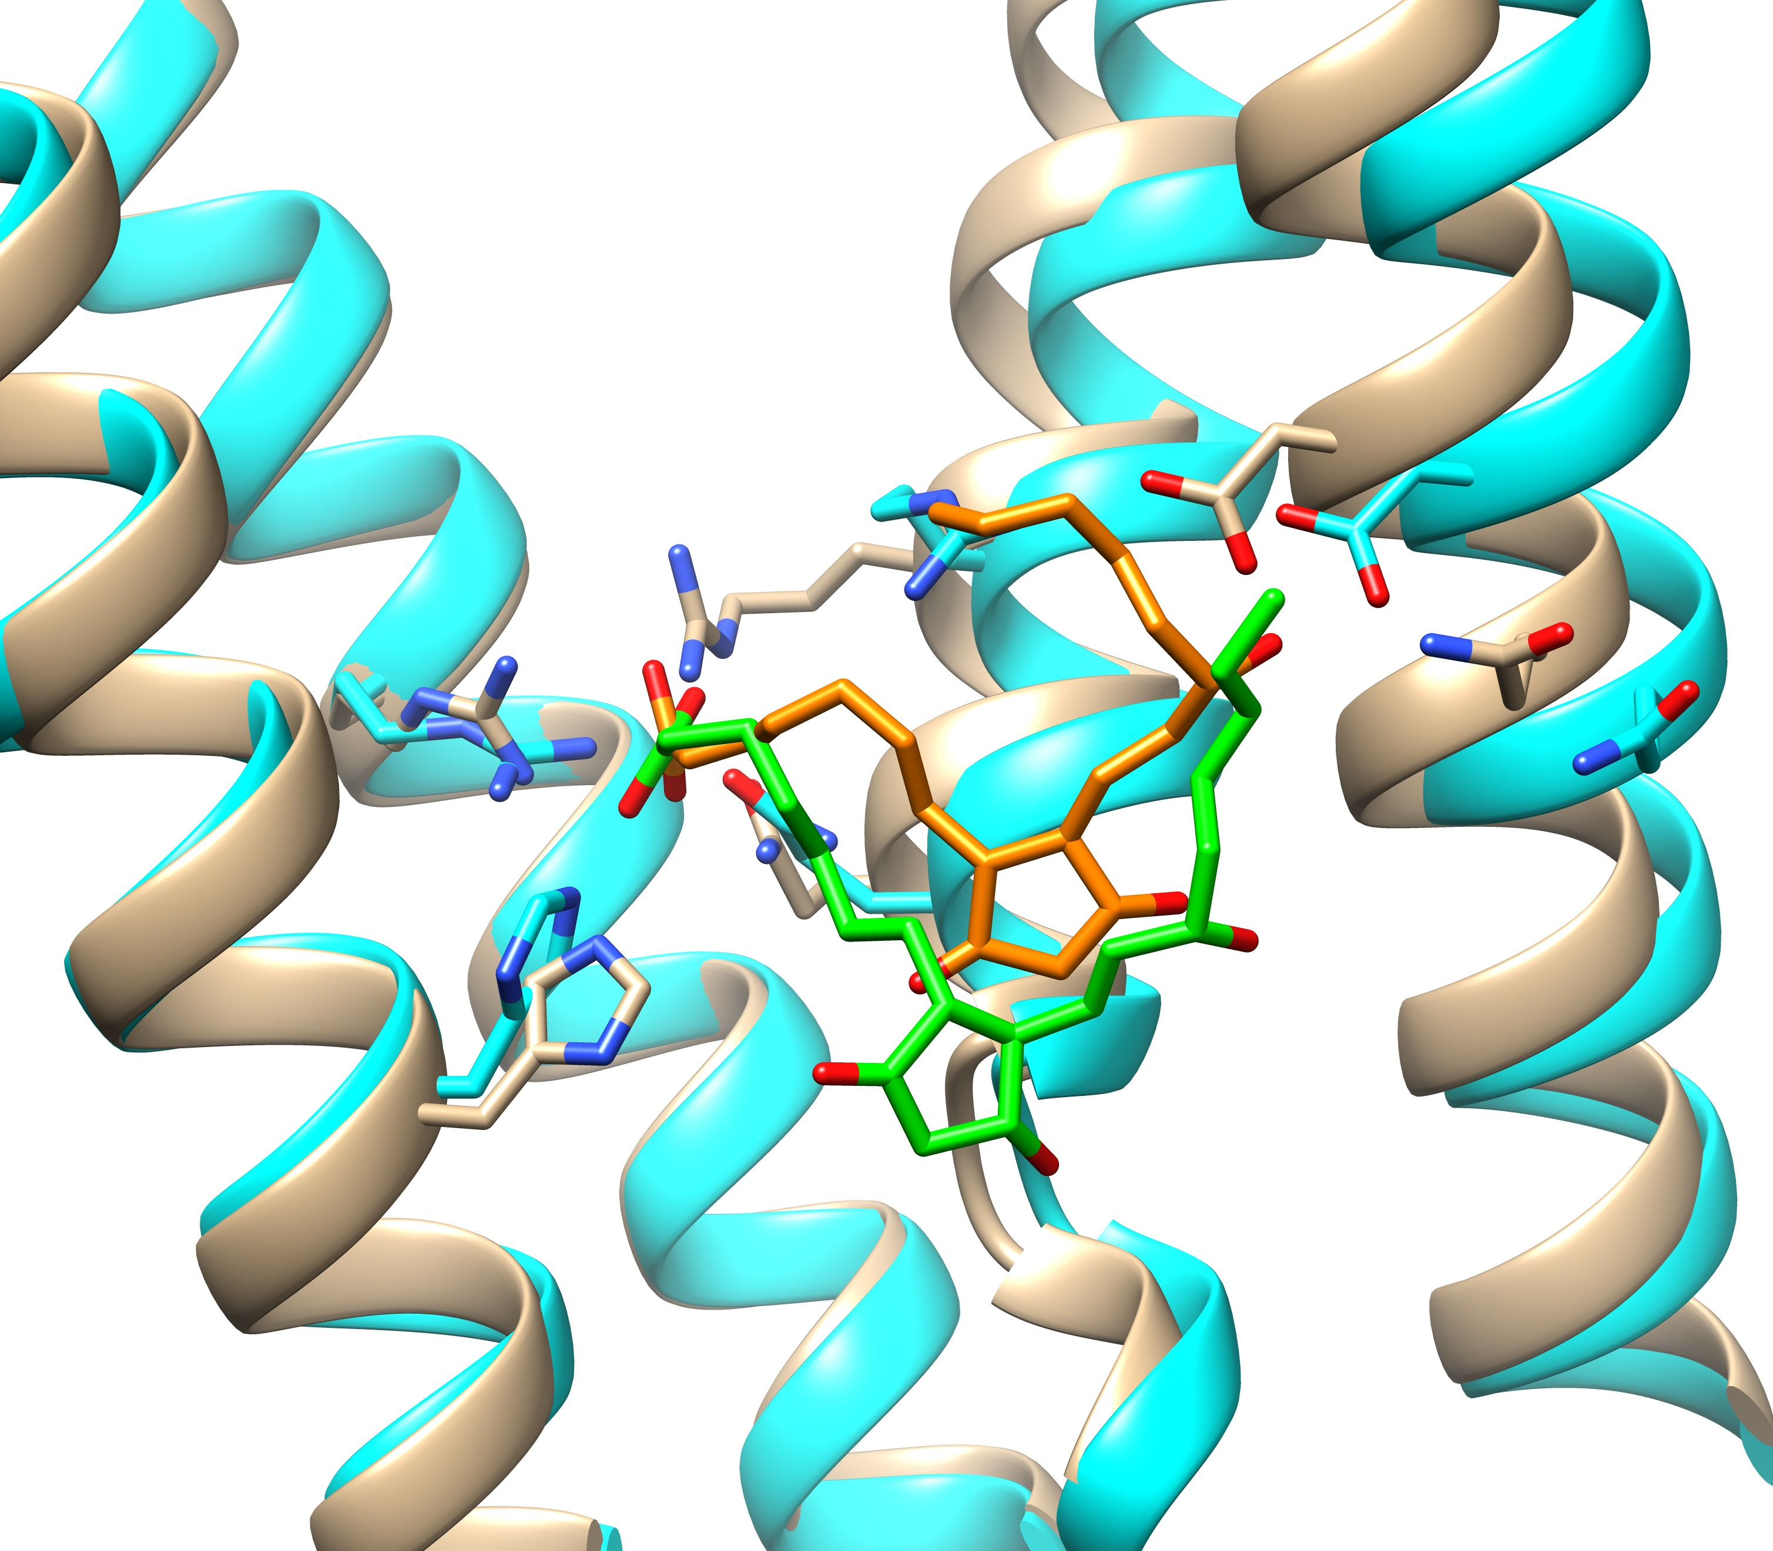
The conformation of the binding pocket is important
T1158
T1158v1: XPG
Protein model 1
(closed conf)
bRMSD: 4.5 Å
Prot-Lig model 2
hRMSD : 1.5 Å
L-RMSD: 3.3 Å
Protein model 2
(open conf)
bRMSD: 5.1 Å
Prot-Lig model 4
hRMSD : 2.6 Å
L-RMSD: 3.6 Å
Exp structure:
lie between these two models
Modeled protein structures were from Jianlin Cheng Lab
Similar results for T1158v2: P2E

Slide 13
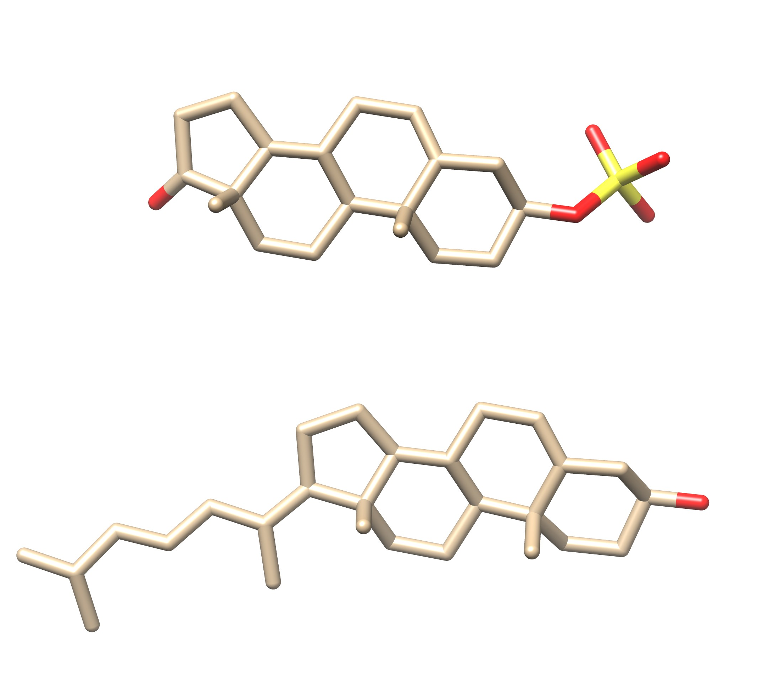
T1158v3: modeled on a wrong binding site
A misleading template
Target ligand: XH0
Binding locations in the predicted models
Template ligand from 6uy0
3D similarity:
SHAFTS score = 1.3
Binding location in the experimental structure
Can this ligand have multiple binding modes?
Template: 6uy0 (grey)

Slide 14
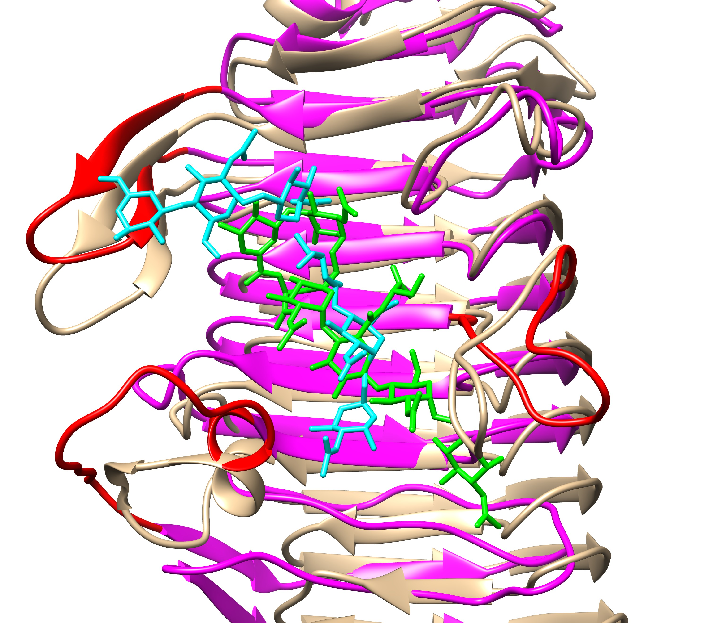
Flexible loops and Flexible ligand decrease the prediction accuracy
T1181: OAA
Challenges:
flexible loops + highly flexible ligand
Predicted ligand
Exp ligand
Exp protein: tan
hRMSD: 6.0 Å
L-RMSD: 8.1 Å
No template available.
from docking

Slide 15
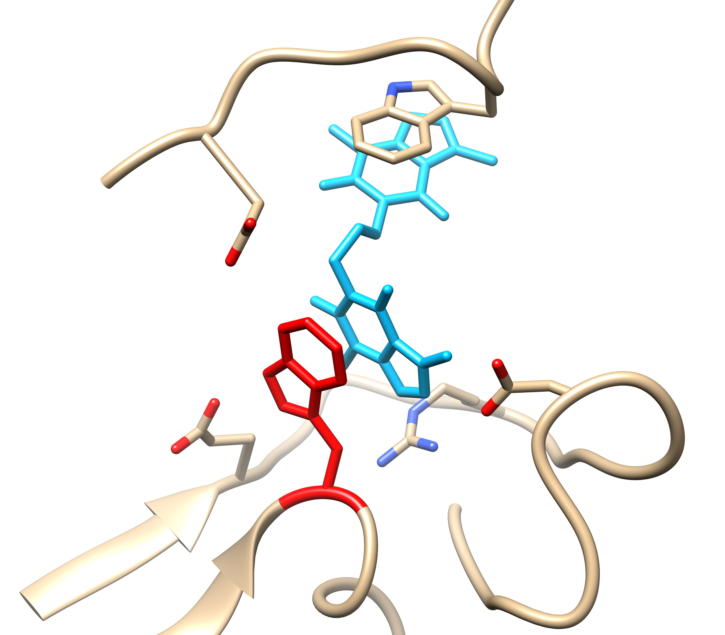
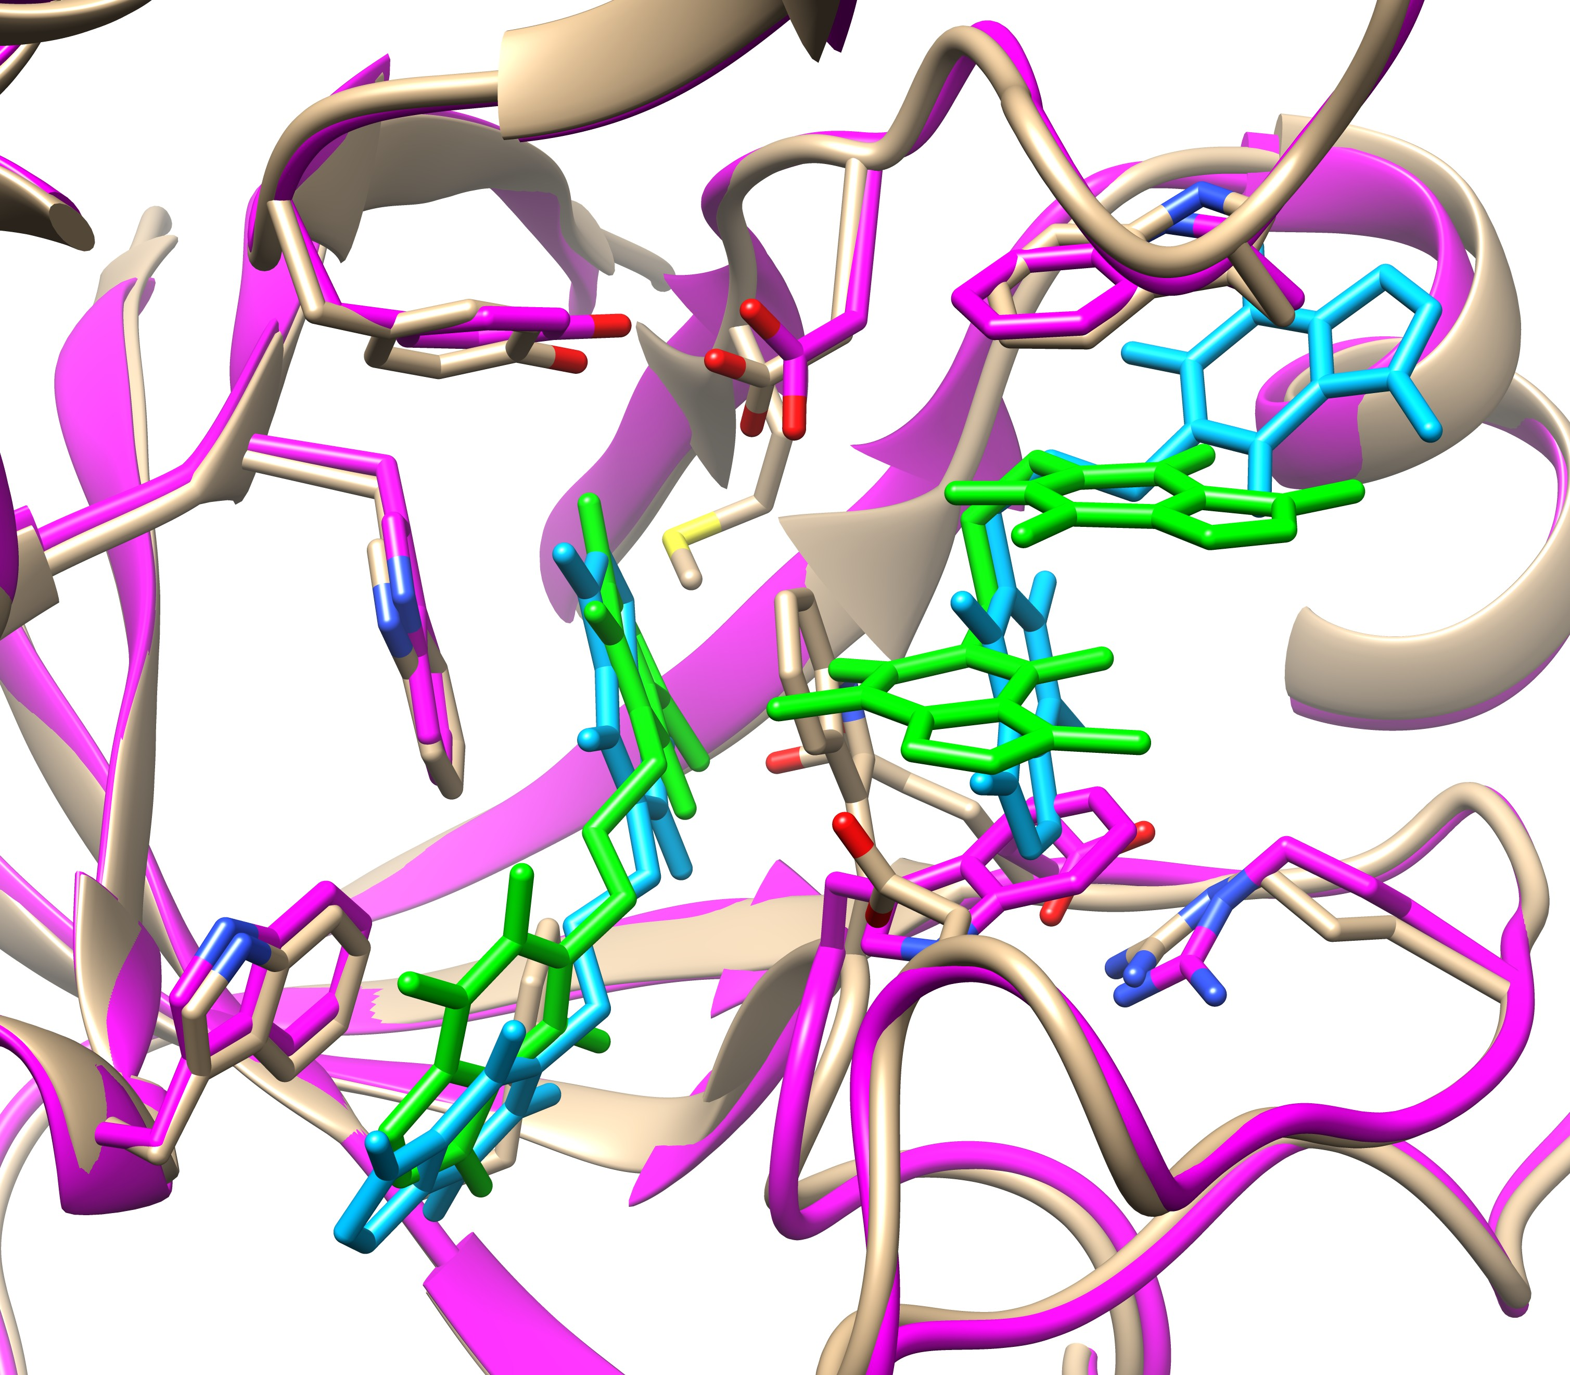
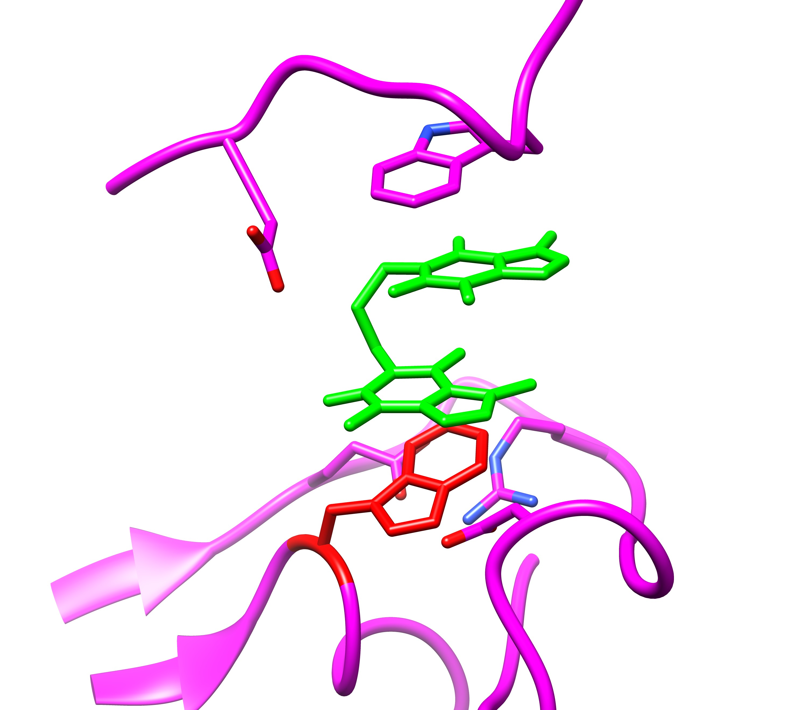
Side chain conformations are important
T1188: DW0
W120
expt
L-RMSD : 4.4 Å
predicted
W120
L-RMSD : 3.7 Å
hRMSD : 2.1 Å
Template 2ybt

Slide 16
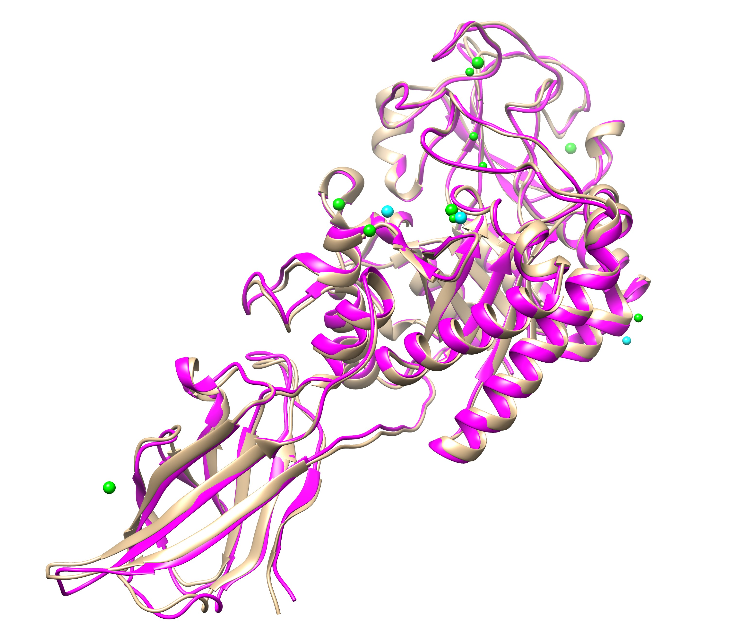
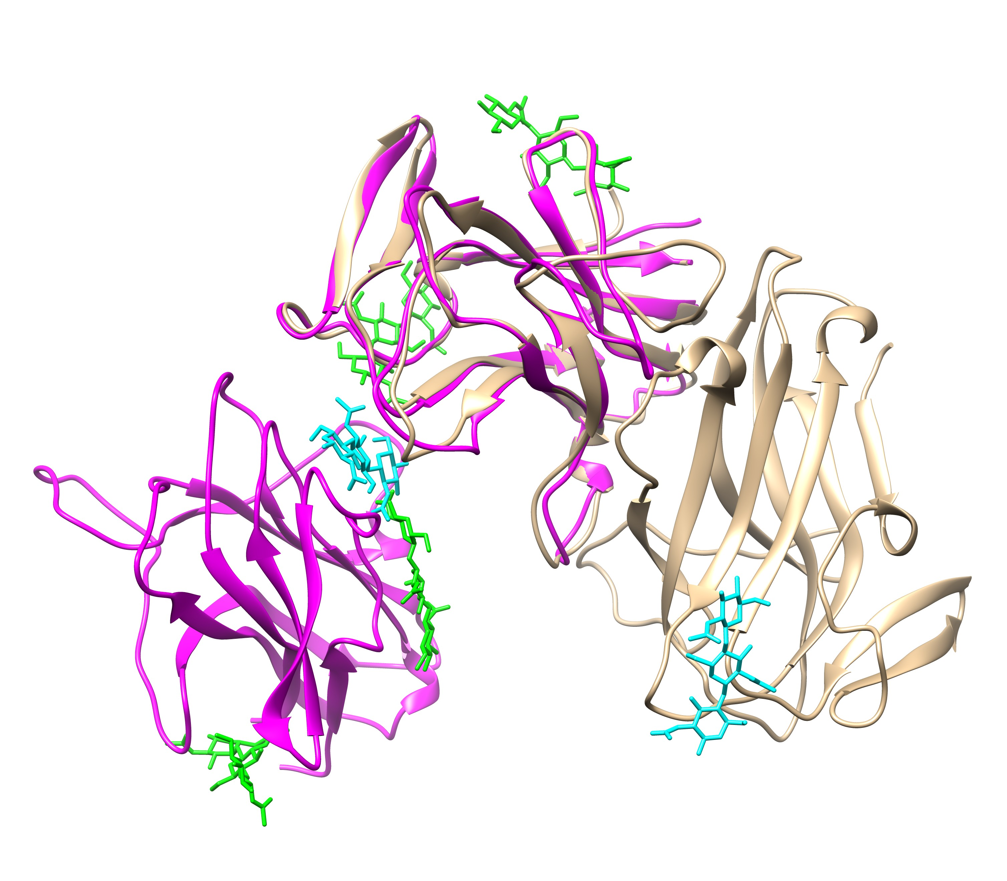
Other Cases
T1181: Zn²⁺ /Ca²⁺ ions
T1188: iron ions
T1187
The homodimer structure used for ligand docking was incorrect.
Correctly predicted only one binding location for three iron ions in one of the five models.
Experimental structures: proteins (tan), ligands (cyan)
Predicted structures: proteins (magenta), ligands (green)

Slide 17
Lessons we have learned
AlphaFold2 provides helpful protein structures for protein-ligand structure prediction.
Protein conformations, especially the conformations of the binding pockets (including the sidechain conformations), are important to protein-ligand complex structure prediction.
Predictions benefit from template structures.
Template structures sometimes mislead the predictions (e.g., T1158v3 and T1188).
Challenging cases: large conformational changes in binding pockets; highly flexible ligands; multiple ligands in a pocket; binding locations of ions

Slide 18
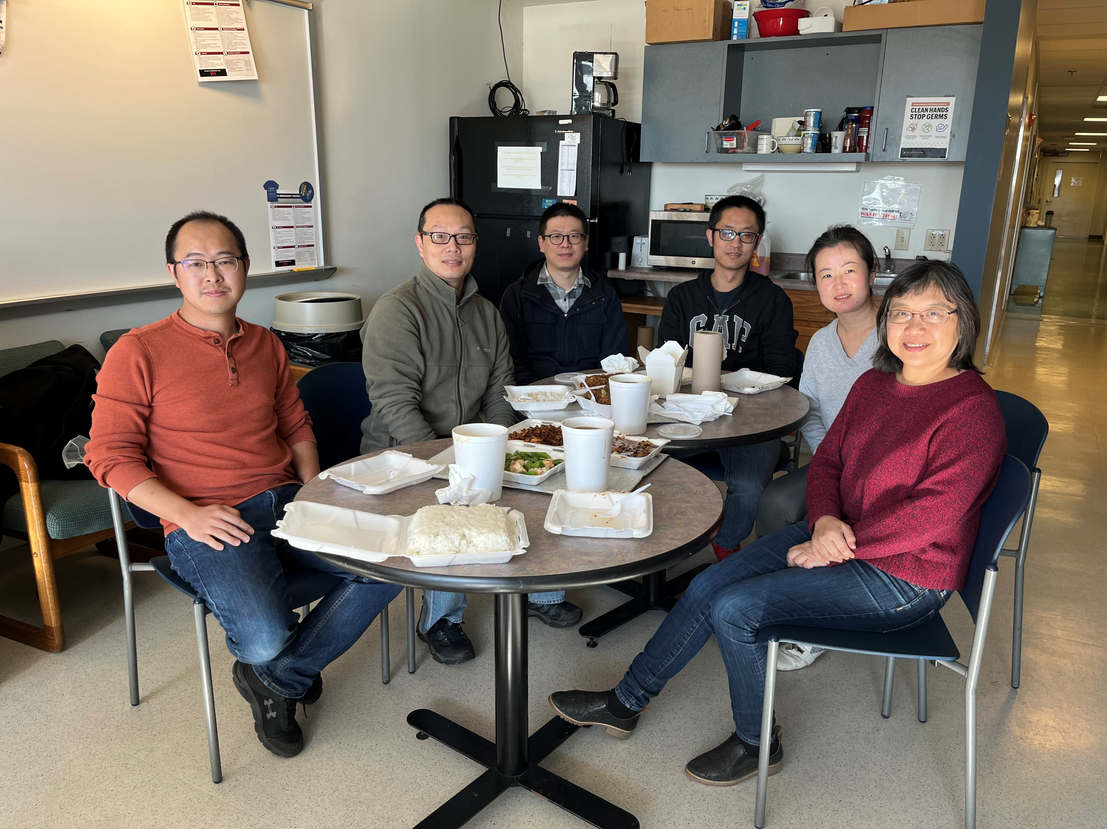
THANKS FOR YOUR ATTENTION!
Protein-ligand prediction:
Dr. Xianjin Xu
Dr. Rui Duan
Protein-protein prediction: Dr. Rui Duan
Dr. Liming Qiu
Dr. Xianjin Xu
Jianlin Cheng lab
Univ. of Missouri - Columbia
OpenEye Scientific Software
Zou lab: http://zoulab.dalton.missouri.edu/
Supported by NIH [R35GM136409 (PI), R01GM109980 (PI), and R01HL142301(co-I)].

