Slide 1
Tertiary/Quaternary
round table

Slide 2
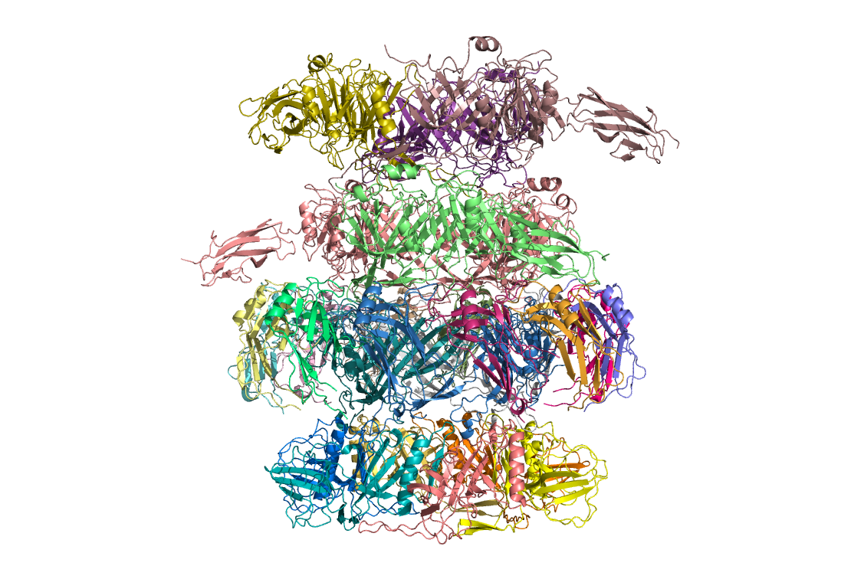


Chain mapping problem of CASP14 is solved:
Heterogenous chain content!
  Combinatorial chain mapping problem
Gabriel Studer
(chain mapping & DockQ calc.)

Slide 3
MSAs
Best practice?
Pairing
Database compilation. Public/private?
Singletons? pLMs?
Modifying
Resource implications. Cost/benefit
Notes:
Will we always be dependent on Neff
Also disorder

Slide 4
Model sampling and selection
DL vs geometry scoring
Best practice?
Resource implications. Cost/benefit
Subcomplexes of heterooligomers
Notes:
Will we always be dependent on Neff

Slide 5
Human vs machine
Humans redundant?
How to automate human contribution
Notes:
Will we always be dependent on Neff

Slide 6
Physics
Refinement
Weak binding
TM proteins
Notes:
Will we always be dependent on Neff

Slide 7
Structural biology
MR
Targets to drive future development
refinement
amyloid etc?
Notes:
Terwilliger preprint on AF2 vs xtal structure in different space group. Bigger point AF2 vs structural biology. SB to validate AF2 etc.
Just do more jellybody, don’t

Slide 8
Back to the future
‘Hybridise’ with earlier methods
Notes:
Will we always be dependent on Neff

Slide 9
templates
Notes:
Will we always be dependent on Neff

