Slide 1
Special Interest Group Discussion:
Intrinsically disordered proteins
Live agenda (please contribute):
https://shorturl.at/aoqAH
D. Piovesan
CASP15
Antalya, Turkey
Dec 11, 2022

Slide 2
CASP Communities
Agenda: shorturl.at/aoqAH
Organizers
Assessors
Data providers (experimental community)
  large, heterogeneous
  Interested in CASP?
Developers (computer scientists)
  Need a simple explanation of the problem
  Easy access to the training data

Slide 3
New challenges
Agenda: shorturl.at/aoqAH
Requirements
Data are generated for a number of years
Data are kept on hold for two years?
Large dataset

Slide 4
Organization
Agenda: shorturl.at/aoqAH
Seminar series (online)
Conferences
…

Slide 5




Agenda: shorturl.at/aoqAH

Slide 6
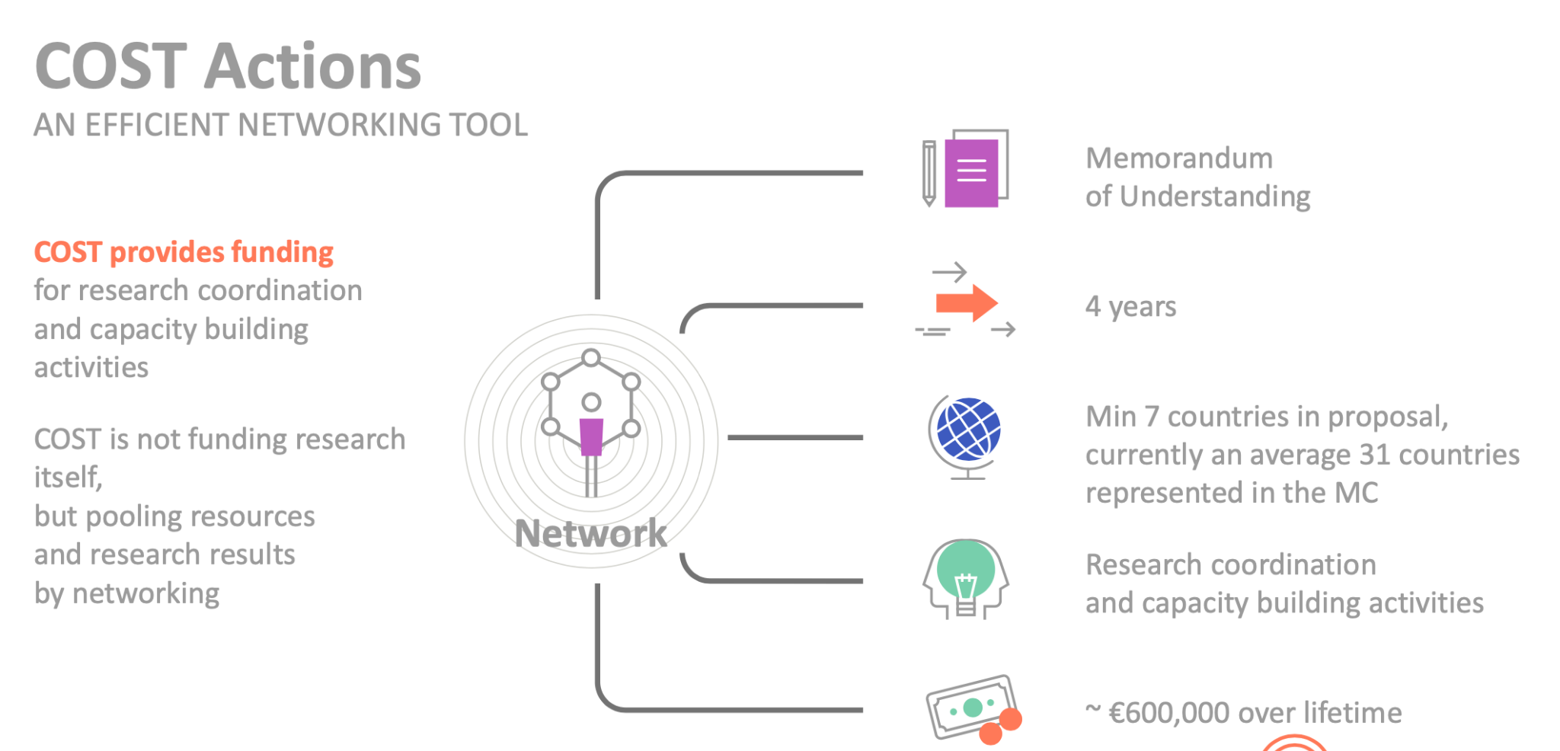

Agenda: shorturl.at/aoqAH
Notes:
A COST Action is an interdisciplinary research network that brings researchers and innovators together to investigate a topic of their choice for 4 years.

Slide 7
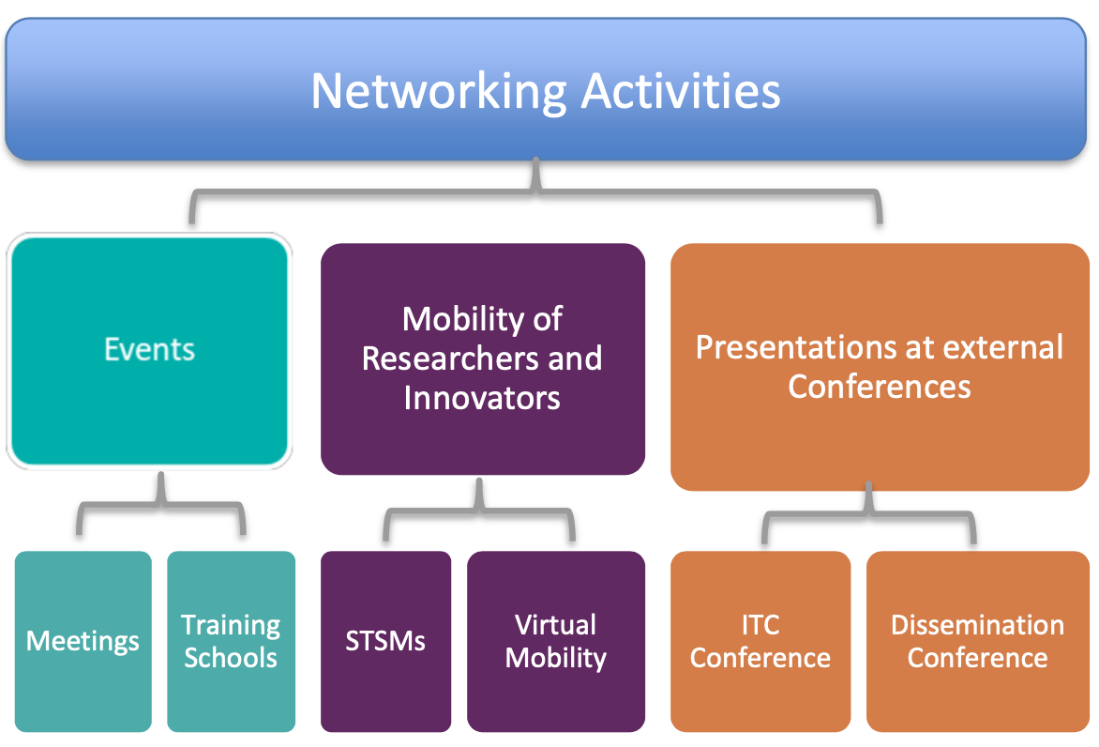
What can be funded by COST?
Agenda: shorturl.at/aoqAH
Notes:
Inclusiveness Target Countries (ITC)

Slide 8
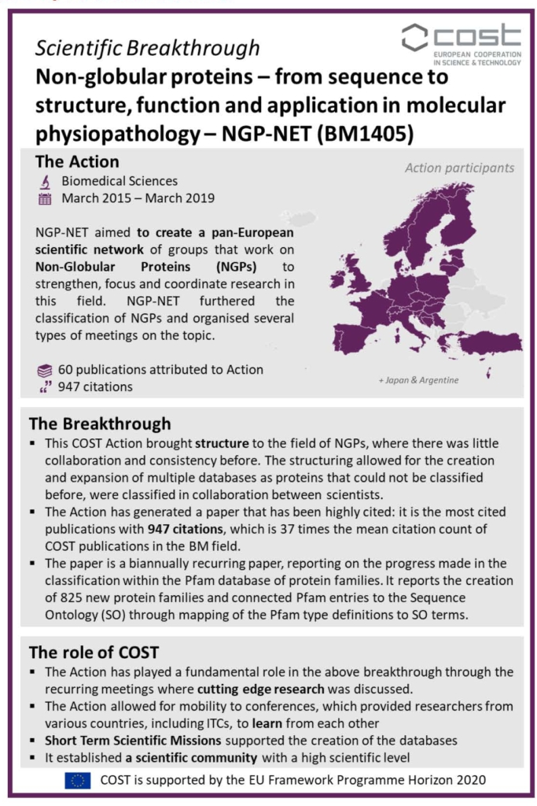
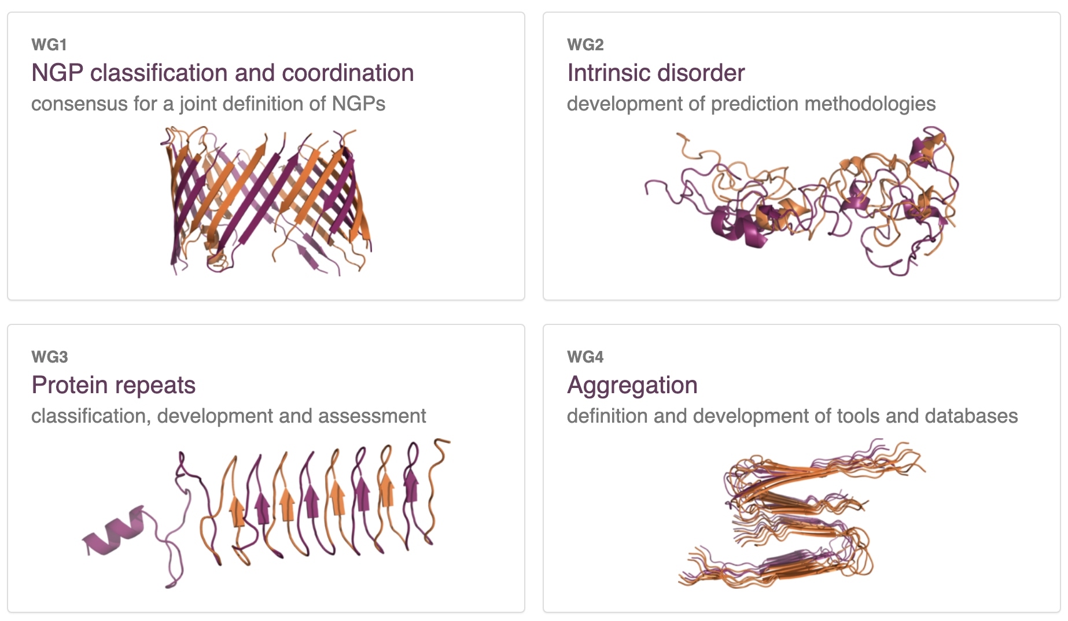
NGP-net
Agenda: shorturl.at/aoqAH
~245 researchers
https://www.cost.eu/the-breakthrough-series-non-globular-proteins/

Slide 9
Working groups
Agenda: shorturl.at/aoqAH
NGPs primary experimental data generation, curation and deposition
Machine learning and NGP structural biology
Assessment of state-of-the-art ML predictors and methods in the NGP field
Improve functional characterization of NGPs
Communication, dissemination and exploitation

Slide 10
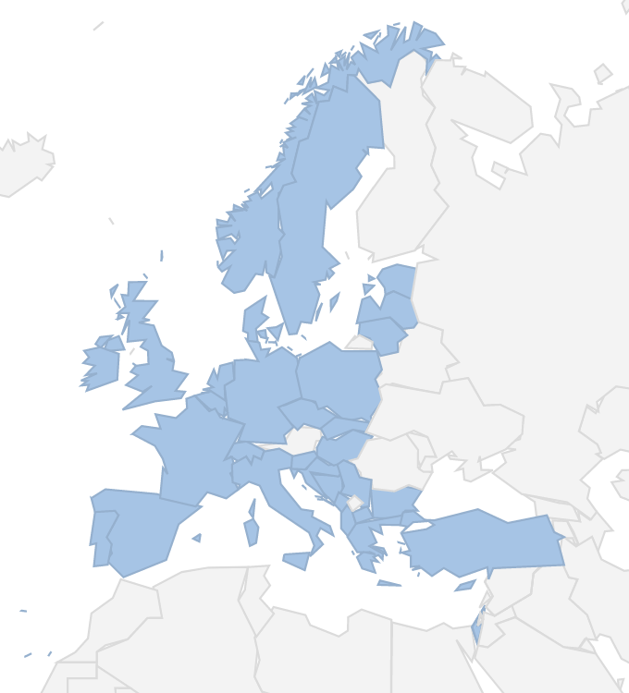
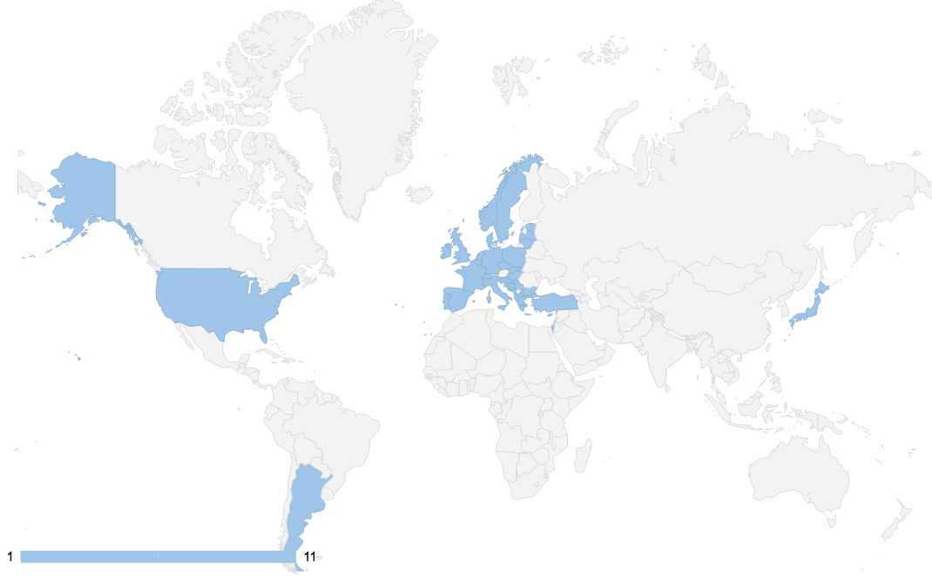
MC members
56 people
33 COST member countries
18 ITC countries
WG applications
108 candidates
30 different countries (17 ITC)
56% males and 44% females
48% young investigators
Notes:
Add Austria
Gender balance
ITC countries
Stakeholders
etc

Slide 11
Core Group
Agenda: shorturl.at/aoqAH
Working Group Leaders
WG 1 Pavel Karedavek, CZ
WG 2 Zsuzsanna Dosztányi, HU
WG 3 Jovana Kovacevic, RS
WG 4 Gonzalo Parra, ES
WG 5 Rita Vilaça, PT
Grant Awarding Coordinator
Darius Šulskis, LT
Science Communication Coordinator Rita Vilaça, PT
Chair
Alexander Monzon, IT
Vice Chair
Zuzana Bednarikova, SK
Grant Holder Scientific Representative
Silvio Tosatto, IT
Notes:
– those positions shall be filled in by election of the MC as per article 3.5 at the first Management Committee (MC1) meeting,
Note: Leaders that are not MC members will be automatically approved WG members

Slide 12
Scientific Advisory Board (SAB)
Agenda: shorturl.at/aoqAH
  Silvio Tosatto (IT)
  Andrey Kajava (FR)
  Miguel Andrade (DE)
  Sonia Longhi (FR)
  Christos Ouzounis (EL)
  Sandra Macedo Ribeiro (PT)
  Salvador Ventura (ES)
  Peter Tompa (BE)
Notes:
In the Memorandum of Understanding of this COST we have proposed to have a Scientific Advisory Board (SAB) formed by Experienced Researchers (Experts in the field) participating in the Action. The SAB will advise the Action Chair and WG leaders, providing feedback based on discussion at Action events. This means that SAB members will also have the possibility to attend our yearly meetings and be reimbursed by COST.

Slide 13
Next meeting
Agenda: shorturl.at/aoqAH
Prague, 4-8 May 2023
Prague Protein Spring (4-7 May)
https://www.pragueproteinspring.cz/scientific-program (to be updated)
NGP4ML Workshop (7-8 May)
https://www.cost.eu/actions/CA21160/

Slide 14
John Jumper’ open questions
Agenda: shorturl.at/aoqAH
How are we going to interface with all the sparse experimental data that biologists have?
  E.g. how do we use chemical cross-linking?
What is the role in interpreting cryo-ET data
Can we say anything useful about mutation effects that shift populations?
How can we handle PTMs and associated state changes? The data will be sparse

