Slide 1
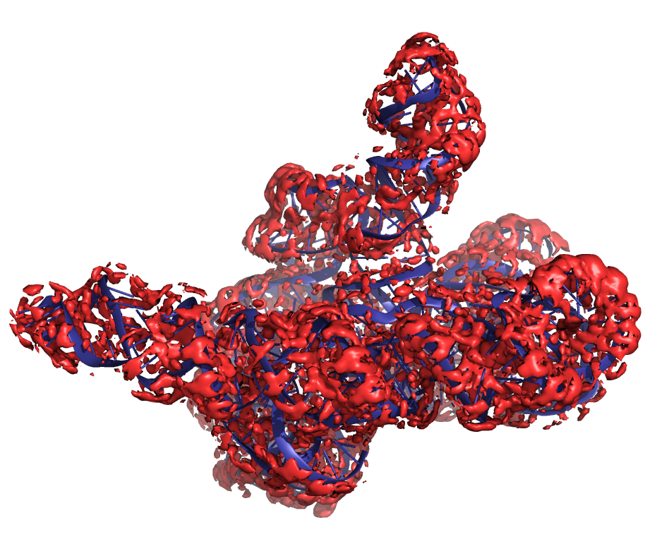
RNA water/ion Assessment
R1260 CASP16
Rhiju Das, Rachael Kretsch
4 December 2024
R1260TS391

Slide 2
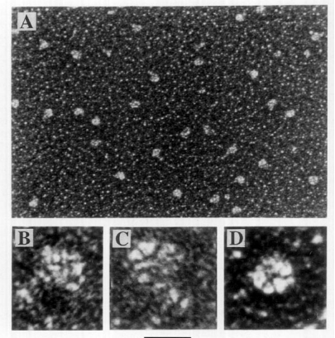
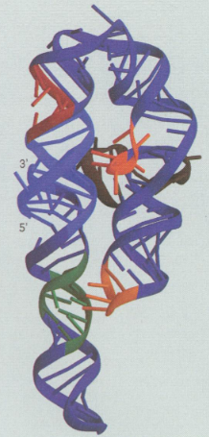
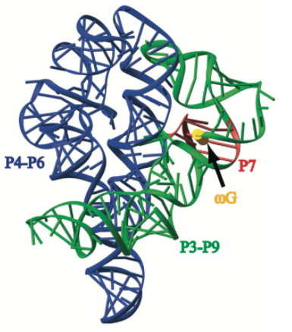
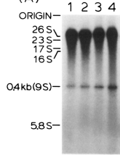
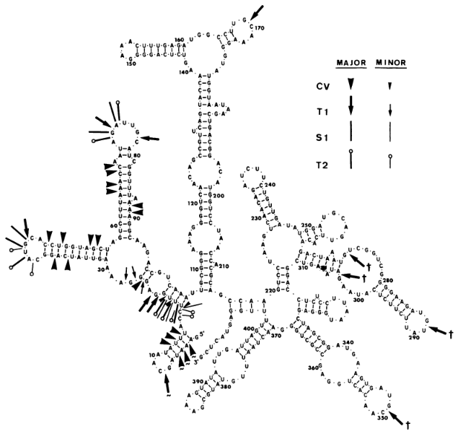
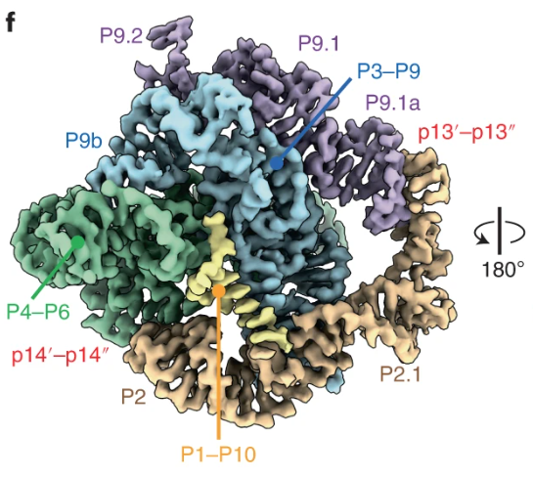
Tetrahymena ribozyme – well known RNA fold
time
ThR
Cech et al 1983
Guo et al 2004
In vitro transcribed RNA
Zaug and Cech 1980
Cate et al 1996
Wang et al 1994
Kappel et al 2020
Liu et al 2022
Su et al 2021

Slide 3
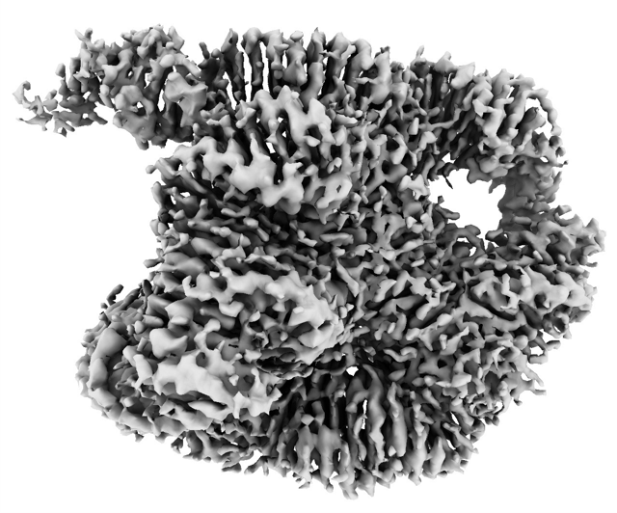
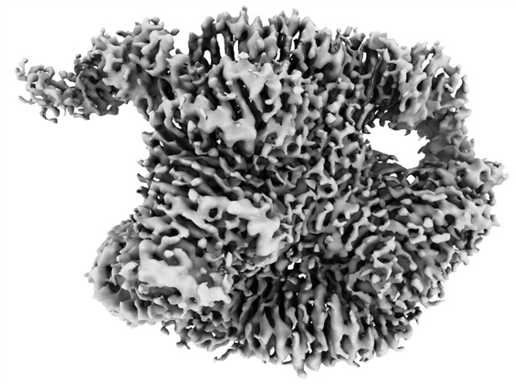
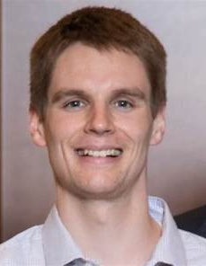
High resolution cryo-EM data
map A :2.2 Å
map B: 2.3 Å
Wah Chiu
Kaiming Zhang
Michael Palo
Shanshan Li

Slide 4
High resolution cryo-EM data
Map A
Map B

Slide 5
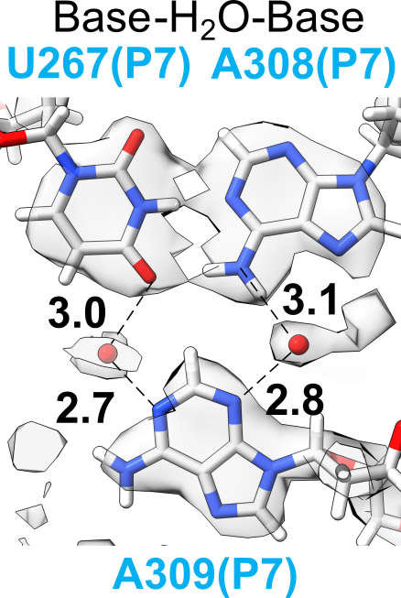
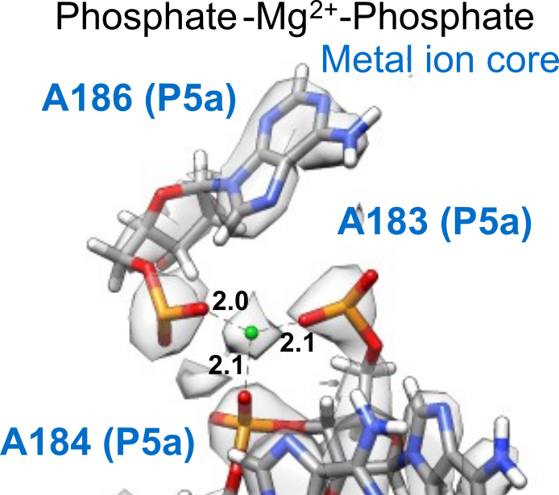
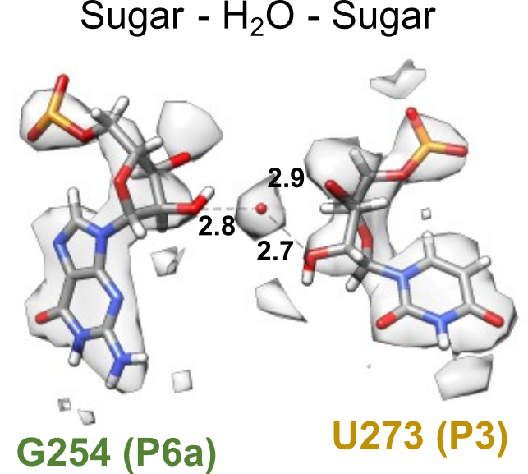
Modeling water and ions - peaks in density (SWIM)
Greg Pinitlie

Slide 6
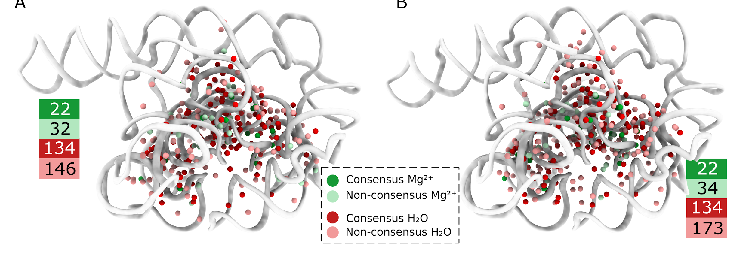
Modeling water and ion - consensus is low?
Model A
Model B
Why?
Cryo-EM specialists - different structure
RNA specialists - noise in data

Slide 7
Why is consensus low?
Map A
Map B
Modeled magnesium ion
Modeled water
Cryo-EM density

Slide 8
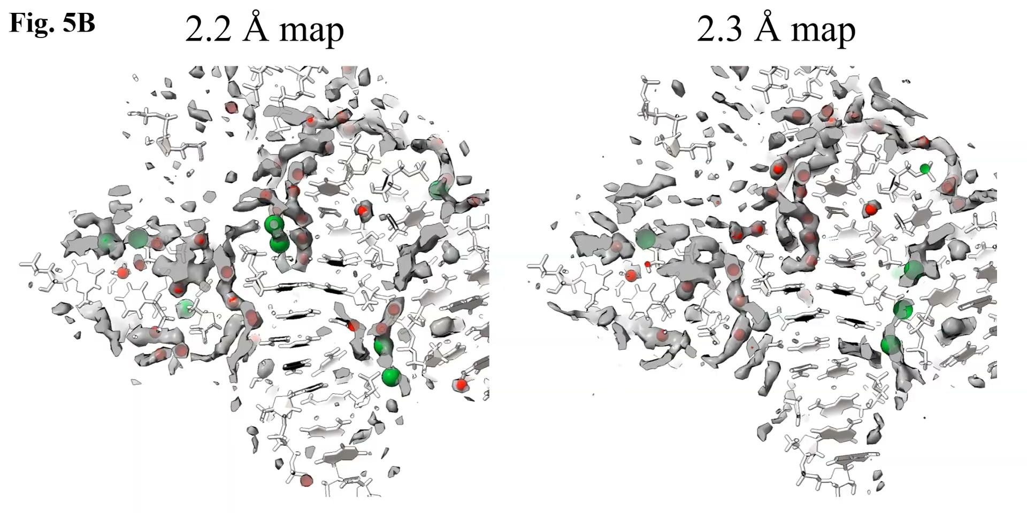

Slide 9
Water+ion ensembles - target
Map A
Map B
Modeled magnesium ion
Modeled water
Cryo-EM density
Predicted magnesium ion density
Predicted sodium ion density
Predicted wat density

Slide 10
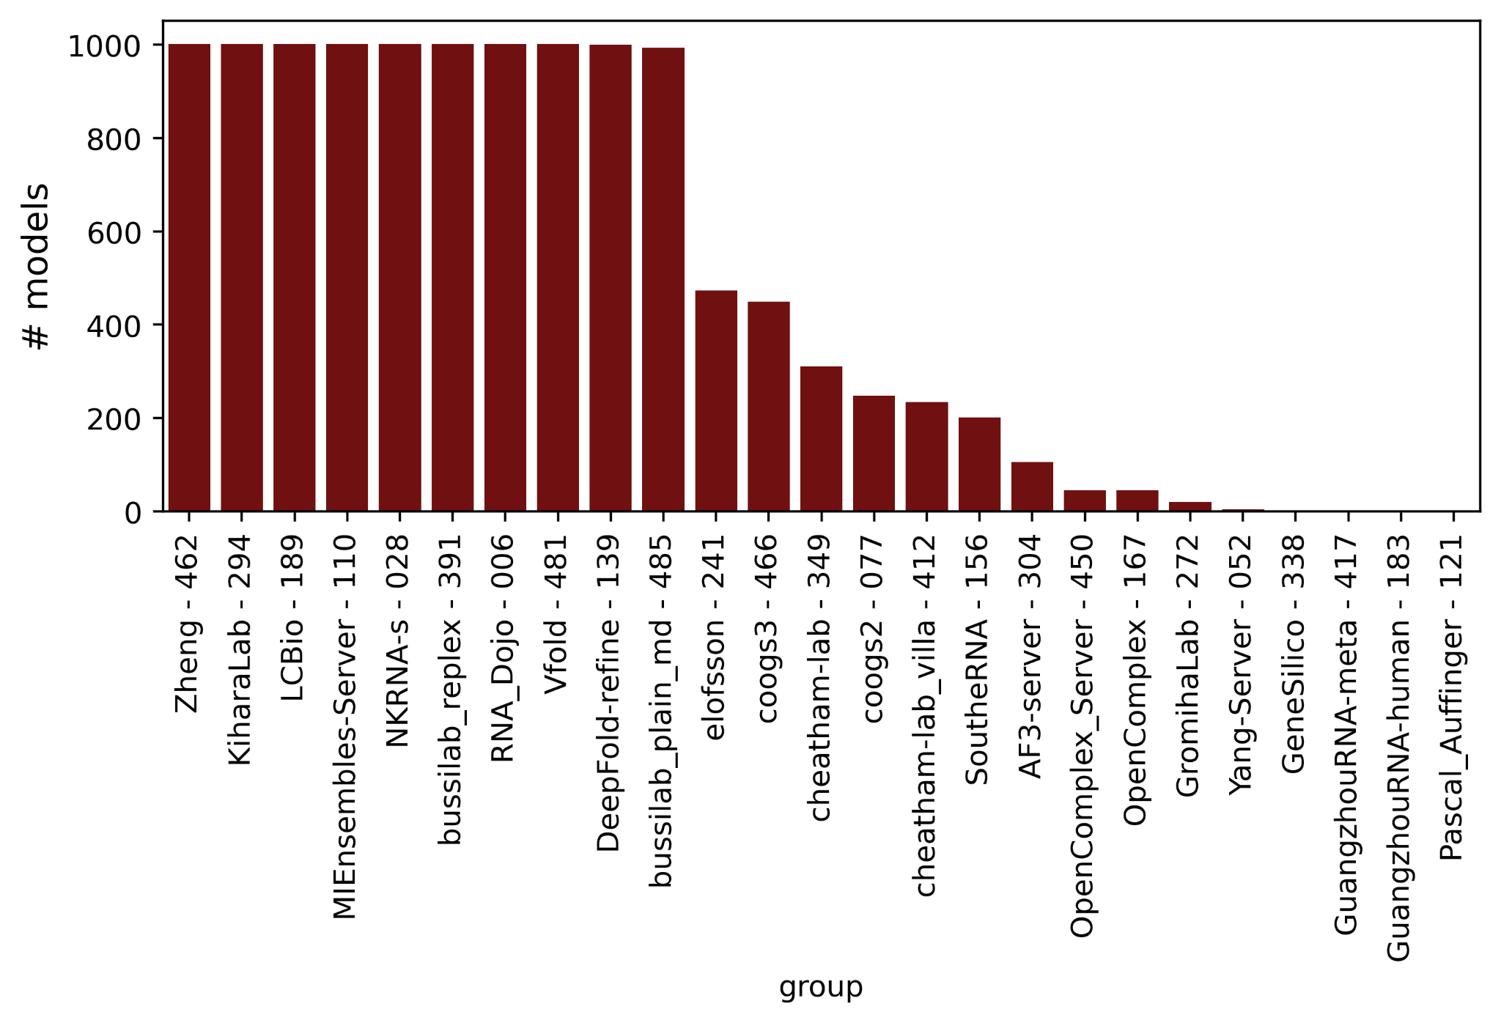
The challenge
Predict ensemble with solvent shell out to 5 A
Assume no large dynamics - <4 A RMSD from 7EZ0
Told experimental buffer conditions, freezing conditions, resolution
Local alignment + map comparison
360k atoms
Notes:
Predictors are invited to submit an ensemble of conformations of this RNA with the solvent shell. The structure of the local solvent shell (water and ions) will be compared against cryo-EM data. We provide the following experimental information. These samples were folded and frozen in a solution of 50 mM Na-HEPES pH 8.0 and 10 mM MgCl2. The sample was folded for 30 min at 50°C, incubated at room temperature for 10 min, and then placed on ice. The sample was frozen on Vitrobot Mark IV with 4 s blot time, 4°C, and 100% humidity using liquid ethane as cryogen. A total electron dose of 57.25 electrons per Angstrom squared was used during data collection. The cryo-EM maps are 2.2 and 2.3 Angstrom according to gold standard FSC and were auto-sharpened using PHENIX. We require, for each conformation, that the RNA coordinates be present and that you submit at least a 5 Angstrom shell of water and ions. Larger solvent shells are allowed but may not be assessed. The RNA conformation may change across the frames. The RNA motion will not be assessed but the predictors are welcome to submit RNA of different conformations. Predictors can assume that the RNA conformations are similar to 7EZ0 (eg. <4 Angstrom RMSD). During assessment these models will be locally aligned before comparing solvent structure. The main assessment will be on the local water and ion structure surrounding each RNA region, based on local alignments compared to experimentally determined high-resolution maps. Given experimental uncertainty in some regions, the solvent structure around the following residues will not be assessed: 42-67, 208-224, 263-274, 311-314, 343-381 (7EZ0 numbering: 63-88, 229-245, 284-295, 332-335, 364-402). To reduce file size, please remove all hydrogen atoms. Please submit as a set of PDB files, these should be tarred, gzipped, and uploaded as one archive file through https://predictioncenter.org/casp16/predictions_submission_WATER.cgi. To create an archive, please run: tar -czf R1260TS234.tgz ./Folder_with_R1260_models. Archive file names should combine the target name R1260 and the group name (234 in the provided example). Names of individual models inside the archive should follow the CASP model naming scheme, e.g. R1260TS234_1, where _1 is the model number. You may submit up to 1,000 conformations, with a suggested minimum of 10. We will assume equal weighting of all models in the ensemble; you may repeat conformations in the ensemble if you wish to give those conformations greater weight.

Slide 11
Converting predictions to densities
1. Parse each RNA water – solvents
5. Score and visualize
4. Piece together local density to global density map
2. For each residue, locally align to native neighborhood (10 Å)
3. Combine all models for group and create a local density map

Slide 12
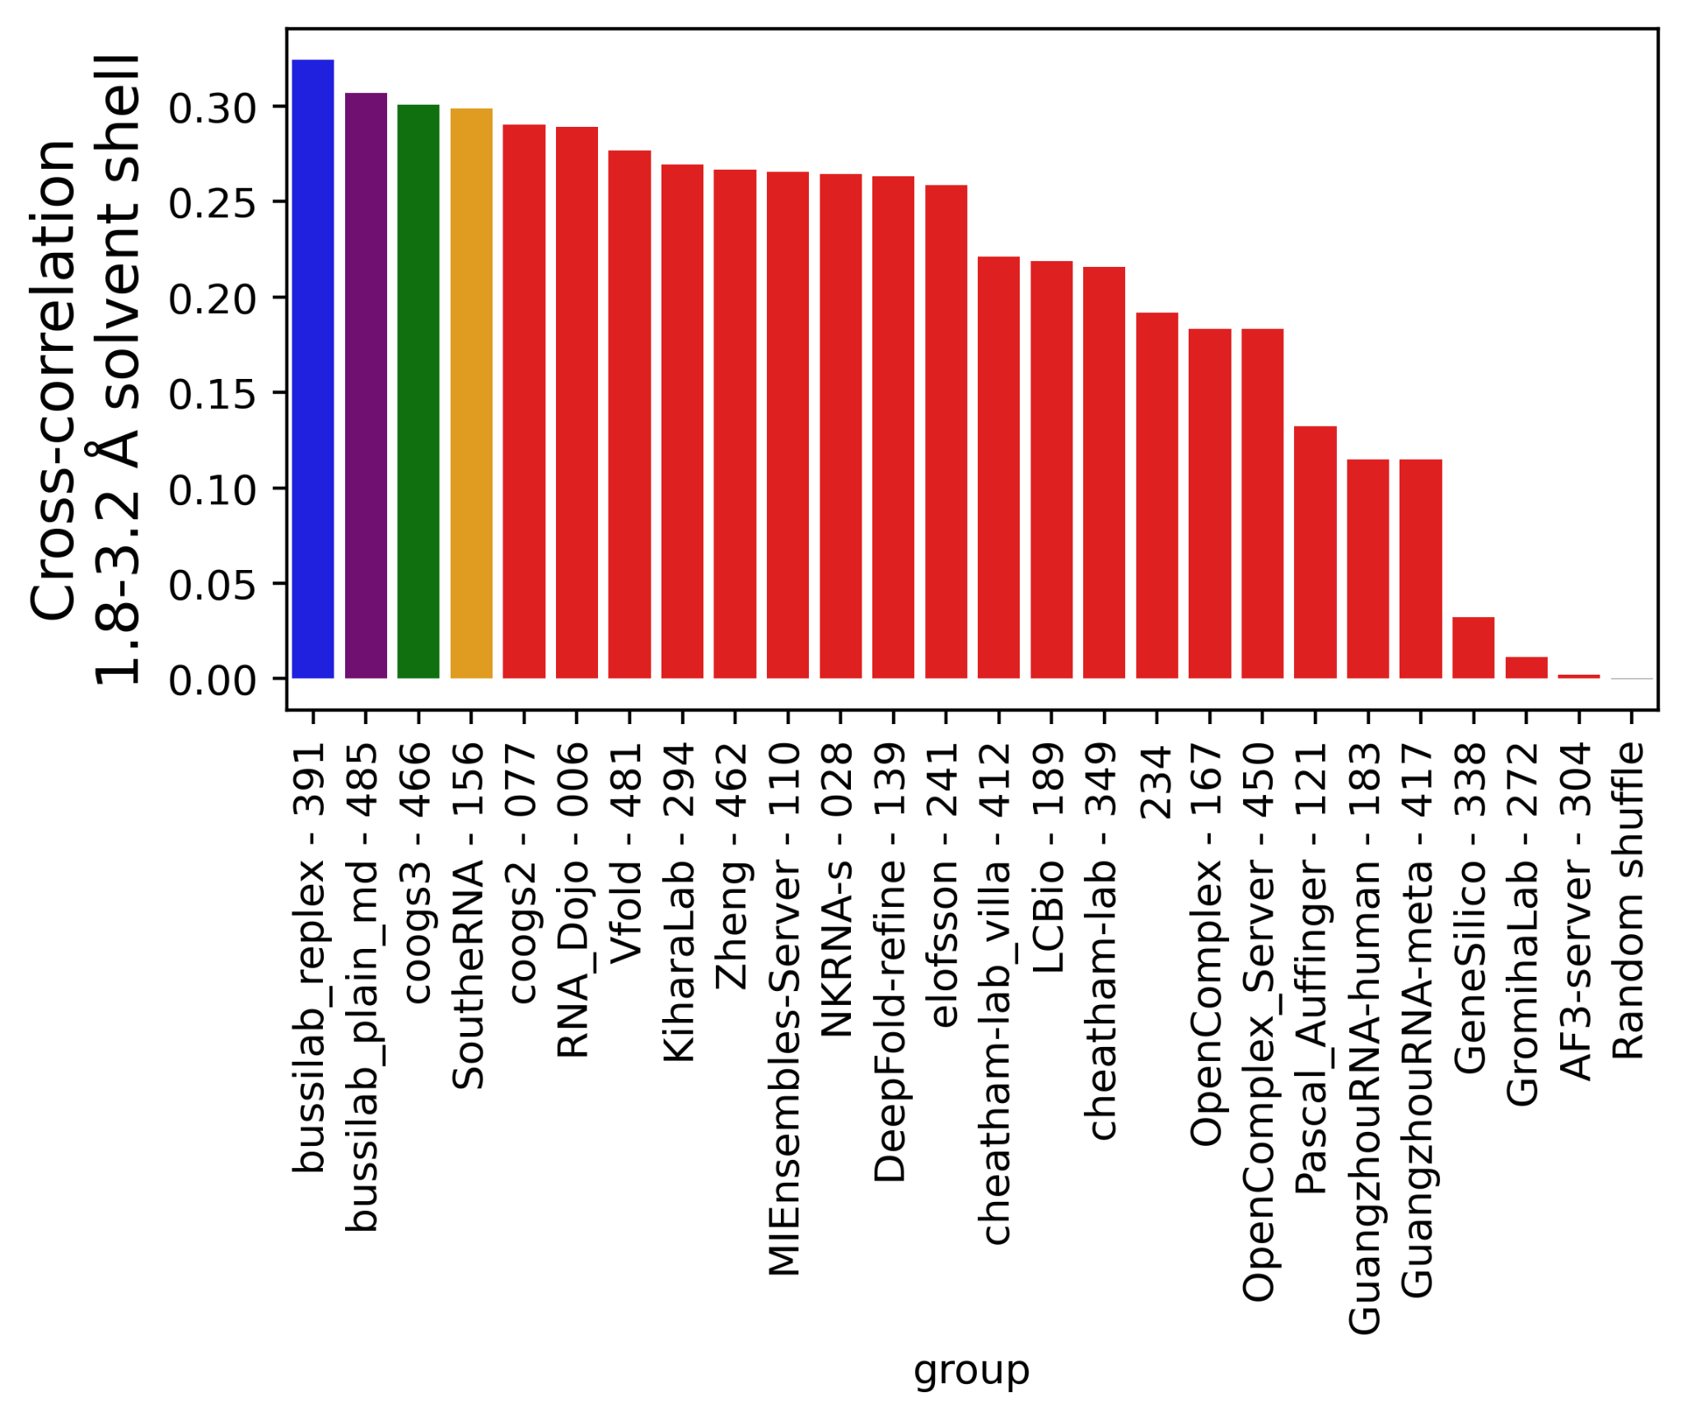
Results - Cross correlation
All MD based methods
Ranking robustness:
Radius of shell
relative scattering water/Mg/Na...

Slide 13
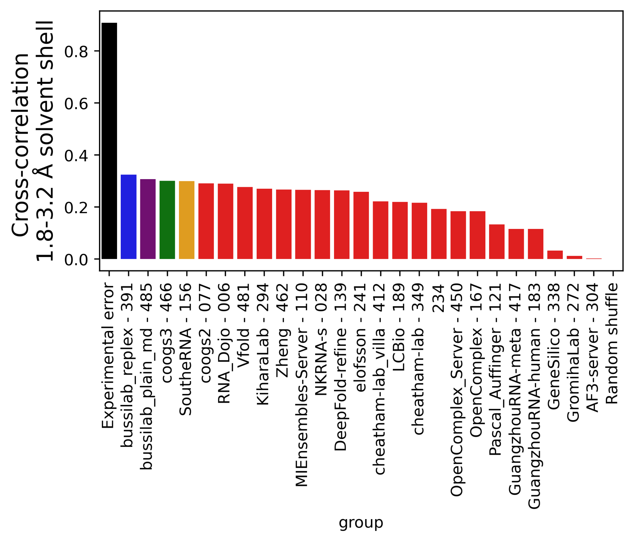
Results - Cross correlation
All MD based methods
Ranking robustness:
Radius of shell
relative scattering water/Mg/Na...

Slide 14
Results - local corrections
Diffuse density between backbone
Experimental
Bussi lab Replex - 391
SouthRNA - 156
better near U170
better near U168
U168
U170
Two densities with low diffuseness

Slide 15
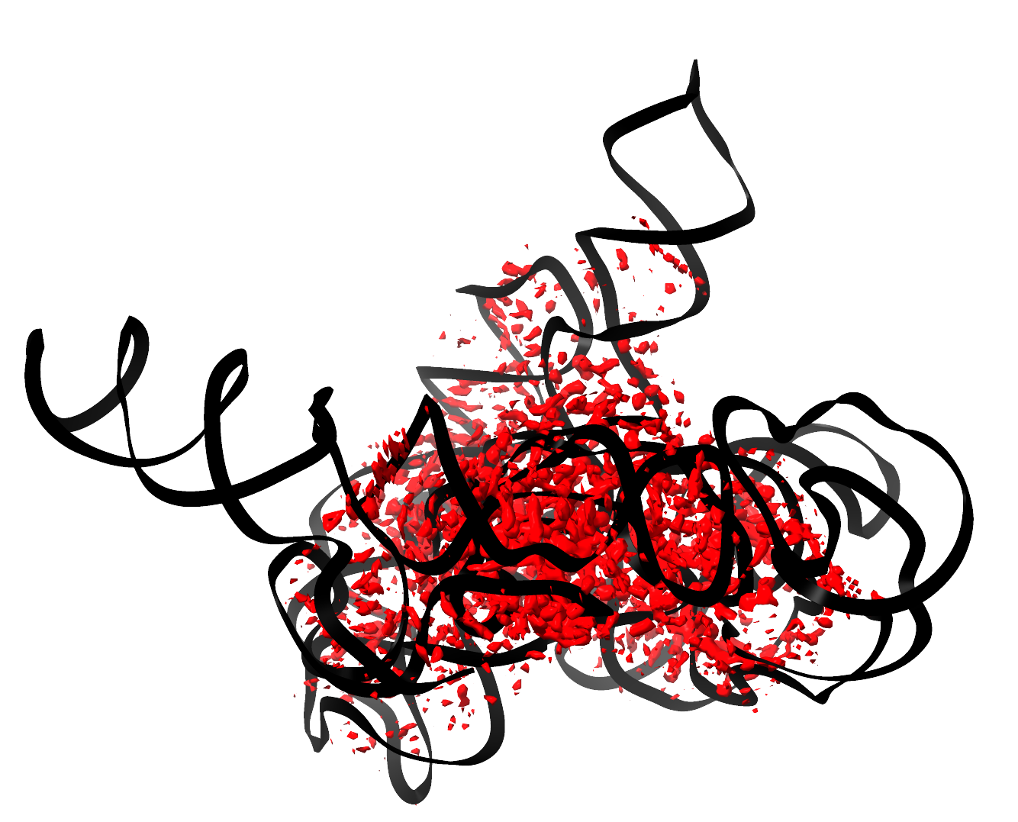
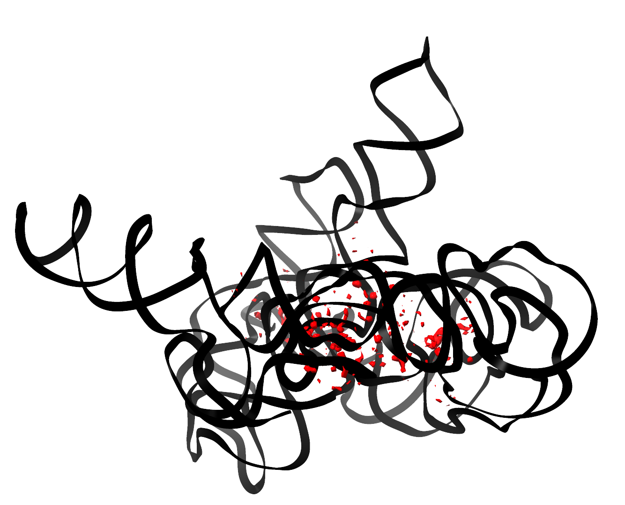
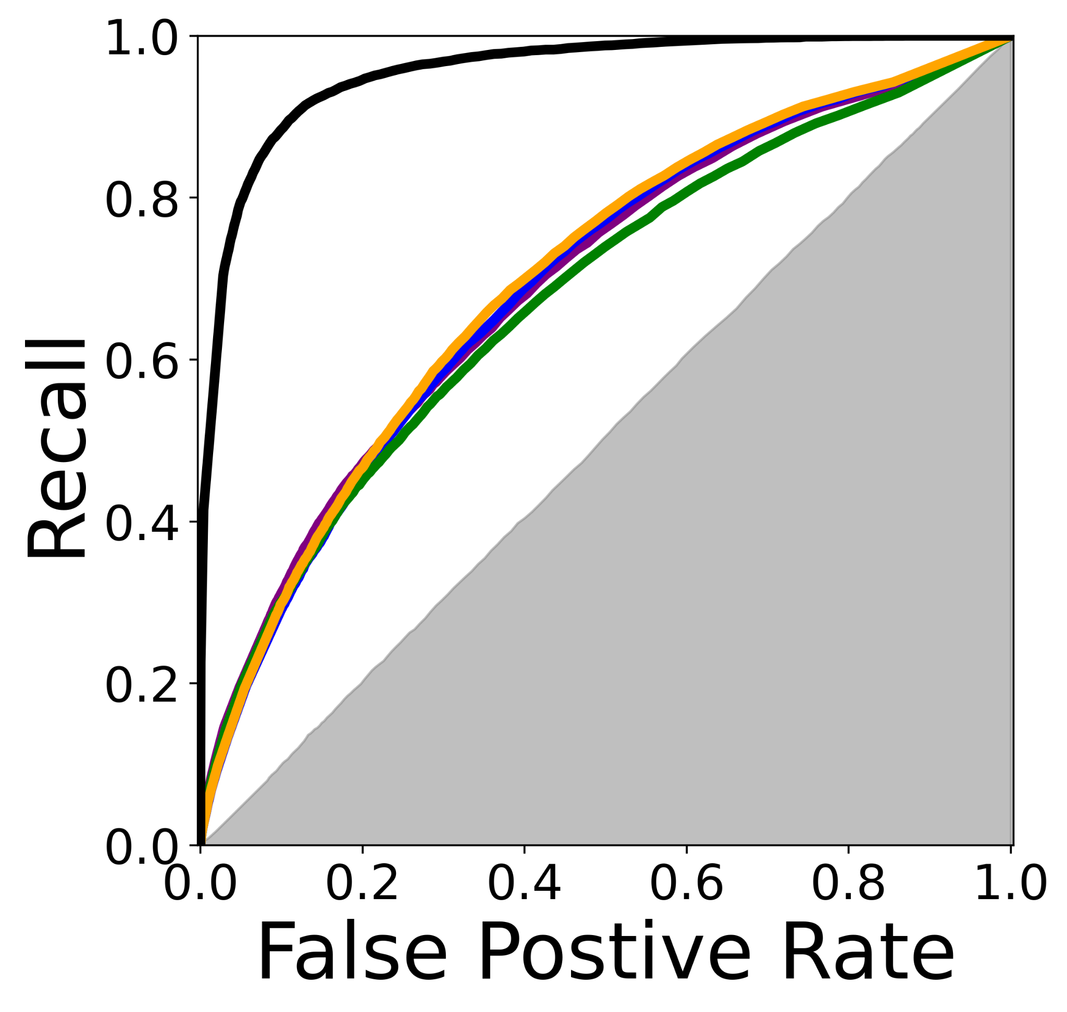
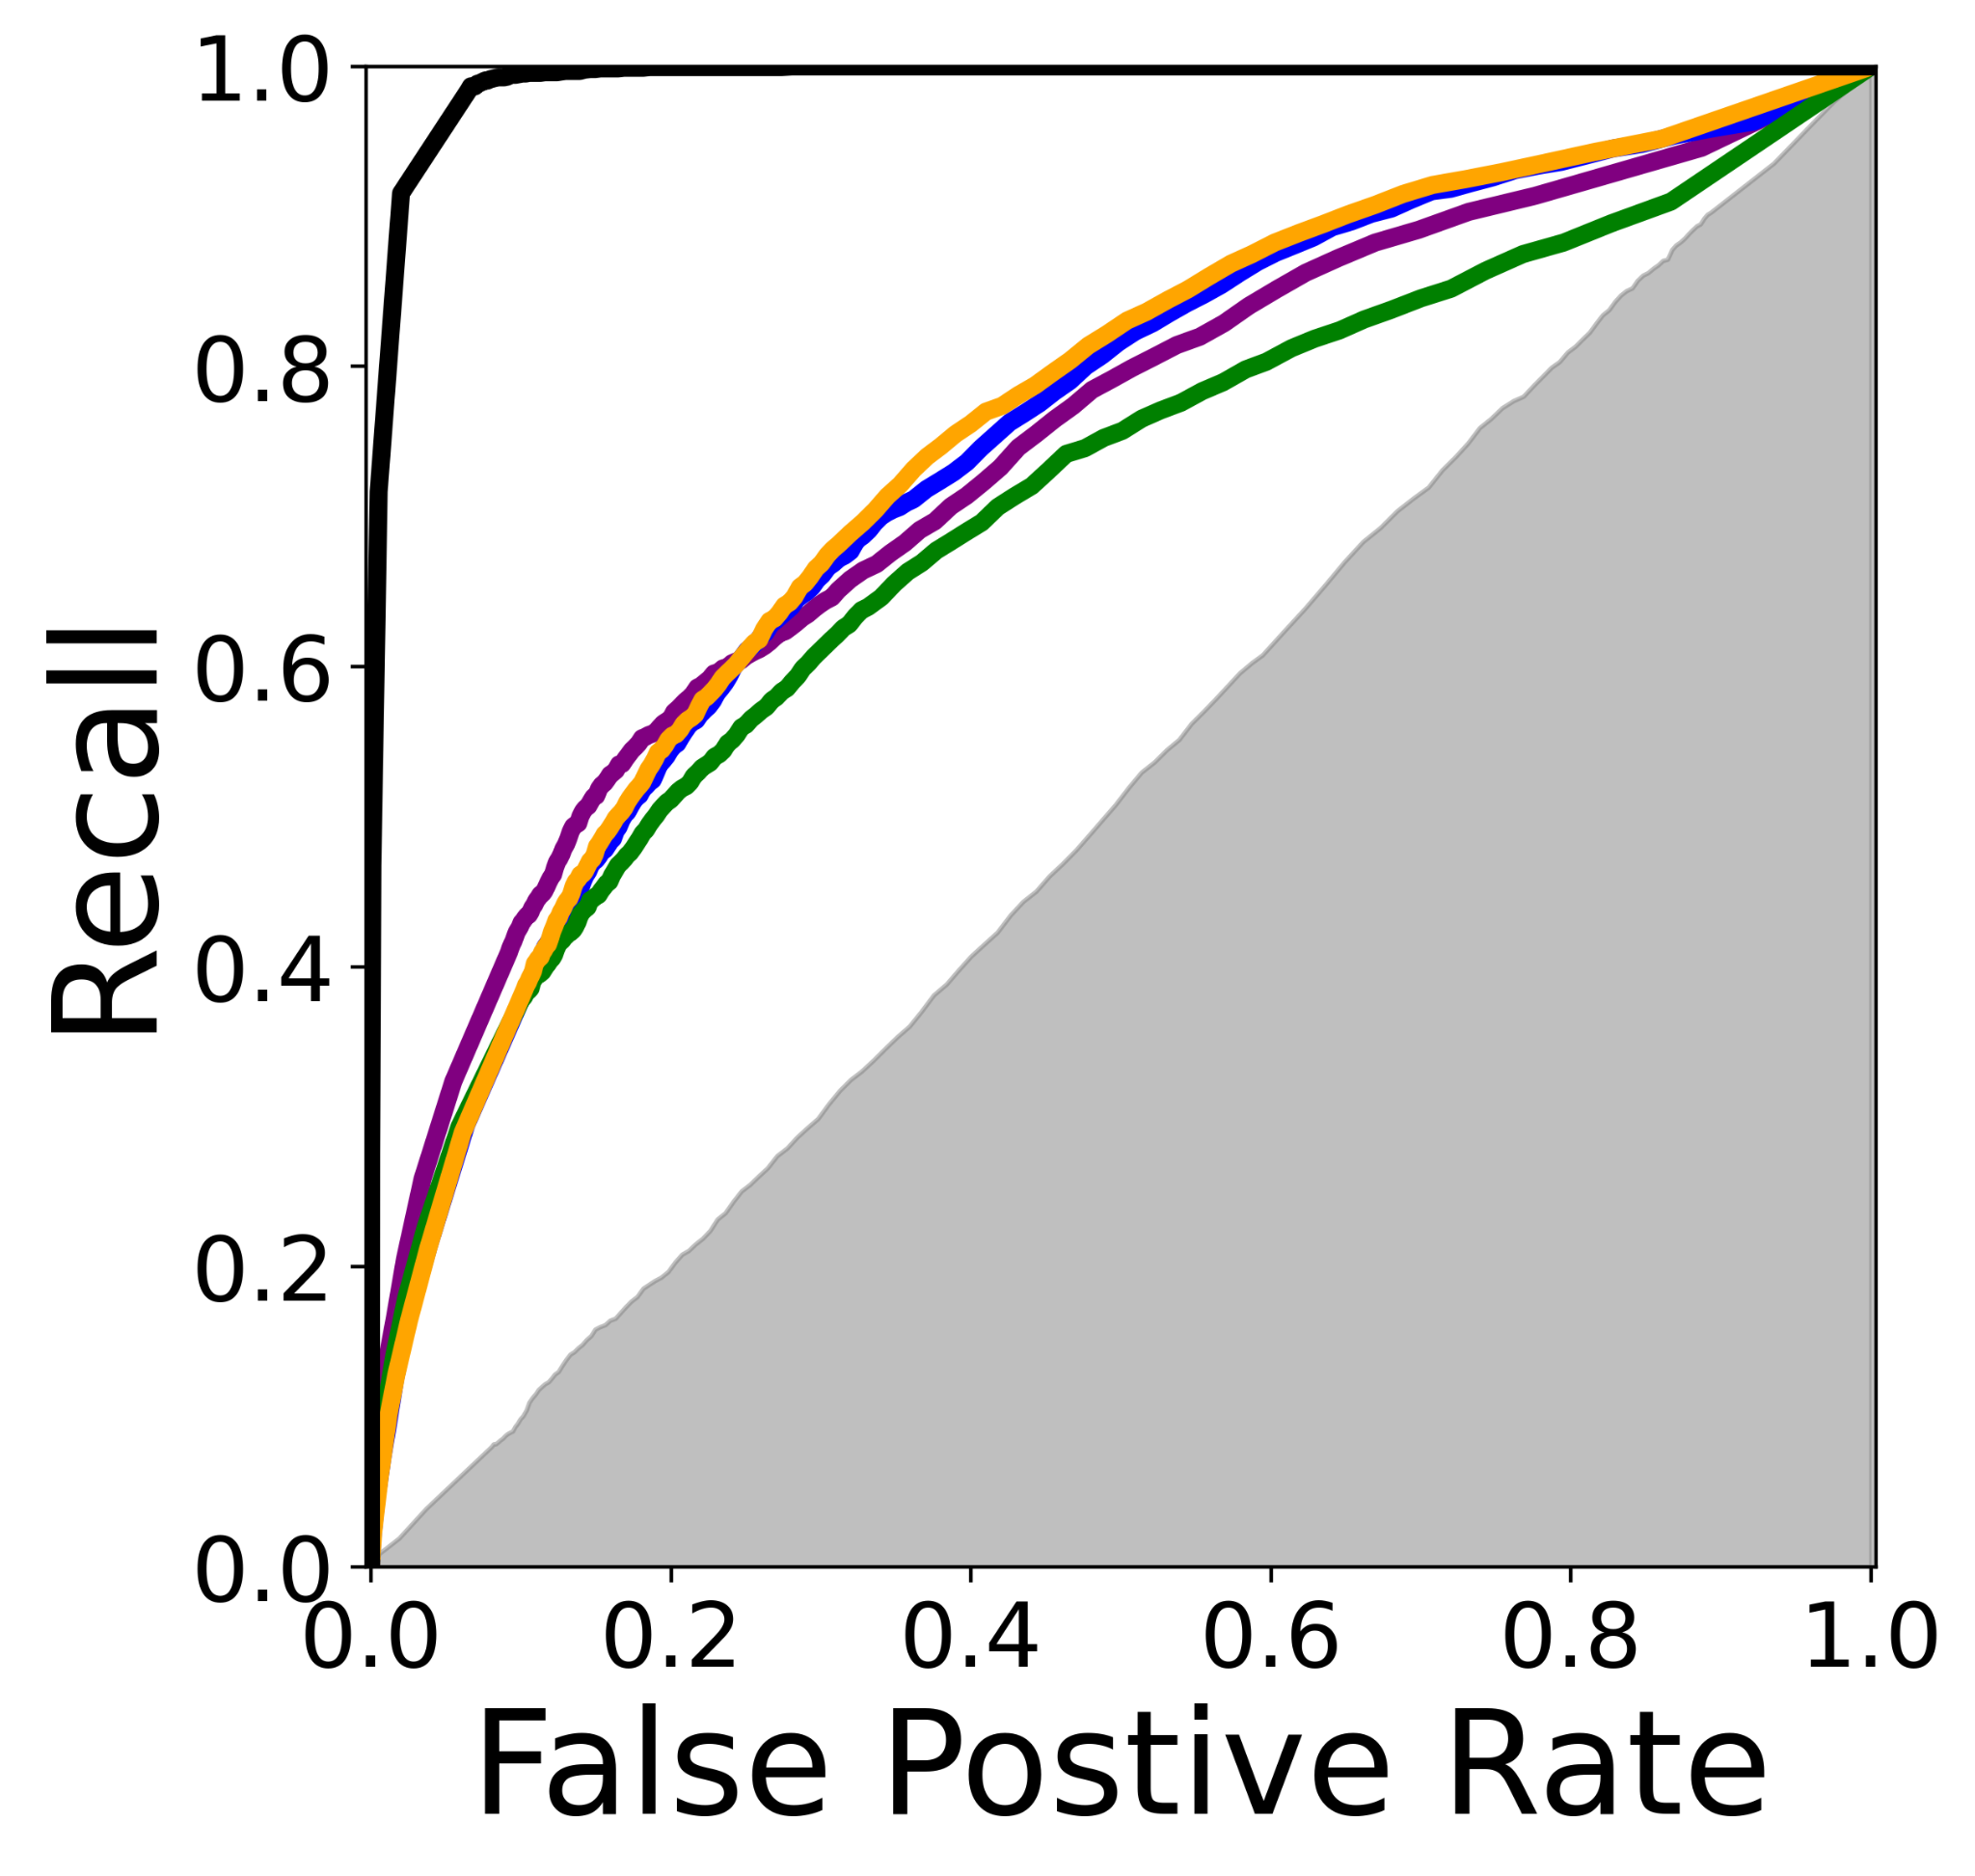
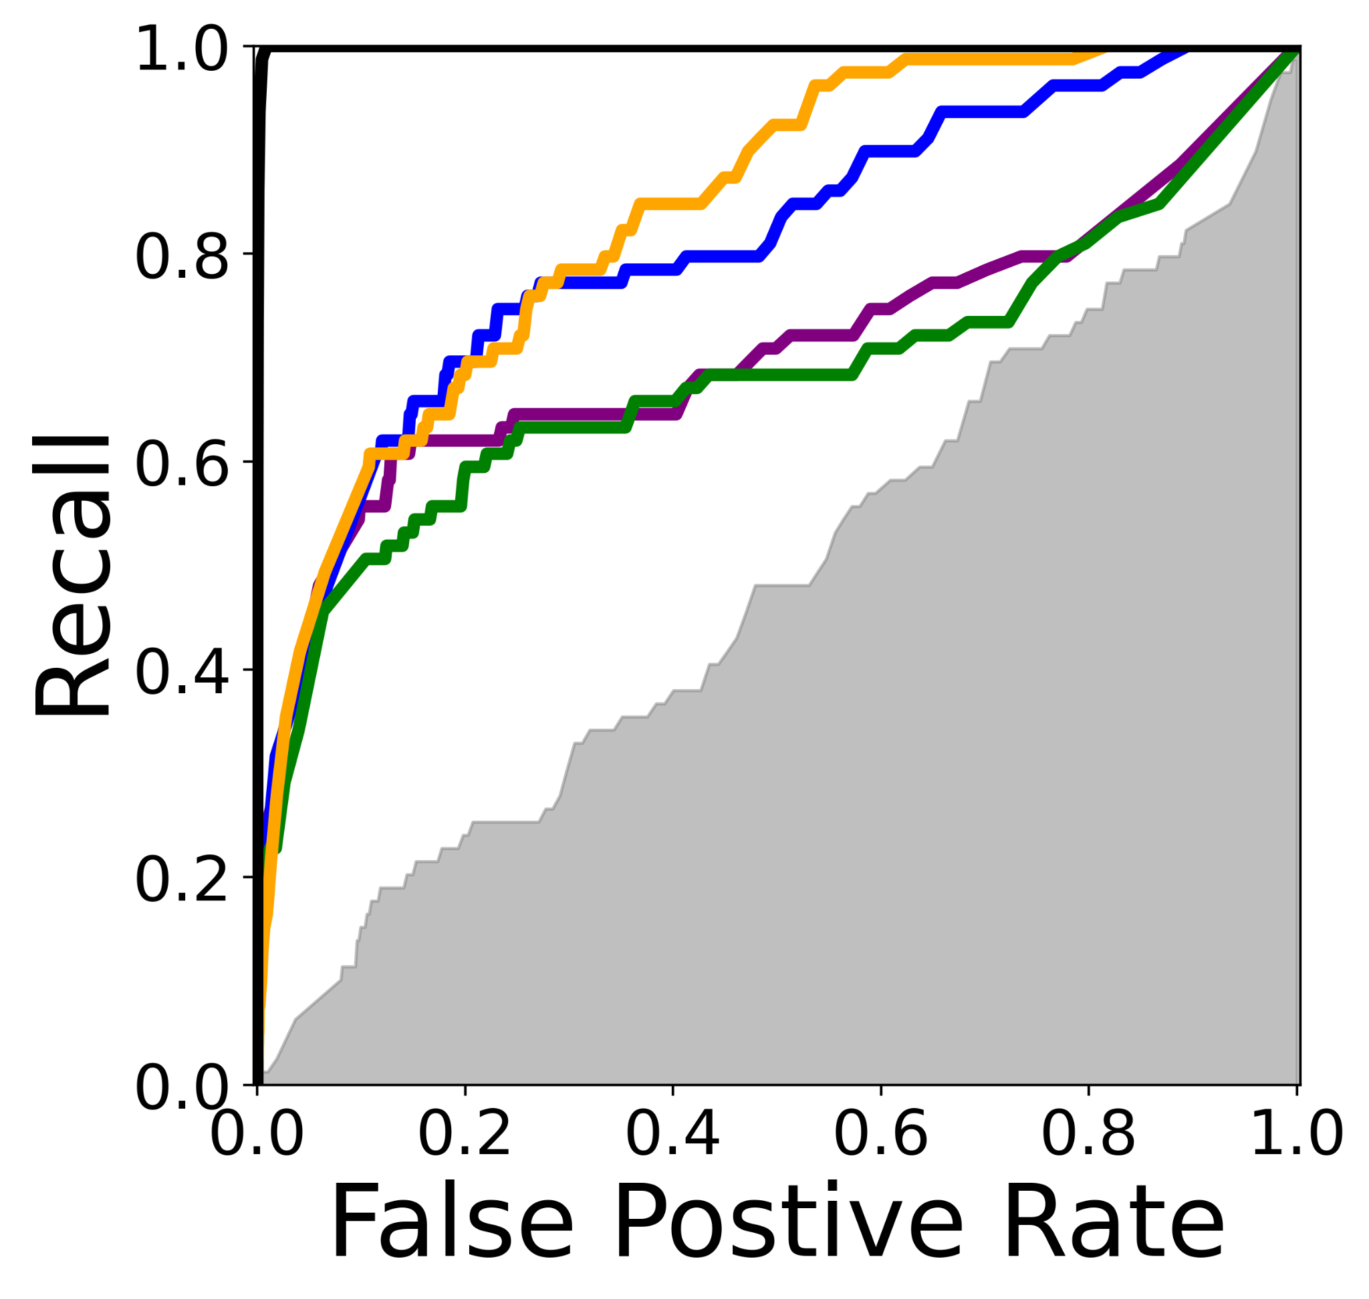
Results - Classification style metrics
Positive
Do predictors successfully predict density positions above X threshold in the experimental map?
More “order”
More “dense”

Slide 16
Results - Classification style metrics
SoutheRNA predict the most ordered positions well
More “order”

Slide 17
RNA water/ion Assessment
25 predictors in this first of its kind experiment
Primary participants and good performers for density-based comparison are MD groups
Local alignment vitally important for assessing the water and ion ensemble
While there were differences in the MD, there is much room for improvement, potentially assisted by similar data and challenges
Data and predictions are a wealth of information
Ordered water and ions

Slide 18
Acknowledgements
RNA assessors
Rachael Kretsch
Rhiju Das
Das lab members
Organizing and assessor teams
Andriy Kryshtafovych
Gabriel Studer
Jérôme Eberhardt
Xavier Robin
Torsten Schwede
Maya Topf
Krzysztof Fidelis
John Moult
Experimentalist
Shanshan Li
Greg Pintilie
Michael Palo
Kaiming Zhang
Wah Chiu
Predictors!

Slide 19
RNA water/ion Assessment
R1260 CASP16
Rhiju Das, Rachael Kretsch
4 December 2024
R1260TS391

Slide 20
Water/ion ensembles
The experimental data
The challenge
Converting predictions to densities
Comparison to experimental data
What’s next?
R1260TS391

