Slide 1
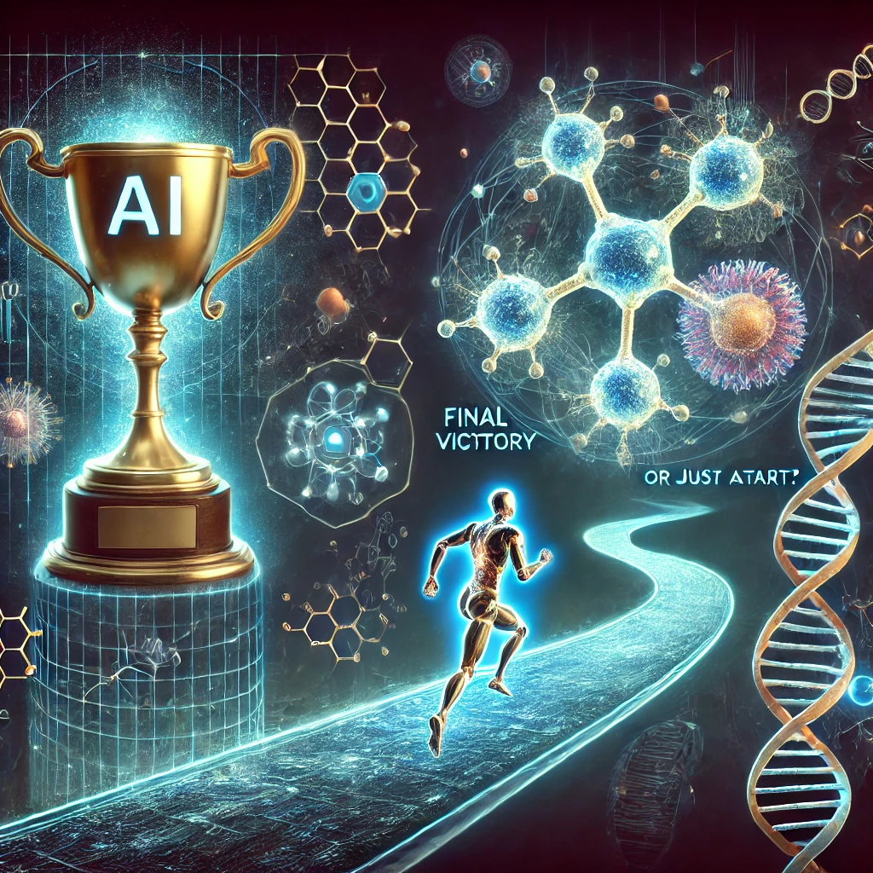
AI Structure Prediction:
Final Victory or Just a Start?
@ChatGTP

Slide 2
Panel:
Minkyung Baek
Alexandre Bonvin
Rhiju Das
Janani Durairaj
Andras Fisher
Michael Gilson
Sanjana Nair
Eric Westhof

Slide 3
Challenges in Modeling RNA, DNA, Complex Structures and Interactions
What changes are needed to accurately model RNA and DNA structures?
Can AI effectively handle complex structures such as filaments, amyloids, and supramolecular assemblies? What about membrane proteins?
Can AI improve in predicting protein-ligand interactions? Are current methods capable of predicting exact binding positions without templates, or do they primarily identify “pockets”?
Are AI tools robust enough for virus complexes and cross-species predictions, particularly in cases with shallow MSAs?
John Moult: “No template no go”

Slide 4
Challenges in Balancing Perfection, Flexibility, and Reliability
How can AI predictions better incorporate disordered regions and loops for functional insights? Can they reliably handle small structural changes such as point mutations or truncations?
Are AI-predicted models too “perfect”, and does this affect their biological relevance for disordered regions and flexibility? How well do they capture conformational flexibility and align with experimental data?
Does running AF3 multiple times guarantee better accuracy? if so, how can we reliably select the best model from the ensemble?

Slide 5
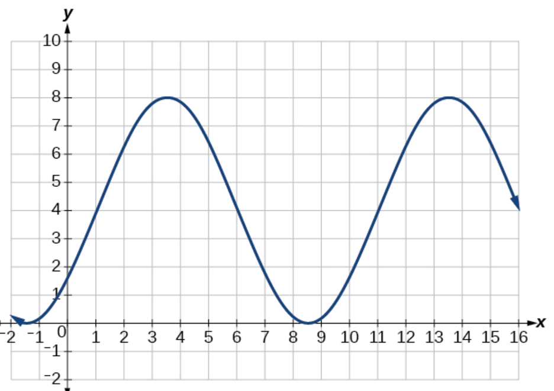
Nick Grishin: “Is CASP in a phase of incremental progress?”

