Slide 1
CASP16 - Nucleic acid prediction discussion
3 December 2024
Rhiju Das, Eric Westhof, Rachael Kretsch,
RNA predictors & the RNA curious
Notes:
11:30-12:15 → 45 min

Slide 2
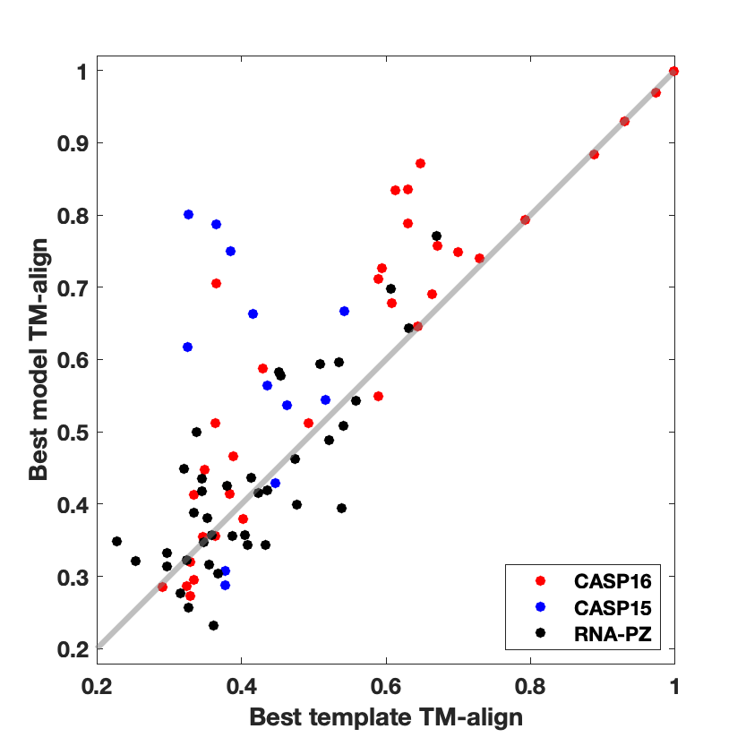
Progress in RNA structure prediction?
Human designed RNAs (blue)
Large MSA - OLE (red)

Slide 3
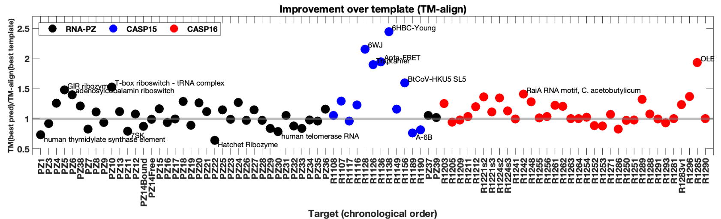
Progress in RNA structure prediction?
Human designed RNAs
Large MSAs

Slide 4
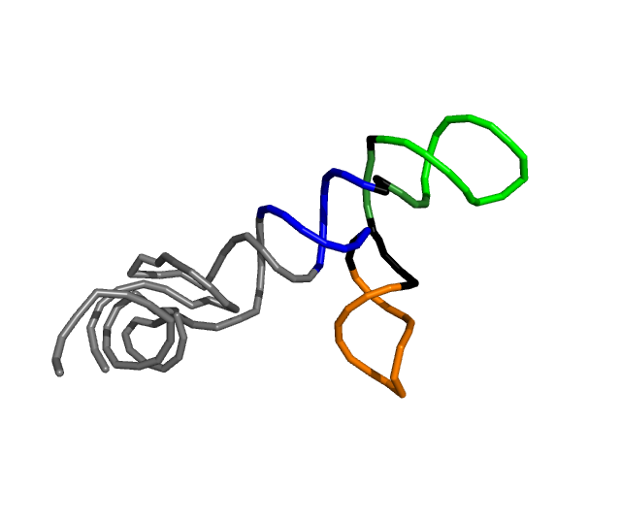

RNA flexibility – how to handle in prediction? assessment?
R1203 GCCCGGAUAGCUCAGUCGGUAGAGCAGCGGGCACUAUGGGCGCAGUGUCAAUGGACGCUGACGGUACAGGCCAGACAAUUA----UUGUCUGGUAUAGUGCCCGCGGGUCCAGGGUUCAAGUCCCUGUUCGGGCGCCA
R1209 -----------------------------GGCACUAUGGGCGCAGCGUCAAUG-ACGCUGACGGUACAGGCCAGACAAGAAACACUUGUCUGAUAUAGUGCC------------------------------------
R1296 -----------------------------GGCACUAUGGGCGCAGCGUCAAUG-ACGCUGACGUUACAGGCCAGACAAGAAACACUUGUCUGAUAUAGUGCC------------------------------------
**************** ******* ********* ************** * ******* *********
R1203
R1209
R1296

Slide 5
The acceleration of RNA structure determination
How does the increasing rate at which structure can be experimentally determined effect the blind prediction CASP model?
Notes:
Can you paste in figures for raiA map (bujnicki) → does not seem right?

Slide 6
Prompts for audience/panelists
Has there been progress since CASP15? What can community do to achieve atomic accuracy in RNA and RNA-protein template-free models?
Should we expand CASP to more flexible RNA targets?
How will CASP work for RNA if anyone can solve an RNA-only cryoEM structure in 1 week?

Slide 7
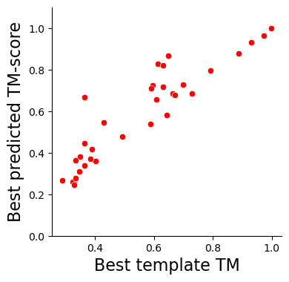
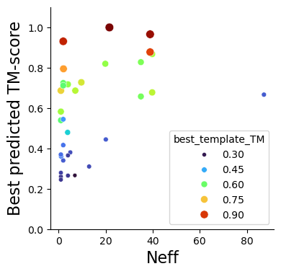
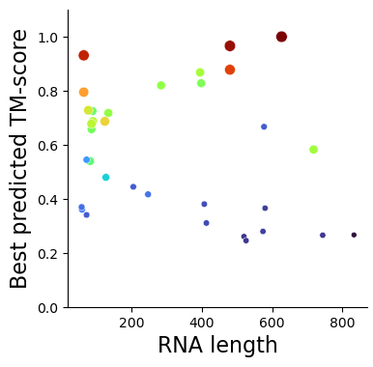

Slide 8
