Slide 1
Protein structure /accuracy discussion

Slide 2
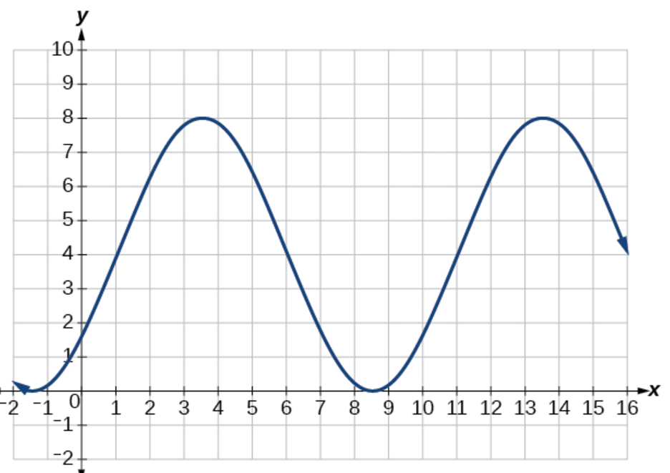
Is CASP in a phase of incremental progress
in protein structure prediction and accuracy self-assessment?
All images are taken from internet, may be subject to copyright, and are quoted here for the purpose of this presentation delivered to a limited audience

Slide 3
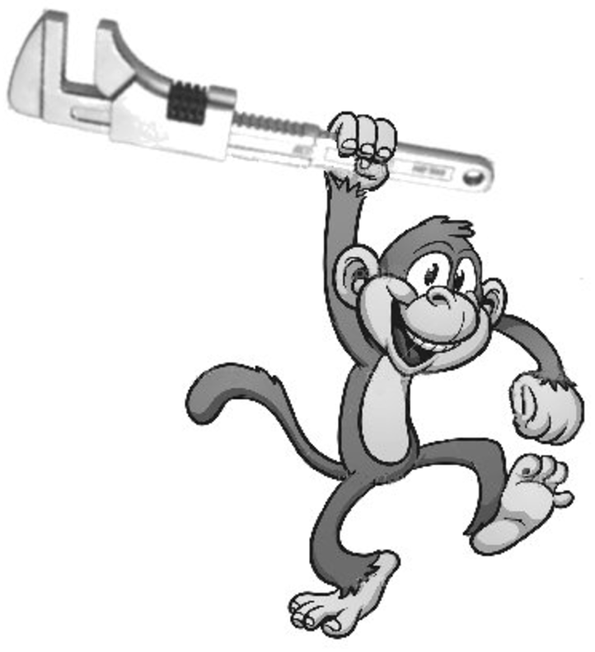
Is there life beyond AF3?
All images are taken from internet, may be subject to copyright, and are quoted here for the purpose of this presentation delivered to a limited audience

Slide 4
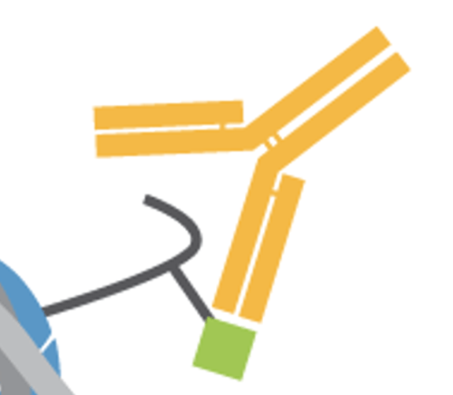
Antibody-antigen interaction prediction (and design?)
All images are taken from internet, may be subject to copyright, and are quoted here for the purpose of this presentation delivered to a limited audience

Slide 5
Are there new ideas for accuracy estimation within the academic community, apart from reporting the results from AF2, AF3 and their derivatives?

Slide 6
Are there more useful ways to communicate confidence measures that make them more intuitive to downstream users of the predicted structures?

Slide 7
Straighter, more regular, more compact,
are predicted models better than some experimental ones?

Slide 8
More AF3 runs, more accurate models. How to pick the right one?

Slide 9
Which targets are more difficult to predict: small sequence changes that introduce structural changes are nearly impossible: point mutations, truncation of a protein

Slide 10
Filaments and extended structures

Slide 11
Organization of the experiment: T0, T1, T2

Slide 12
Assessment methods: are we doing it right?
Suggestions to do it better.

