Slide 1
Assessing template-based models
Tristan Croll, Massimo Sammito, Gábor Bunkóczi and Randy Read

Slide 2
Definition of template-based modelling targets
TBM-hard (22 domains) and TBM-easy (37 domains)
not TBM/FM or FM
Target classification is partially post hoc
if some predictors made good models, it must have been relatively easy!
Domain classification has a subjective element
merge domains into evaluation unit (aka ”domain”) if at least some models have good relative domain orientation

Slide 3
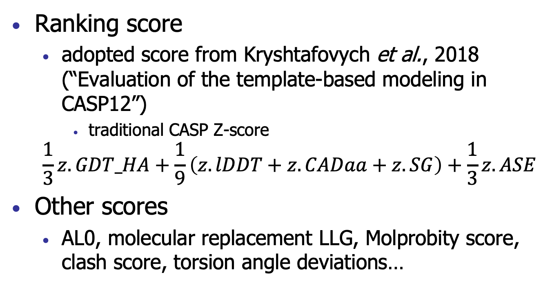
Evaluation criteria
Ranking score
adopted score from Kryshtafovych et al., 2018 (“Evaluation of the template-based modeling in CASP12”)
traditional CASP Z-score
$$\frac{1}{3}z.GDT_HA+\frac{1}{9}\left(z.lDDT+z.CADaa+z.SG\right)+\frac{1}{3}z.ASE$$
Other scores
AL0, molecular replacement LLG, Molprobity score, clash score, torsion angle deviations…

Slide 4
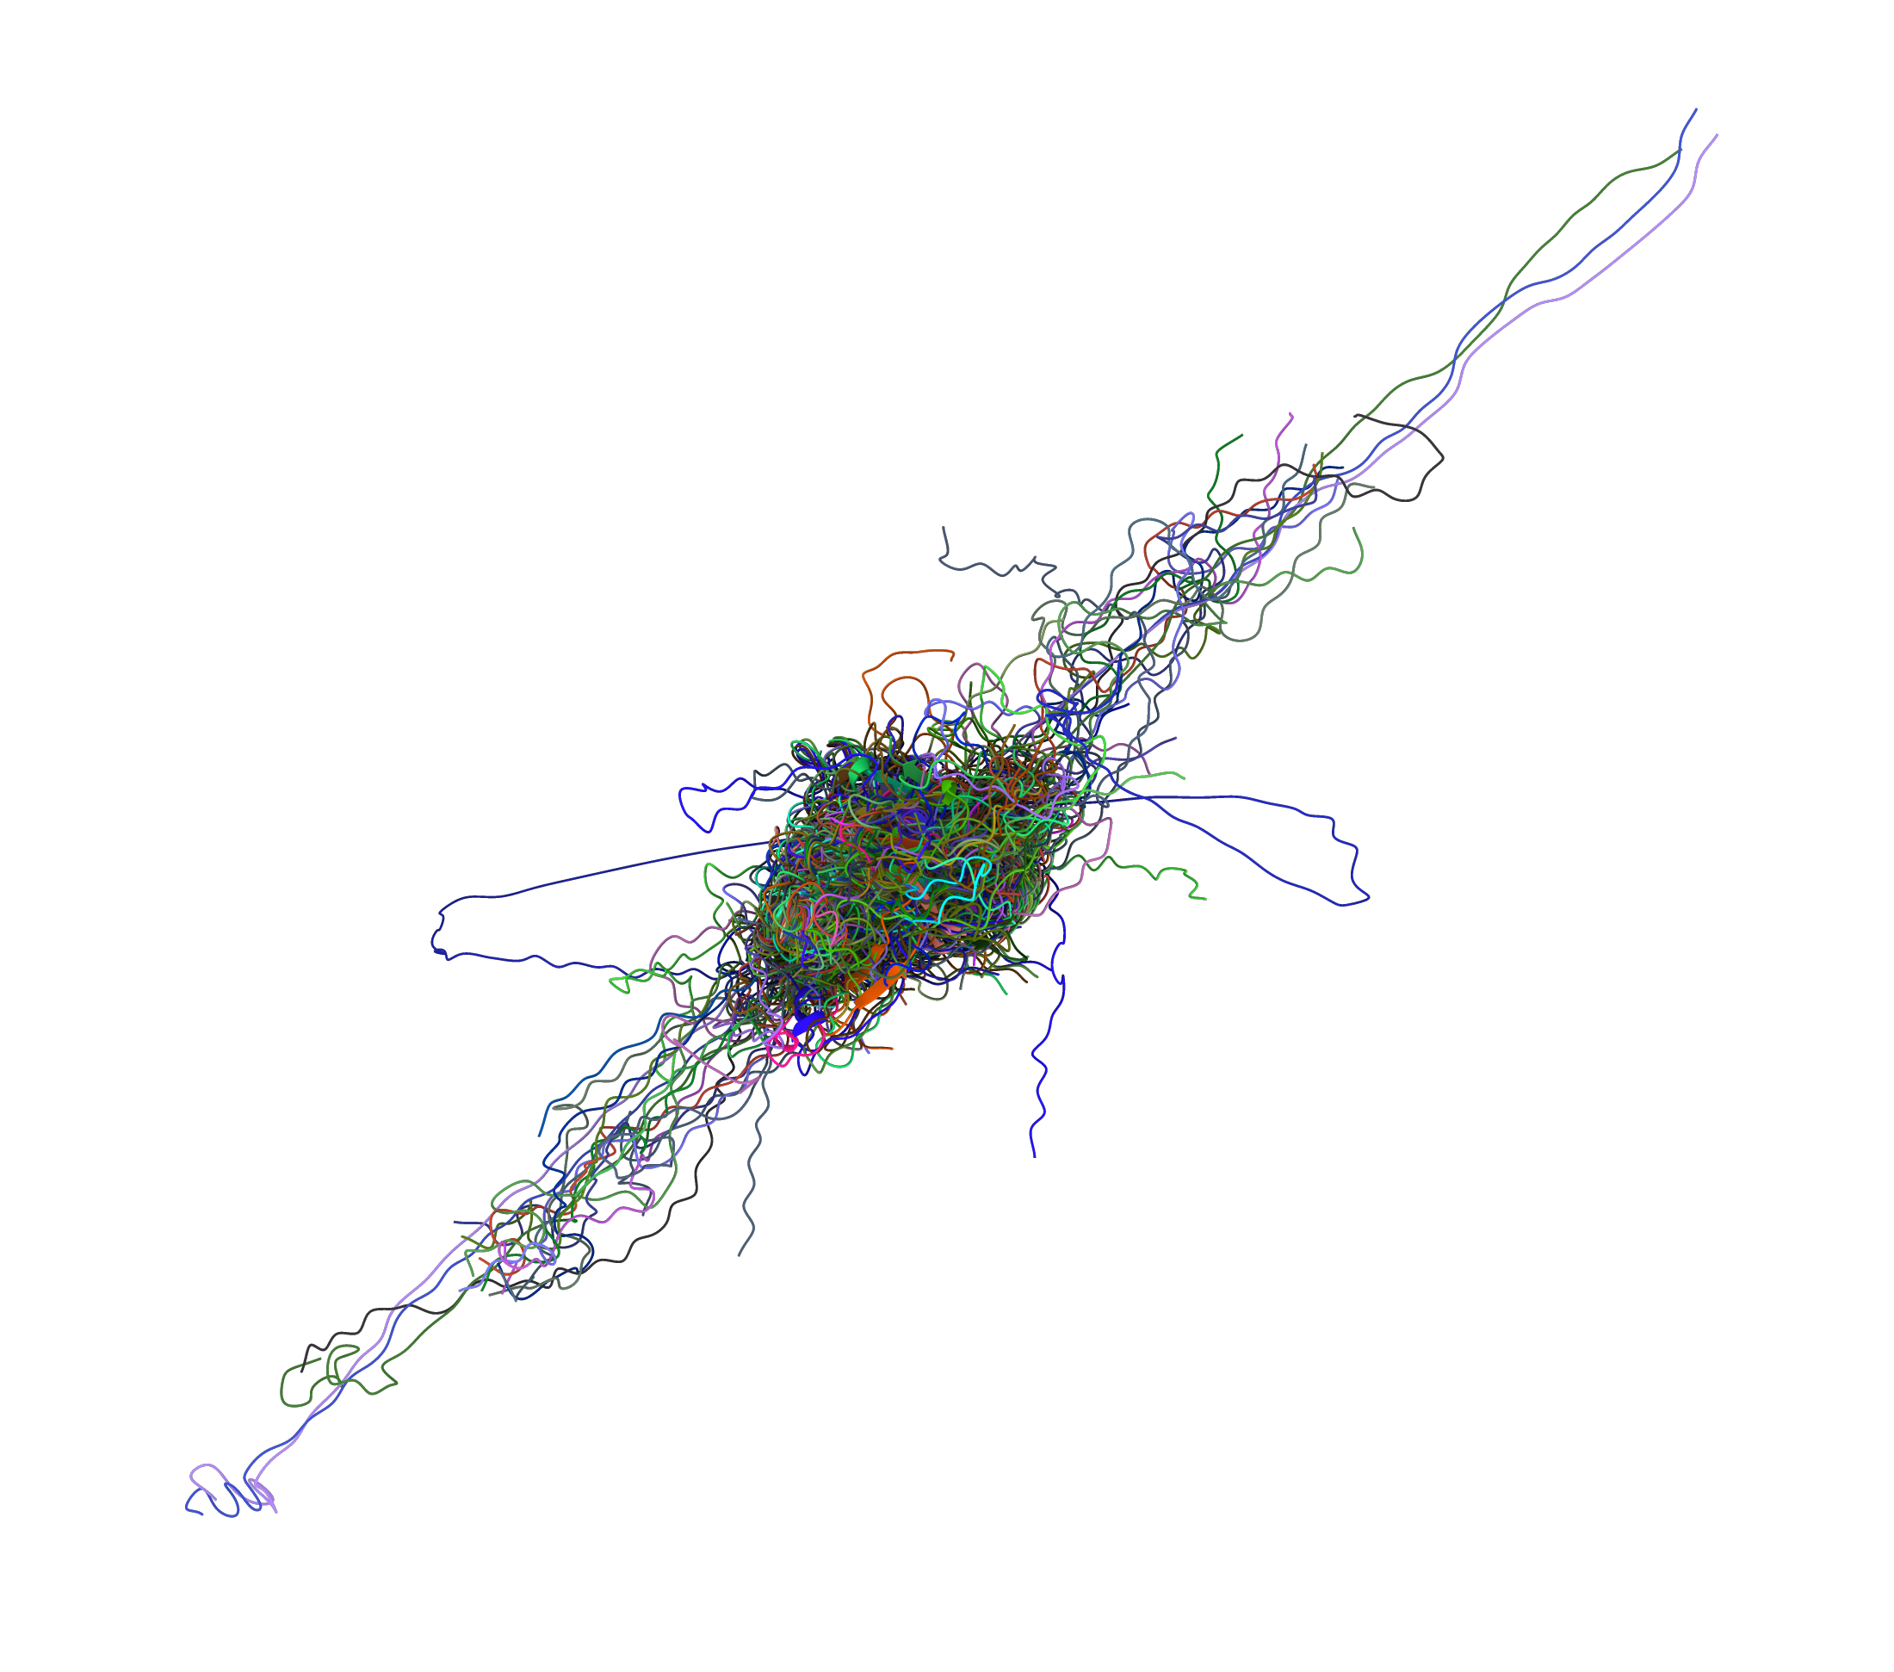
Evaluation criteria
Scoring methods need to be robust…

Slide 5
Justification of ranking score
Equal weighting of overall fold accuracy (GDT_HA), all-atom local accuracy (lDDT, CADaa, SG) and error estimation (ASE)
relatively uncorrelated
GDT_HA is more stringent than GDT_TS for highlighting the most accurate models
Consider whether ASE can favour poor models with all errors estimated as large (Andriy)
not enough to skew the results

Slide 6
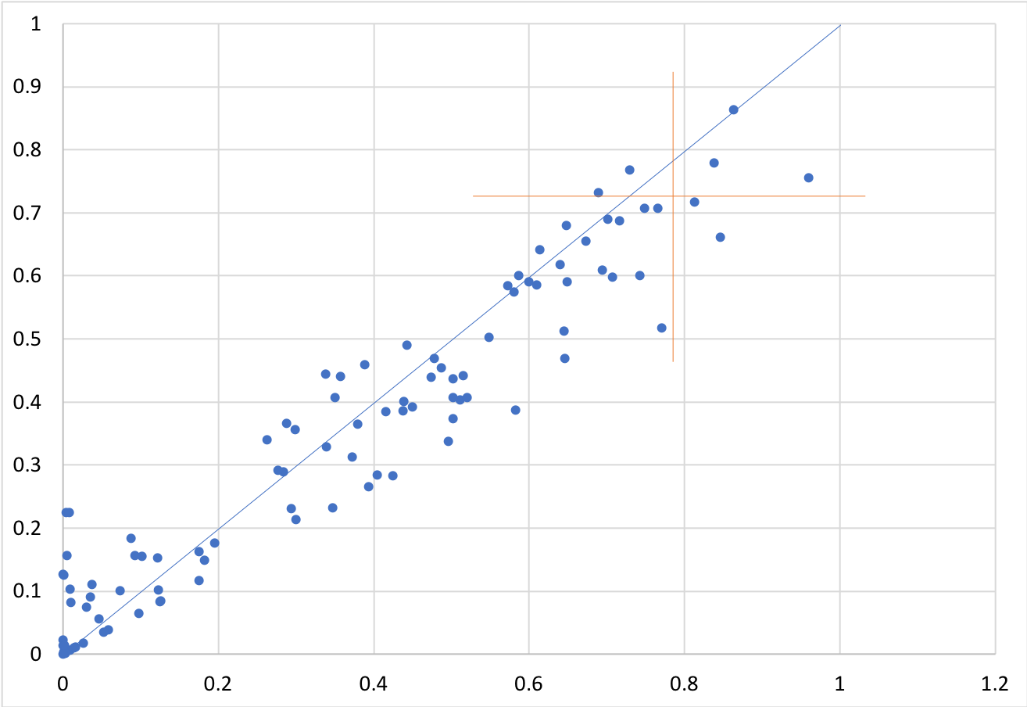
Effect of including ASE measure
mean Z-score with ASE
mean Z-score without ASE

Slide 7
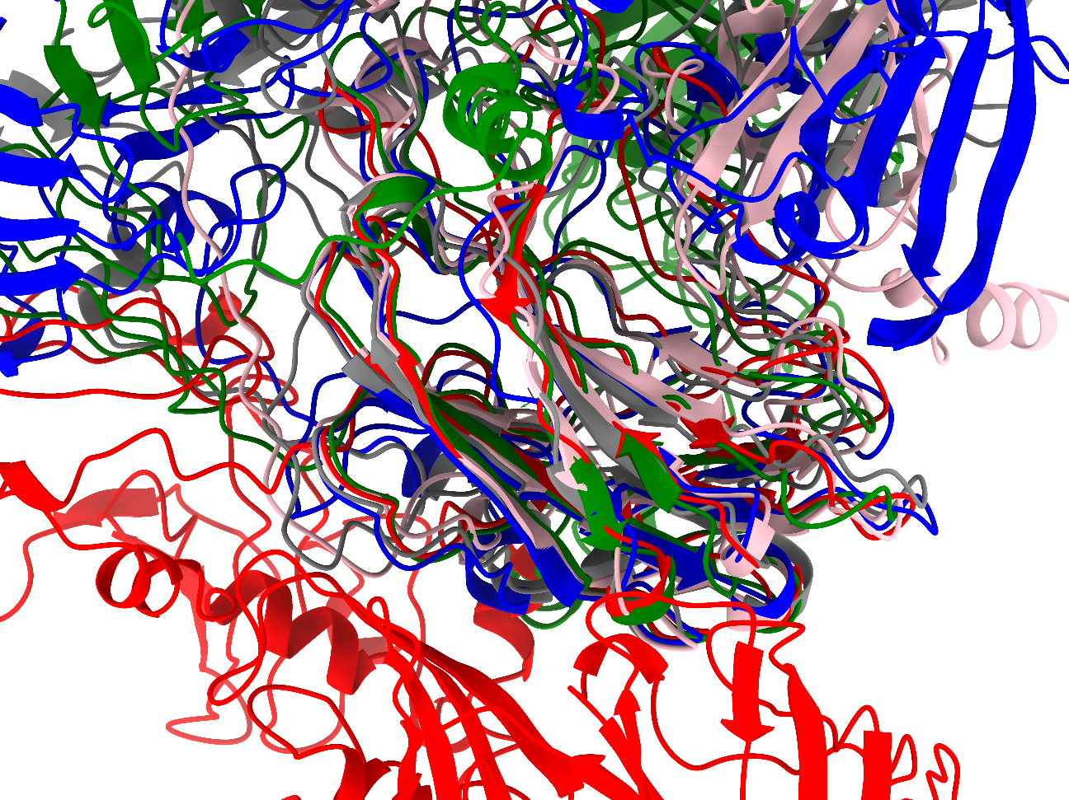
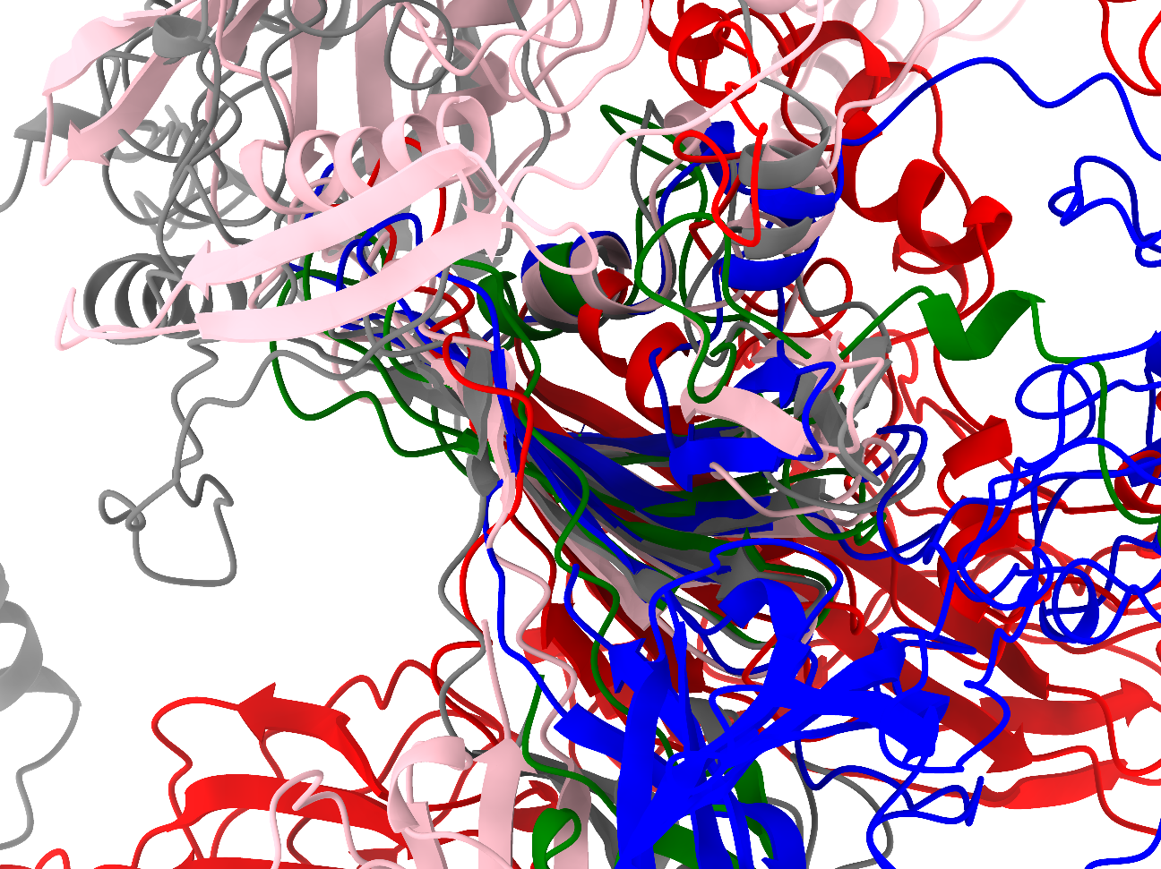
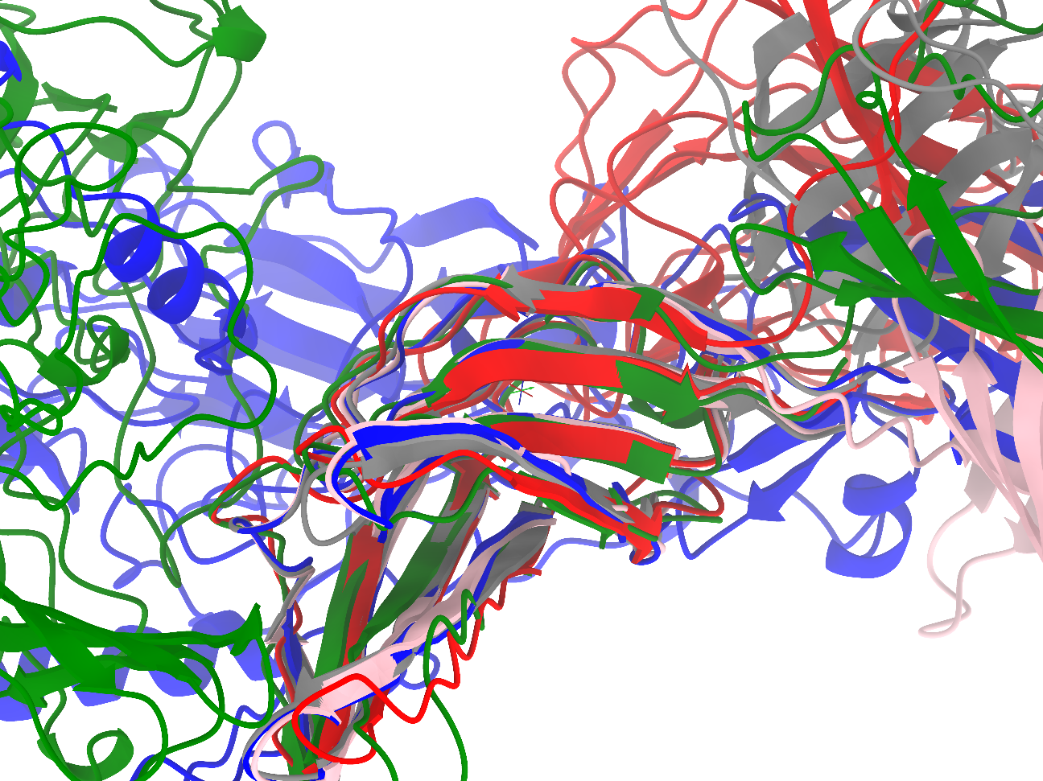
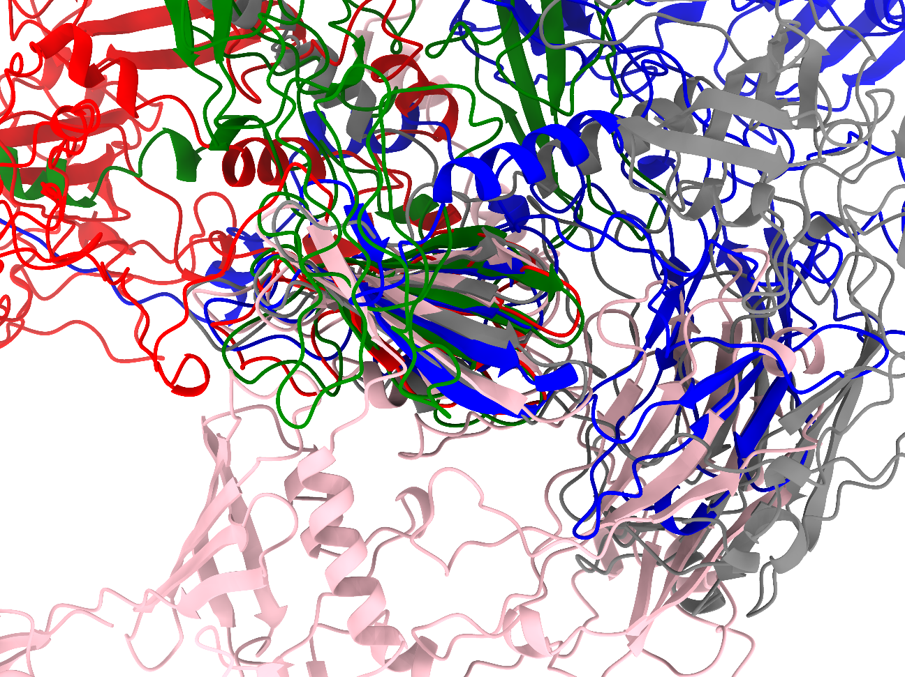
Question for Discussion
Should error estimates be calculated at a global or local (domain-scale) level?
Example: Group 43 (A7D) predictions for T0981
Individual domains well-predicted
Inter-domain arrangements highly variable
Enormous predicted errors (11-76Å)
Aligned on D2
Aligned on D4
Aligned on D5
Aligned on D1

Slide 8
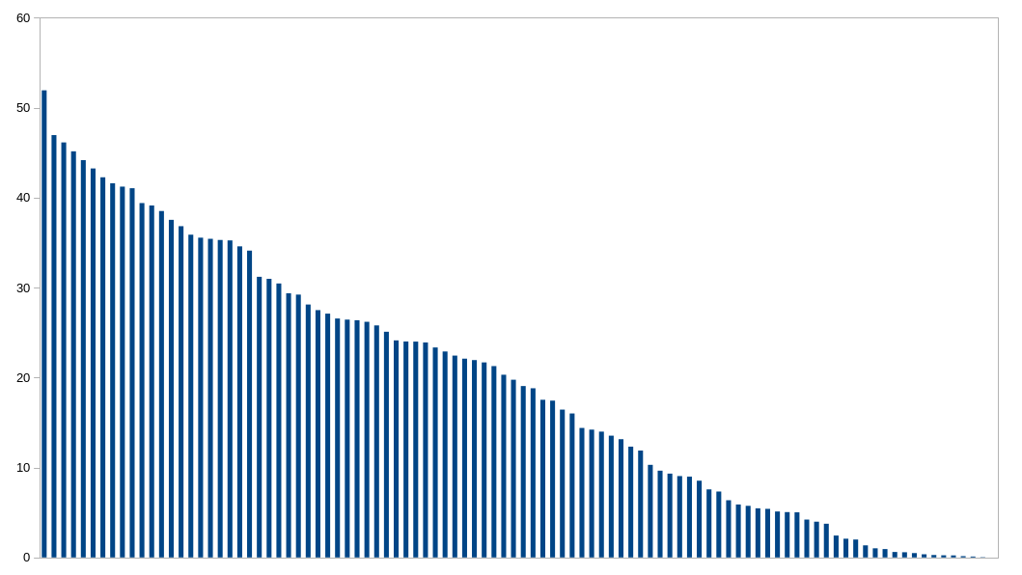
Predictors sorted by ranking score

Slide 9
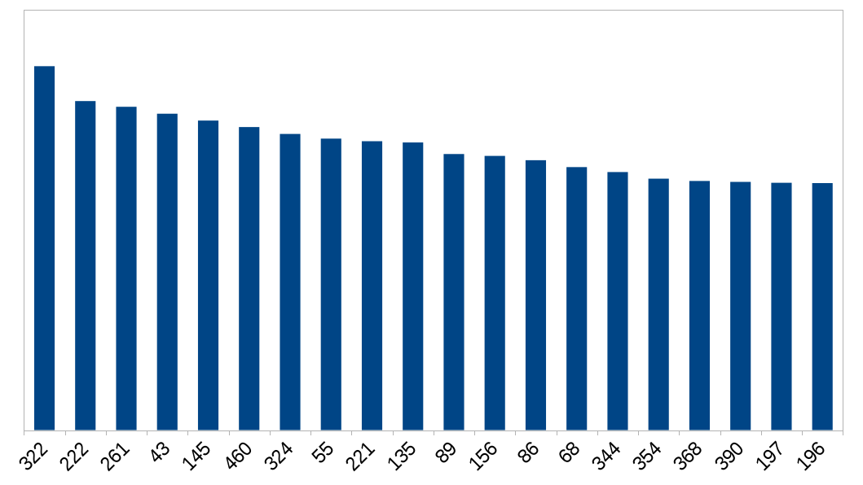
Top predictors sorted by ranking score
Template-based modelling
Quality assessment
Fragment-based
Ab Initio
Server
T
S
Q
T
S
S
F
A
Q
S
T
Q
T
Q
S
Q
T
T
Q
S
Q
Q
Q
T
Q
Q
Notes:
322: Zhang lab
222: Seok-refine
261: Zhang server
043: A7D (Deep Mind/UCL)
145: QUARK (Zhang)
460: McGuffin
324: RaptorX-DeepModeller

Slide 10
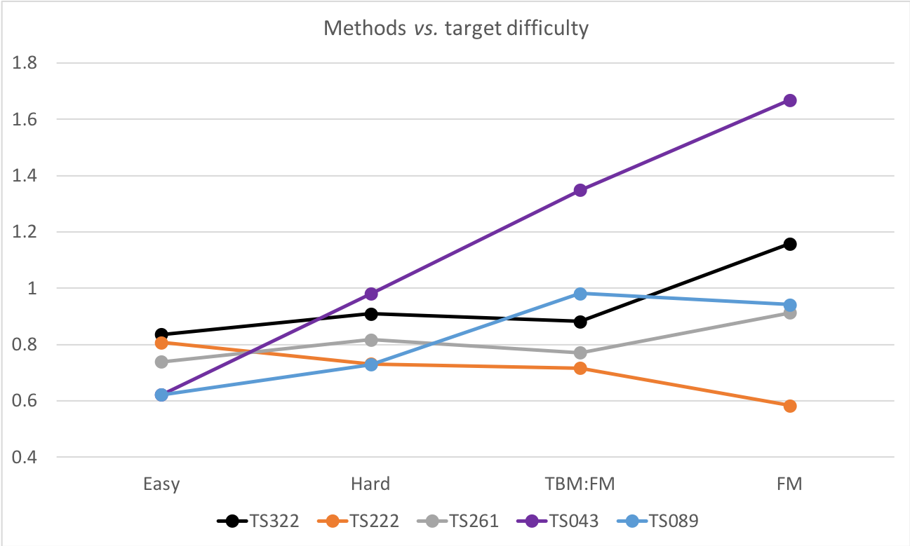

Ranks vs. target difficulty
$$\left\langle Z\left(0σ\right)\right\rangle$$
Notes:
322: Zhang
222: Seok-refine
261: Zhang server
43: A7D
89: MULTICOM

Slide 11
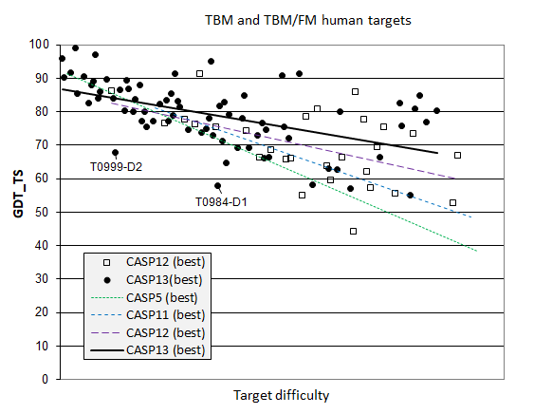
Progress in TBM category?

Slide 12
Geometric quality analysis: The Devil’s in the details
Goal is (arguably) a stable model matching target
Cα based metrics only take you so far
Backbone geometry (flipped, cis or twisted peptide bonds)
Incorrect sidechain conformations
Clashes
-> high-energy states pushing model apart
-> degradation of model upon MD simulation, incorrect conclusions, …

Slide 13
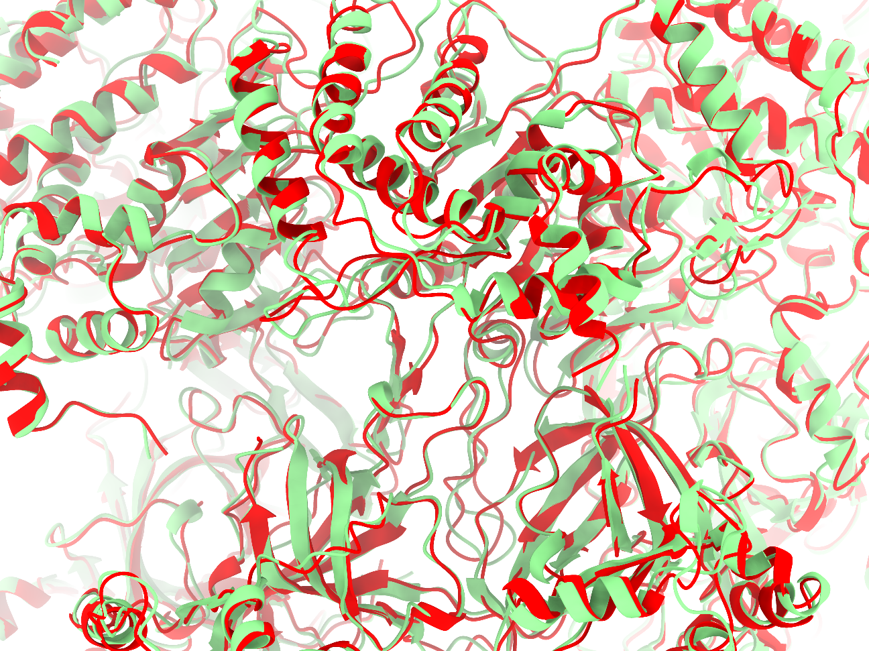
Case study
3ja8 (2015 3.8Å cryo-EM model)
Re-refined using ISOLDE (6eyc)
Croll, T. (2018) Acta Crystallogr D 74: 519-530
Before vs. After GDT-HA (chain 7): 0.82
and yet…

Slide 14
Case study
Original model
After brief MDFF
Rebuilt

Slide 15
Comparison of backbone torsions reveals dramatic changes not captured by distance-based metrics

Slide 16
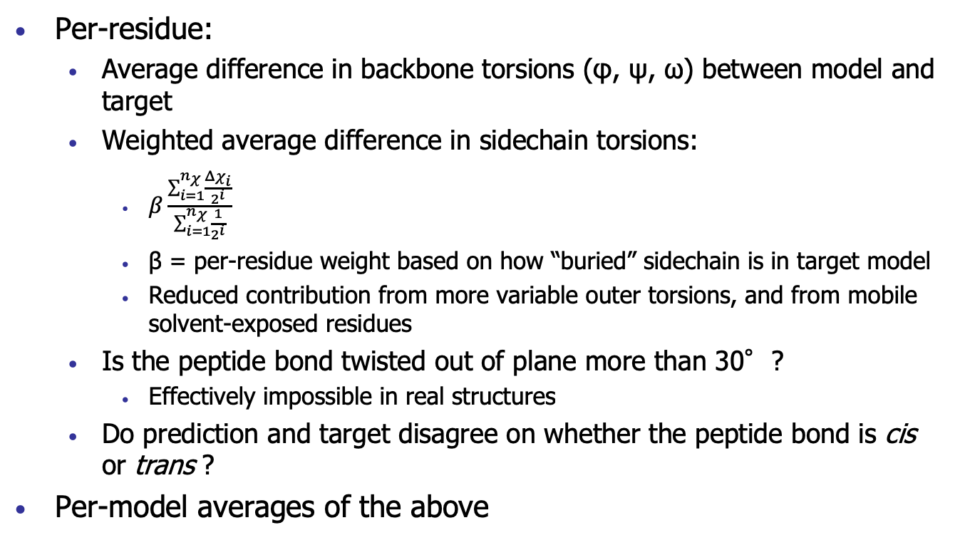
Torsion-based validation criteria
Per-residue:
Average difference in backbone torsions (φ, ψ, ω) between model and target
Weighted average difference in sidechain torsions:
$β\frac{\sum_{i=1}^{n_{χ}}{\frac{Δχ_{i}}{2^{i}}}}{\sum_{i=1}^{n_{χ}}{\frac{1}{2^{i}}}}$
β = per-residue weight based on how “buried” sidechain is in target model
Reduced contribution from more variable outer torsions, and from mobile solvent-exposed residues
Is the peptide bond twisted out of plane more than 30°?
Effectively impossible in real structures
Do prediction and target disagree on whether the peptide bond is cis or trans ?
Per-model averages of the above

Slide 17
Torsion-based validation criteria
Important caveat: target model itself may not be correct everywhere
errors in interpretation
poorly-modeled disorder
where model and target disagree, target may be wrong
much less likely for high-resolution targets

Slide 18
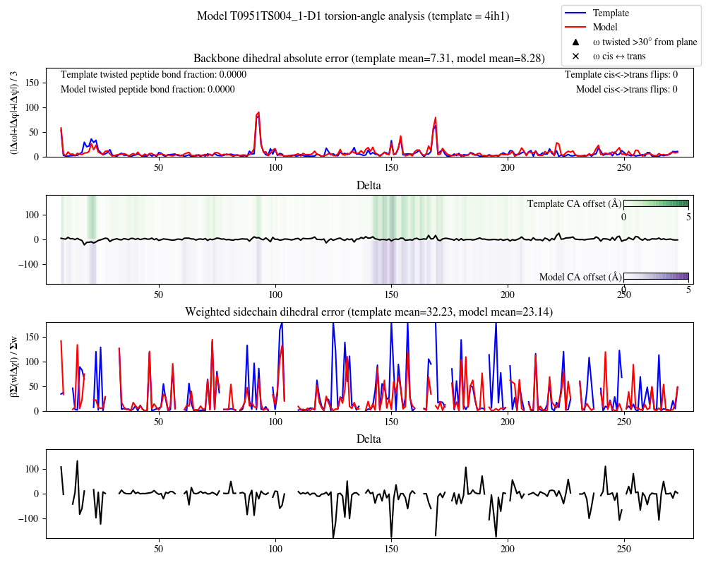
Sample validation chart (good model)

Slide 19
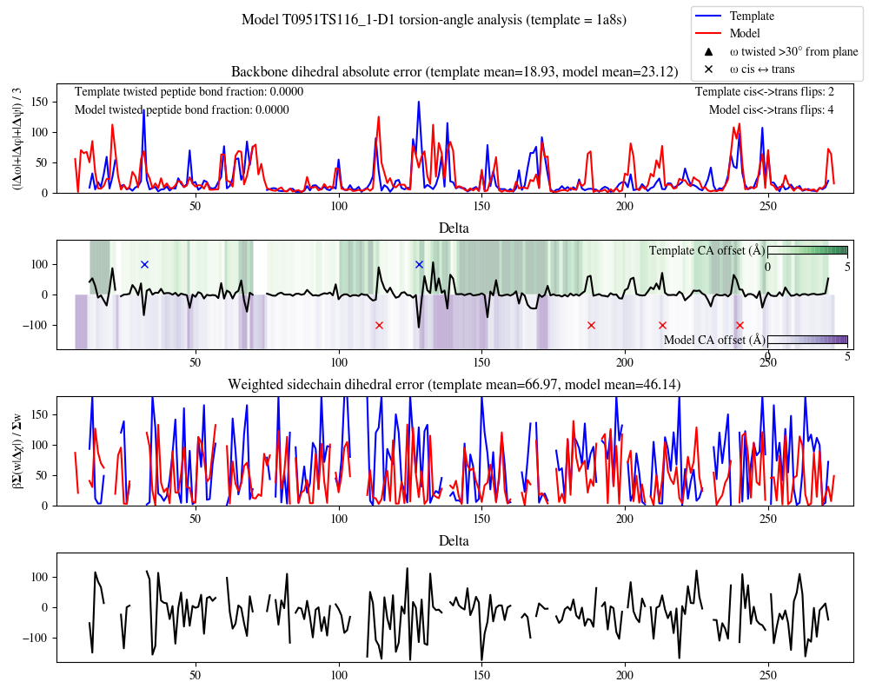
Sample validation chart (moderate model)

Slide 20
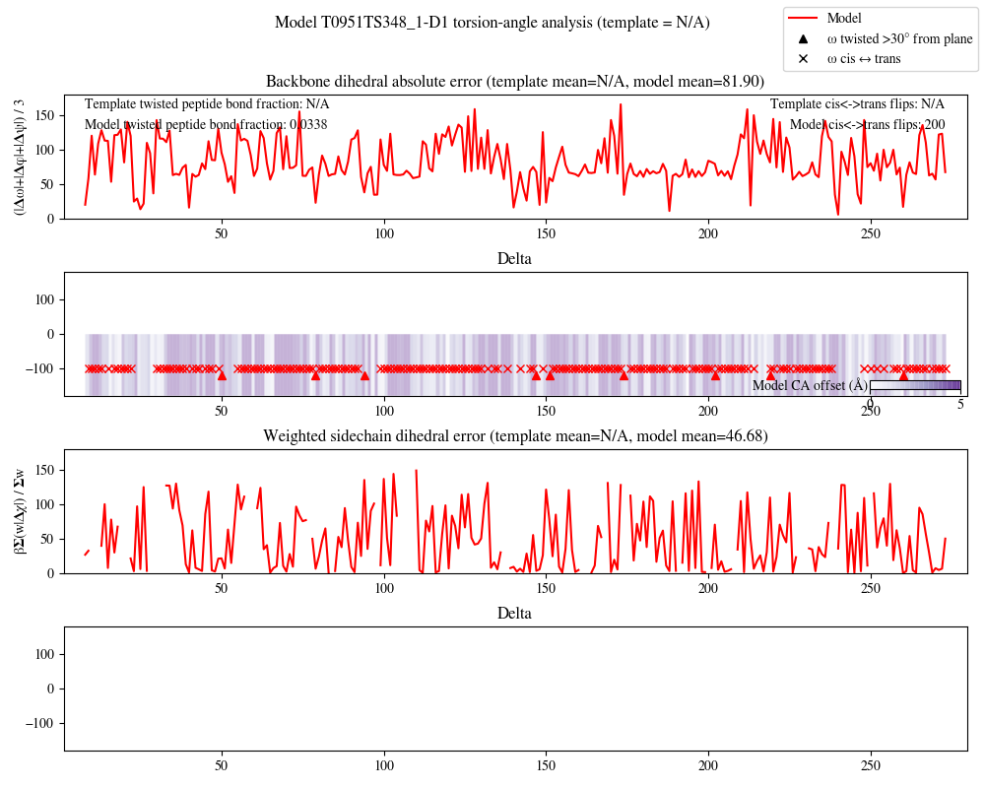
Sample validation chart (I don’t even…)
NOTE: backbone threading not bad for a ~10ms, template-free job!
Notes:
HMSCasper-Refiner – Recurrent geometric network in torsion space for backbone, Rosetta FastRelax for adding sidechains & minimising

Slide 21
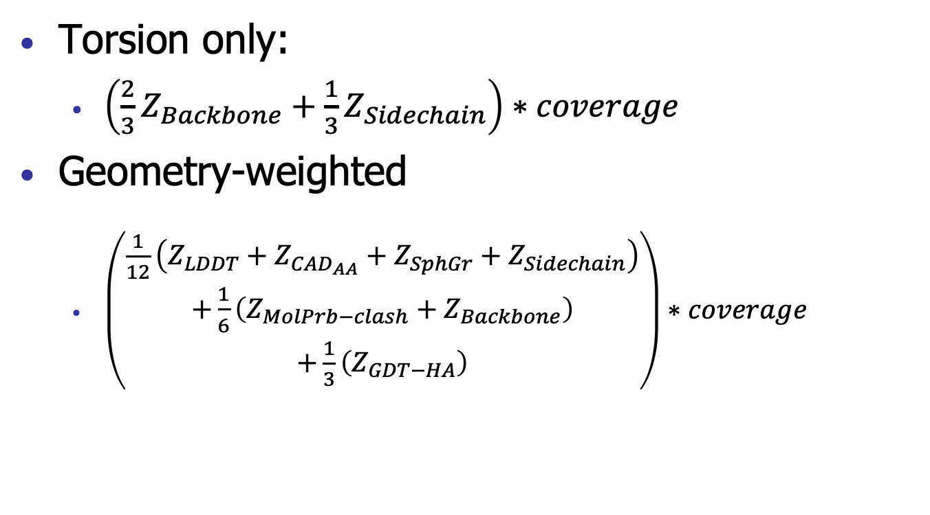
Ranking scores
Torsion only:
$\left(\frac{2}{3}Z_{Backbone}+{\frac{1}{3}Z}_{Sidechain}\right)∗coverage$
Geometry-weighted
$\left(\begin{matrix}\frac{1}{12}\left(Z_{LDDT}+Z_{CAD_{AA}}+Z_{SphGr}+Z_{Sidechain}\right) \\ +\frac{1}{6}\left(Z_{MolPrb−clash}+Z_{Backbone}\right) \\ +\frac{1}{3}\left(Z_{GDT−HA}\right)\end{matrix}\right)∗coverage$
Notes:
Note: GDT-HA included to penalize models with incorrect overall fold

Slide 22
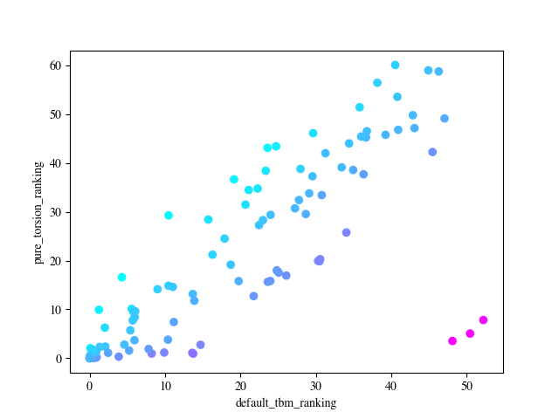
Comparison to default scoring: Torsion-only
Torsion-only scores ~orthogonal to default
Upweights mostly wrong models with a kernel of truth
Downweights models with correct fold but poor control of torsions
Pure torsion vs default (all TBM-easy/hard)
368
222
344
55
43
309
Σ(Z_{torsion}>0)
322
145
261
Σ(Z_{TBM}>0)
Notes:
Points are coloured by how far each model shifts in the rankings
Red numbers: top 5 MR groups.
368, 043, 344, 055, 309

Slide 23
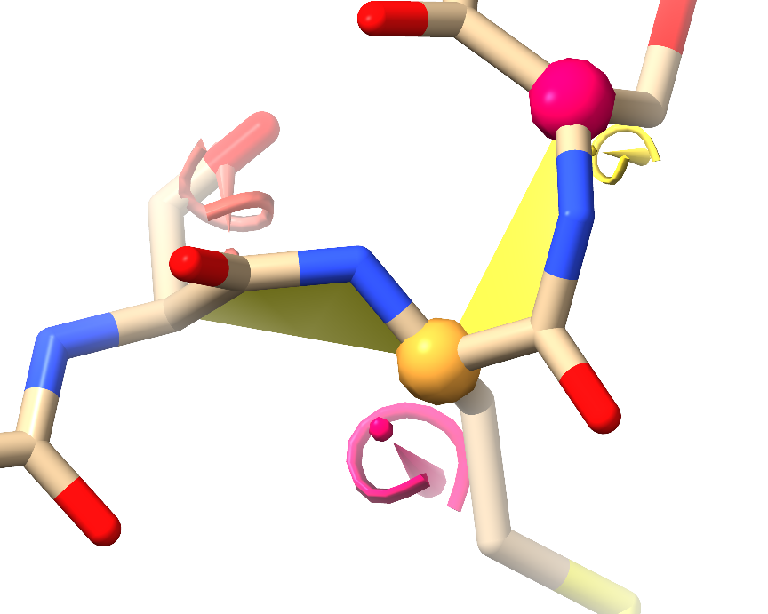
Interlude: model geometry mark-up
Marginal rotamers
(0.0005 < P < 0.02)
Ramachandran (backbone geometry) outlier (P < 0.0005)
Ramachandran marginal
(0.0005 < P < 0.02)
Twisted peptide (>30° out of plane – effectively impossible)
Sidechain rotamer outlier
(P < 0.0005)

Slide 24
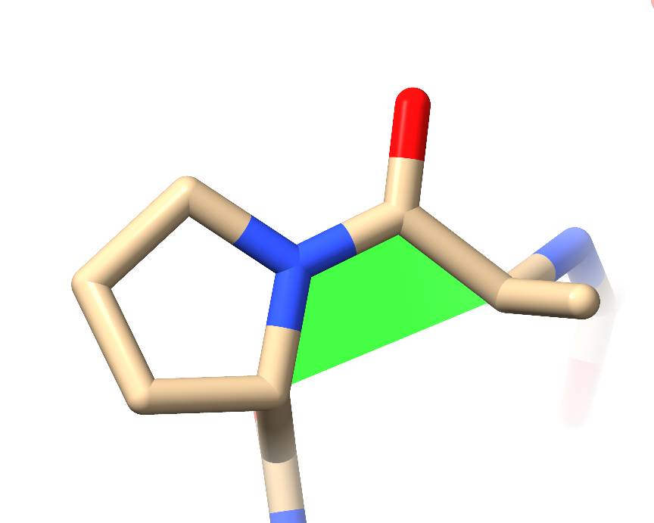
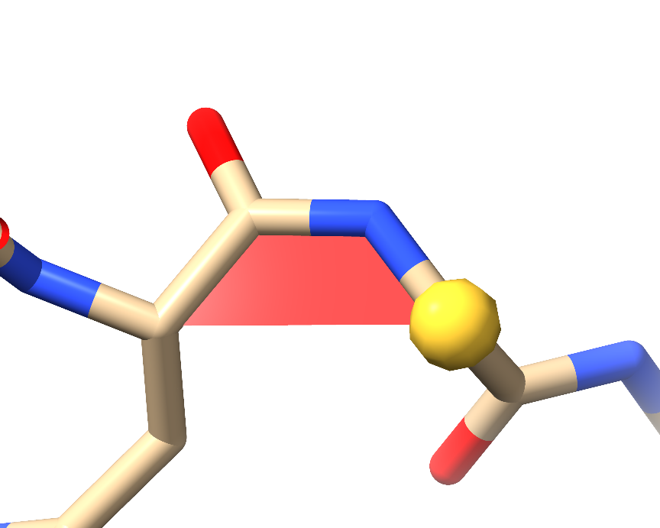
Interlude: model geometry mark-up
cis non-proline
(P ≈ 0.0003)
cis proline (P ≈ 0.05)

Slide 25
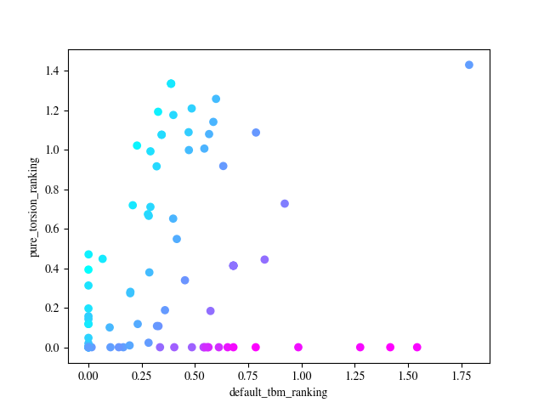
Example: T0981-D5 (TBM-Hard)
Group 43
Torsion Z score
Group 322
Group 261
Standard TBM Z score

Slide 26
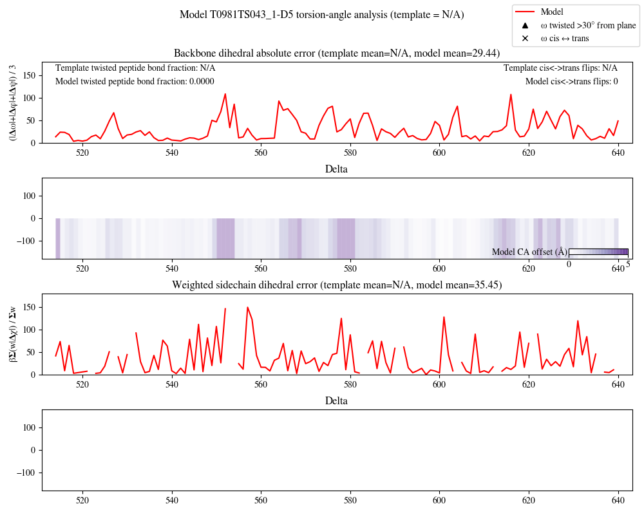
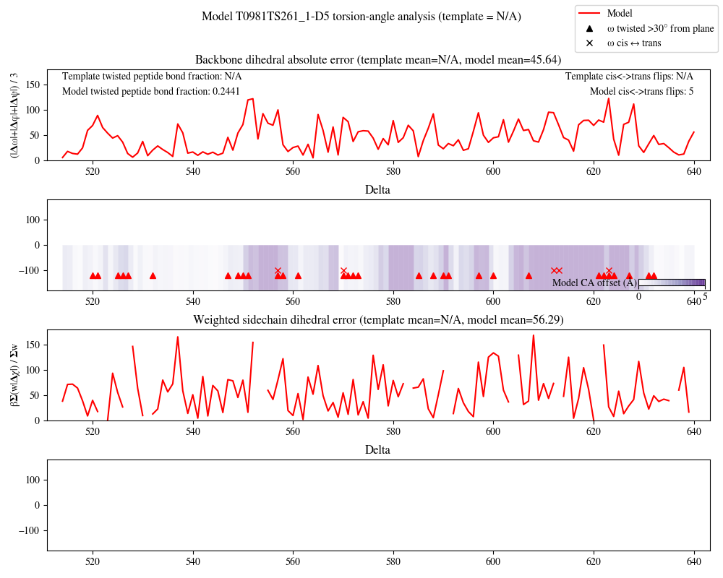
Example: T0981-D5 (TBM-Hard)

Slide 27
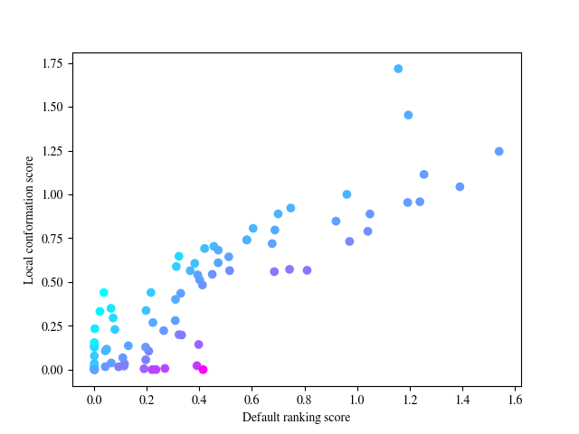
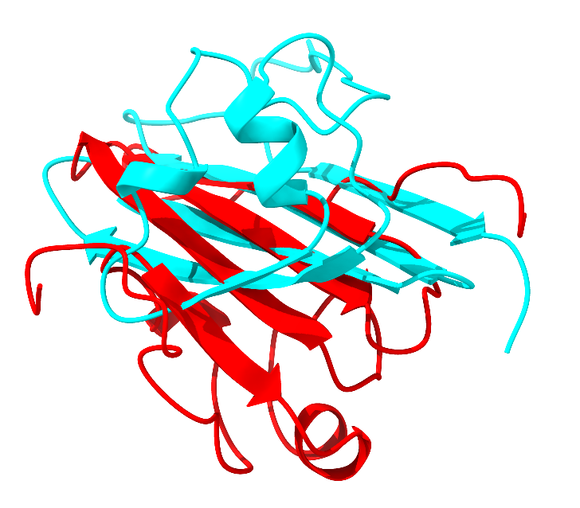
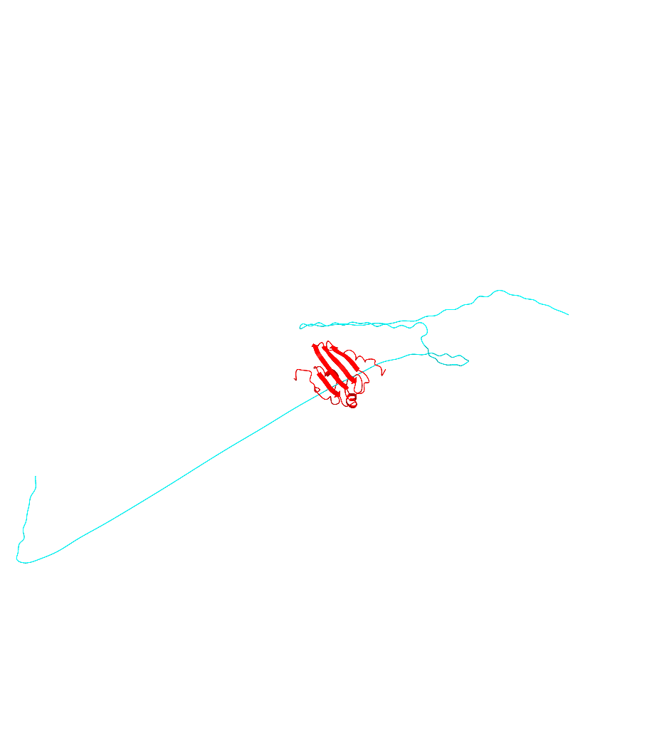
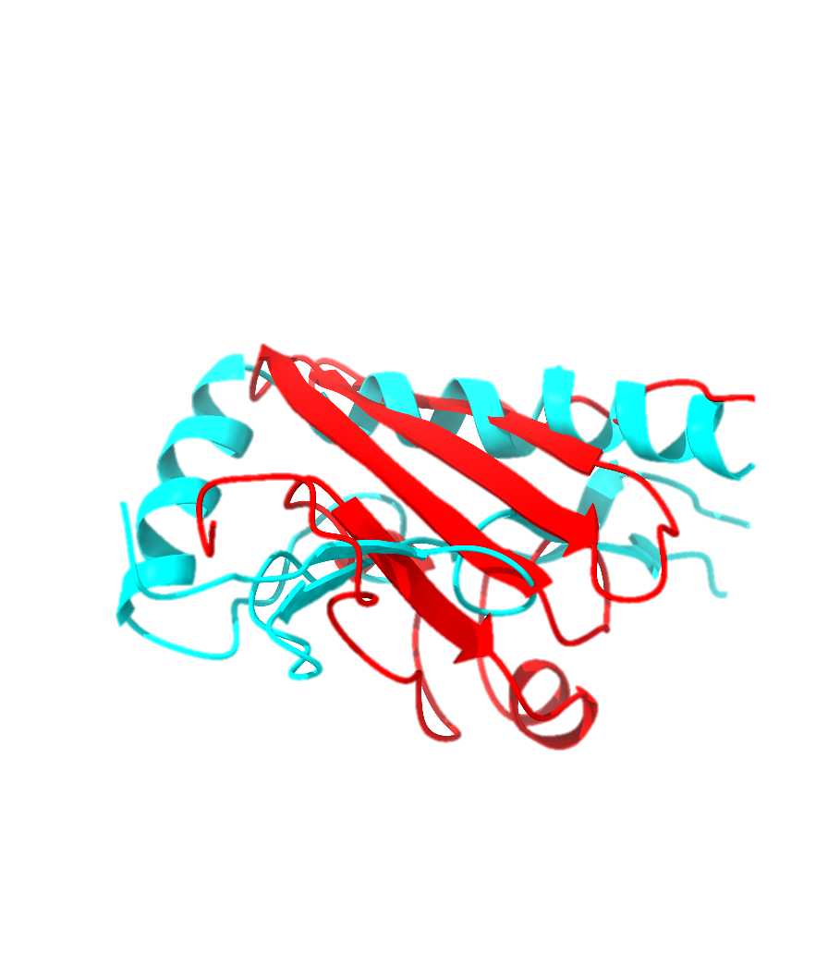
Comparison to default scoring: geometry-weighted
Wrong model with some truth
Just plain wrong models
Sheet and helices individually predicted correctly, but helices placed on wrong side of sheet

Slide 28
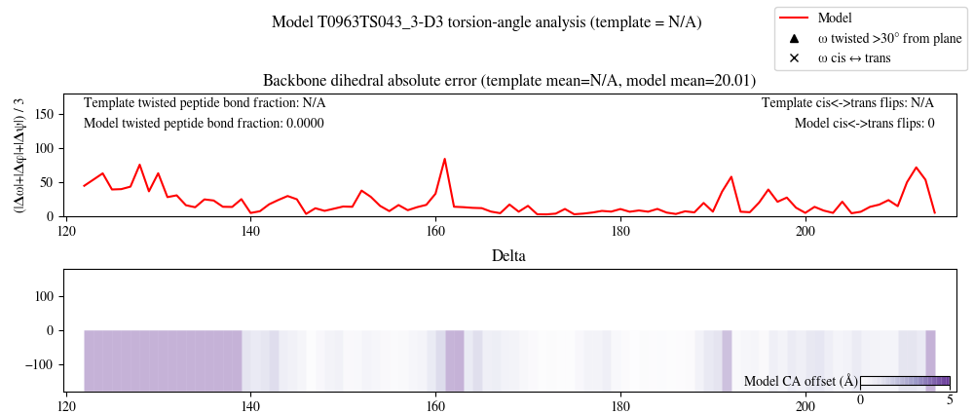
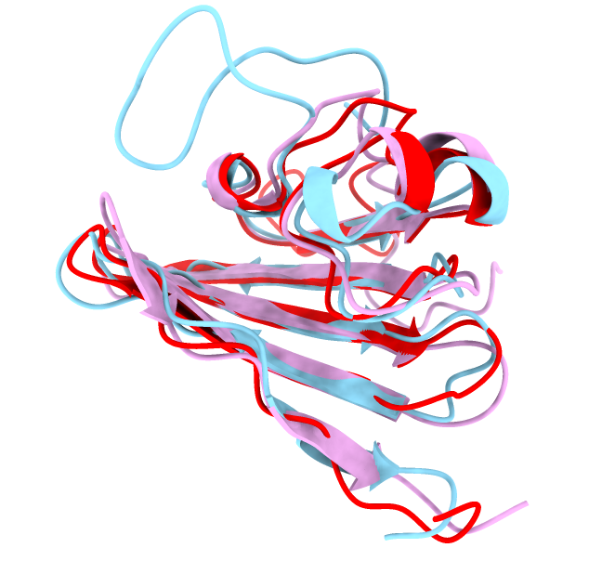
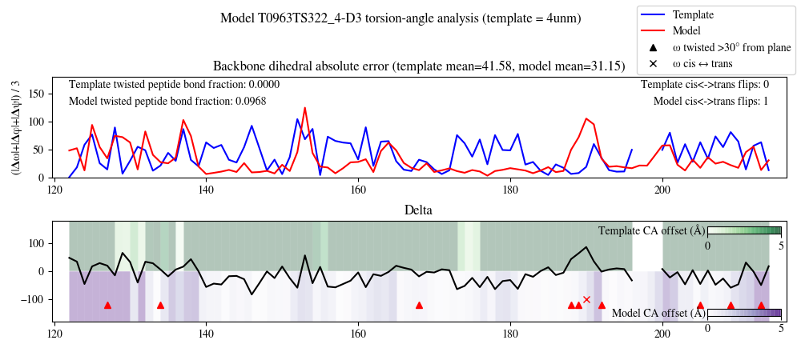
Comparison to default scoring: geometry-weighted
Group 43 (cyan)
Group 322 (purple)
Notes:
Group 43 penalised in default scoring due to incorrect presentation of ASE, and wrong turn on floppy tail. Significantly better on both backbone and sidechain torsions throughout (note substantial number of twisted peptide bonds in 322 model). Note that the template comparison for 322 is wrong (my script chose the wrong template to compare it against – I need to do some tweaking)

Slide 29
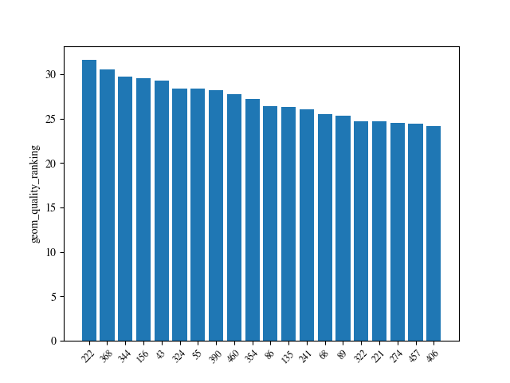
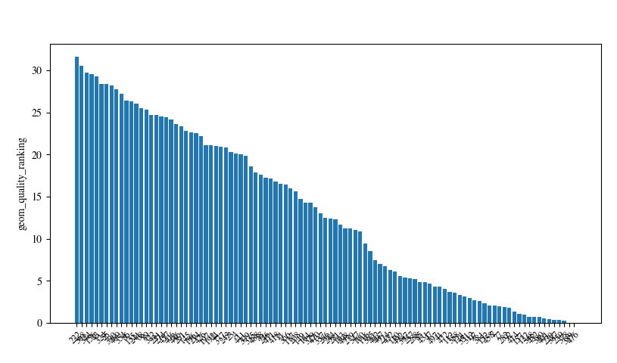
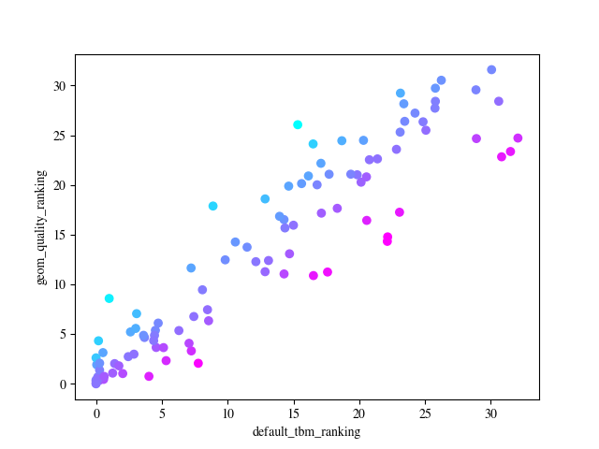
TBM-easy overall geometric quality rankings
Template-based modelling
Quality assessment
Fragment-based
Ab Initio
Server
Q
ST
Q
ST
F
ST
Q
Q
Q
Q
T
Q
?
Q
Q
T
ST
Q
Q
Q
368
222
322
261
Notes:
222: Seok-refine
368: Baker-RosettaServer
344: Kihara lab
156: Seok-server
43: A7D

Slide 30
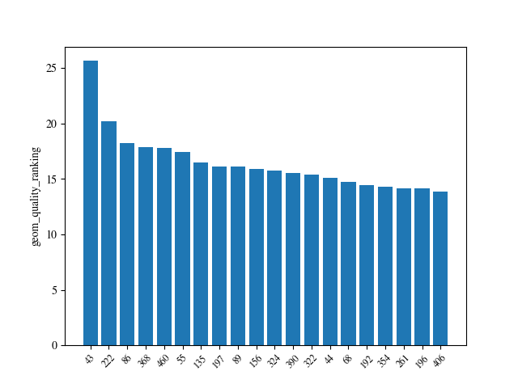
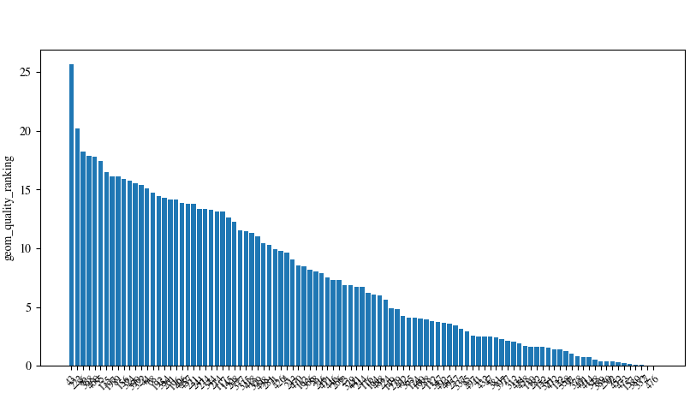
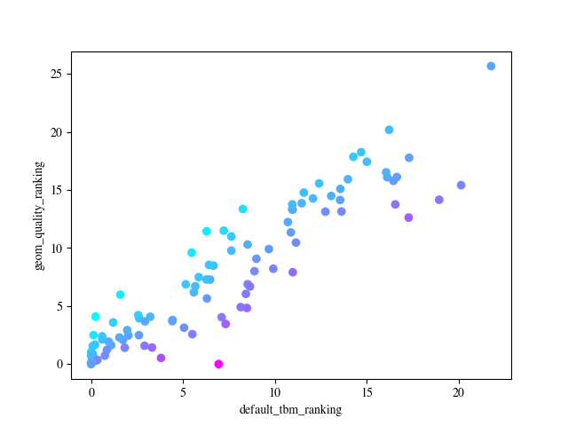
TBM-hard overall geometric quality rankings
F
Template-based modelling
Quality assessment
Fragment-based
Ab Initio
Server
Q
T
ST
Q
Q
Q
Q
Q
ST
ST
Q
T
Q
Q
Q
Q
ST
Q
Q
43
222
322
Notes:
43: A7D
222: Seok-Refine
86: Baker

Slide 31
A word on template selection
Templates selected based on sequence homology to target
… and seemingly not much else.
Little sign of selection for quality of template model
1,651 templates were used in this CASP round
Let’s take a closer look

Slide 32
A word on template selection
15 templates could not be retrieved from PDB
Most obsoleted - typically replaced by better models with new accession IDs
1m98, 1wb1, 2e79, 2mp7, 2w8a, 3t75, 3u5x, 3yw3, 4egb, 4ew8, 4rnb, 5ak1, 6bll, 6had, 6hac
36 lower than 4Å resolution (lowest 39Å!)
Of the rest…
Withdrawn from PDB entirely (with no replacement)
Doesn’t appear to exist (but listed by groups 135, 196, 309, 488)
Unreleased entries(?)

Slide 33
A word on template selection
Clashscore < 2: 11%

Slide 34
A word on template selection
Rotamer outliers < 1%: 27%

Slide 35
A word on template selection
2pff
Resolution: 4.0Å
Clashscore: 106
Rama outliers: 30.9%
Rota outliers: 16.1%
2uv8
Resolution: 3.1Å
Clashscore: 27
Rama outliers: 1.0%
Rota outliers: 11.2%
Would be here
(but wasn’t used)
Rama non-favoured < 2%: 24%

Slide 36
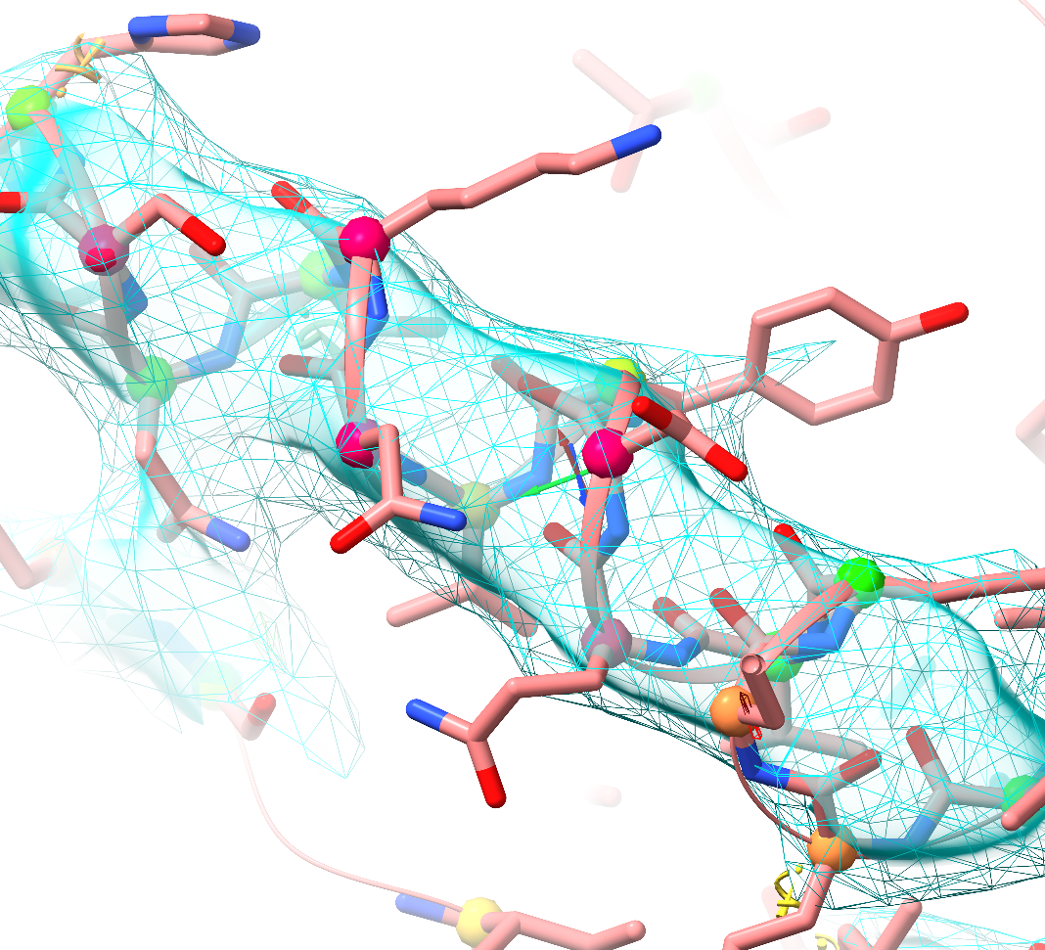
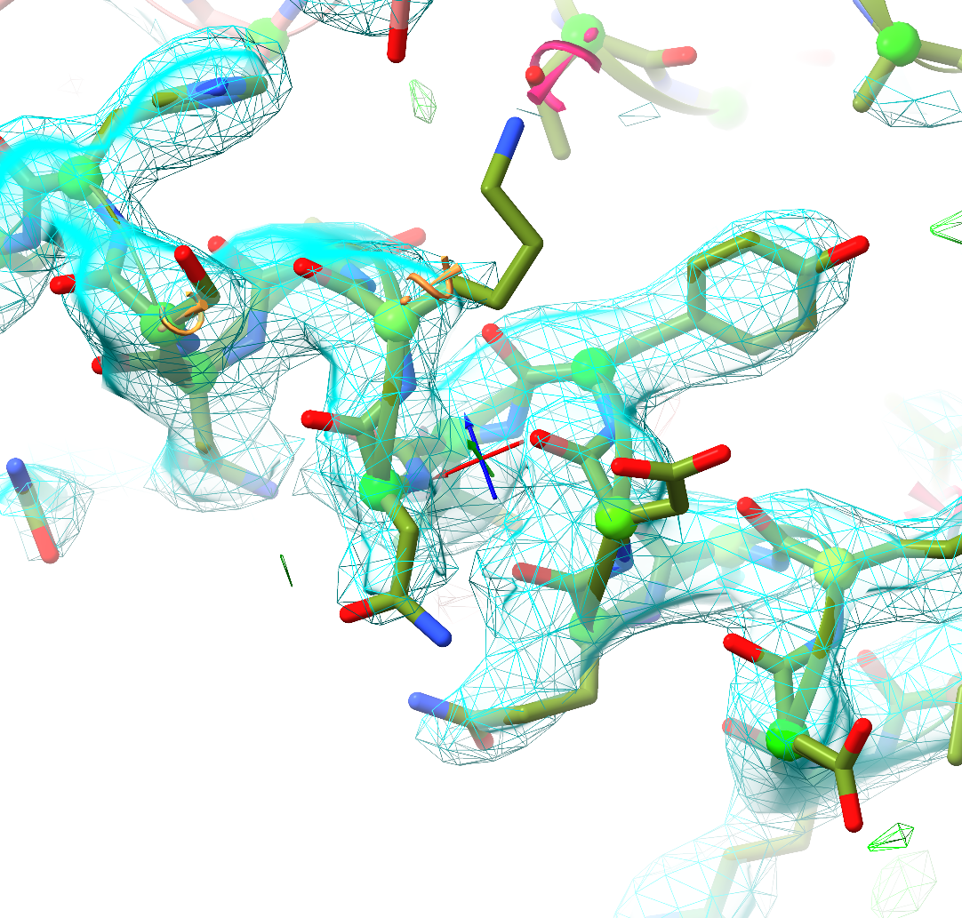
A word on template selection
Ile528
2pff_B
2uv8_G

Slide 37
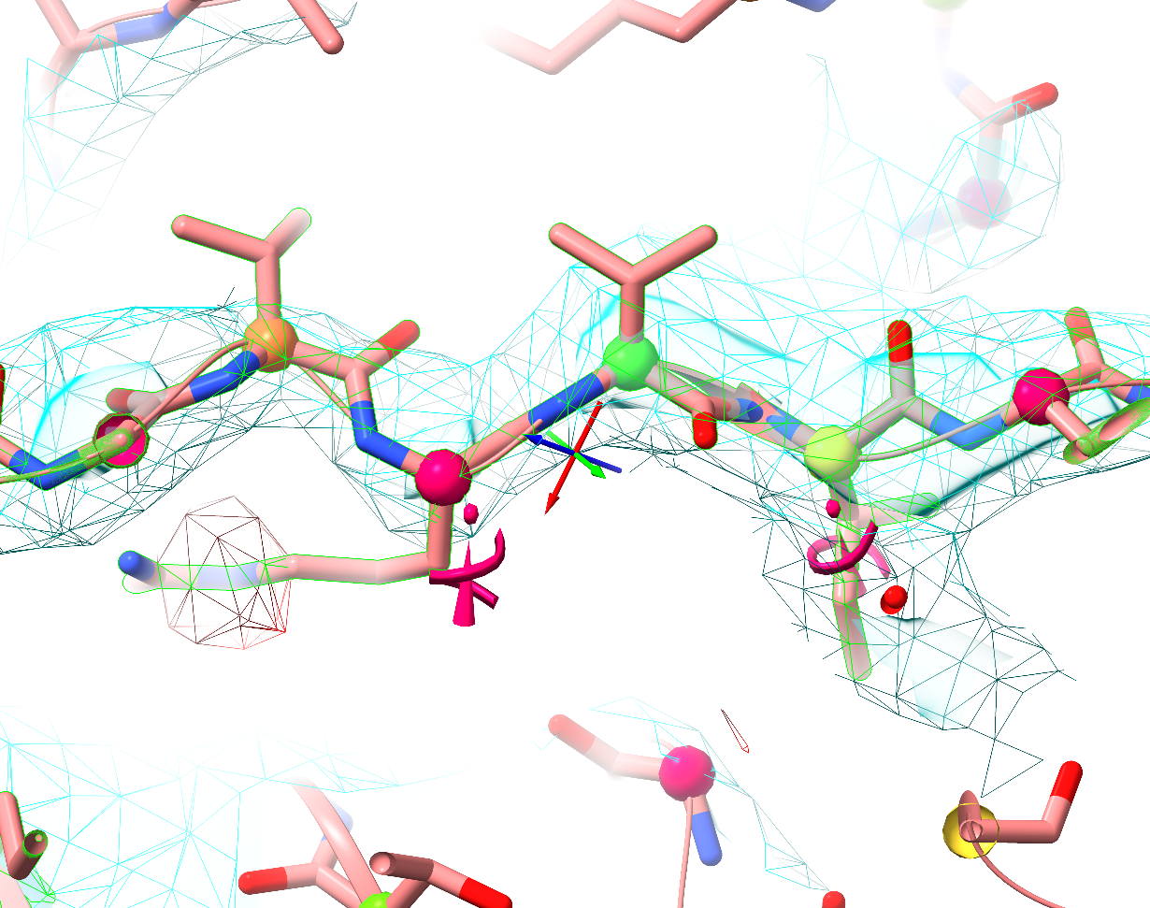
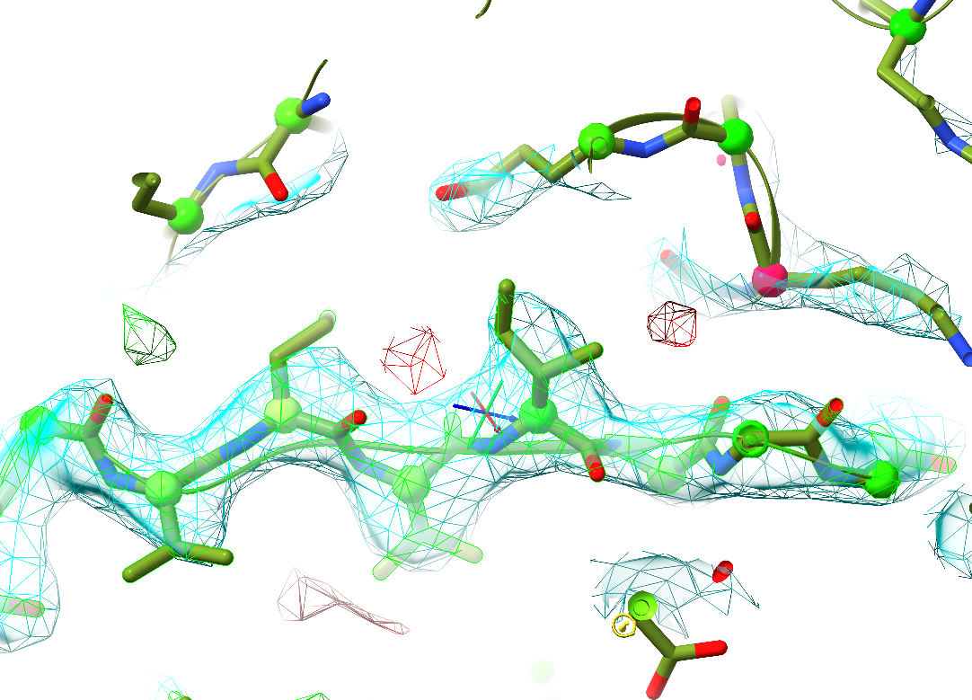
A word on template selection
Val525
Val527
Arg526
Ile528
Arg526
Ile528
Val527
Val525
2pff_B
2uv8_G

Slide 38


Acknowledgements
Randy Read: Phaser lab head
Andriy Kryshtafovych & Prediction Center!

